Slide 1

Chapter 7:
Project Cost Management
Information Technology Project Management, Eighth Edition
Note: See the text itself for full citations.

Slide 2
Which of the following is not a Organizational Process Asset?
Plans
Policies
Procedures
Knowledge bases
Government regulations

Slide 3
Which of the following is not an Enterprise Environmental Factor?
Organizational culture
Weather conditions
Government regulations
Political situation within the organization
All are EEFs

Slide 4
Which of the following is not a basic tool for duration estimating?
Expert judgement
Fishbone diagrams
Meetings
History database
Estimation software like COCOMO

Slide 5
Analogous estimating is most like ______ and requires that you have ____.
Bottom-up estimating, project estimation software to work from
Top-down estimating, previous similar projects to work from
Bottom-up estimating, previous similar projects to work from
Top-down estimating, project estimation software to work from

Slide 6
Which of the following is not one of the three purposes for estimation?
Far-out Strategic Planning (5 years out)
Budgetary (2 years out)
WAG
Definitive (immediately before execution and used within execution)

Slide 7
Scope _____ is often achieved by a customer inspection and then sign-off on key deliverables.
Acceptance
Validation
Completion
Close-out
Determination

Slide 8
What type of diagram shows planned and actual project schedule information?
A Gantt chart
A milestone chart
A tracking Gantt chart
A schedule chart
A network chart

Slide 9
Which of the following is false?
Avoid the temptation to set too many deadlines on tasks.
Avoid using too many specific date constraints on tasks.
Avoid creating predecessor/successor task relationships between summary tasks.
Avoid assigning resources to summary tasks.
Only one task in a project should be entered without a predecessor
Only one task in a project should be without a successor.
All of the above are true
All of the above are false

Slide 10
Which of the following statements regarding crashing is false?
Never crash noncritical tasks
Tasks to be crashed have a minimum duration below which they cannot be crashed regardless of how much resources are allocated to them
Crashing the critical path to the point where it is no longer critical is a common practice
Always pick a task to crash that is on the critical path
Choose critical tasks with the smallest crash cost per day first

Slide 11
As discussed in class, the cost to fix a defect _____ over time and becomes exorbitant once the defect ______
  decreases linearly, is found
  increases linearly, ‘walks out the door’
  increases exponentially, ‘walks out the door’
  decreases exponentially, is found

Slide 12
Learning Objectives
Understand the importance of project cost management
Explain basic project cost management principles, concepts, and terms
Describe the process of planning cost management
Discuss different types of cost estimates and methods for preparing them

Slide 13
Learning Objectives
Understand the processes of determining a budget and preparing a cost estimate for an information technology (IT) project
Understand the benefits of earned value management and project portfolio management to assist in cost control
Describe how project management software can assist in project cost management

Slide 14
The Importance of Project Cost Management
IT projects have a poor track record for meeting budget goals
The CHAOS studies found the average cost overrun (the additional percentage or dollar amount by which actual costs exceed estimates) ranged from 180 percent in 1994 to 43 percent in 2010
A 2011 Harvard Business Review study reported an average cost overrun of 27 percent. The most important finding was the discovery of a large number of gigantic overages or “black swans”

Slide 15
What Went Wrong?
The U.S. government, especially the IRS, continues to provide examples of how not to manage costs
  A series of project failures by the IRS in the 1990s cost taxpayers more than $50 billion a year
  In 2006, the IRS was in the news for a botched upgrade to its fraud-detection software, costing $318 million in fraudulent refunds that didn’t get caught
  A 2008 Government Accountability Office (GAO) report stated that more than 400 U.S. government agency IT projects, worth an estimated $25 billion, suffer from poor planning and underperformance
The United Kingdom’s National Health Service IT modernization program was called the greatest IT disaster in history with an estimated $26 billion overrun. It was finally scrapped in 2011.

Slide 16
U.S. Government--
FBI – Virtual Case File—shelved in March 2005 after delivering only 1/10th of its planned capability and costing $170 million.
  Contractor complained that the project went through 10 different government project managers and 36 major contract changes

Slide 17
Other major cost overruns
Boston Big Dig highway construction project—originally estimated at $2.6 billion cost, eventually totaled about $15 billion—an estimation error of more than 400%

Slide 18
What is Cost and Project Cost Management?
Cost is a resource sacrificed or foregone to achieve a specific objective or something given up in exchange
Costs are usually measured in monetary units like dollars
Project cost management includes the processes required to ensure that the project is completed within an approved budget

Slide 19
Project Cost Management Processes
Plan cost management :determining the policies, procedures, and documentation that will be used for planning, executing, and controlling project cost.
Estimate costs: developing an approximation or estimate of the costs of the resources needed to complete a project
Determine the budget: allocating the overall cost estimate to individual work items to establish a baseline for measuring performance
Control costs: controlling changes to the project budget

Slide 20
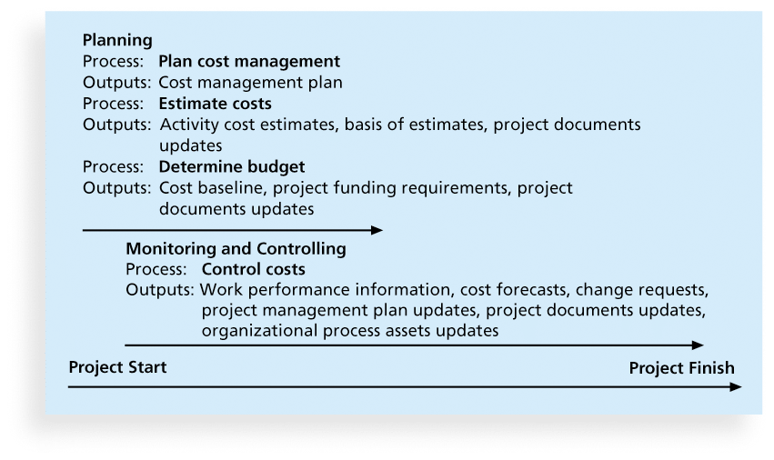
Figure 7-1. Project Cost Management Summary

Slide 21
Basic Principles of Cost Management
Most members of an executive board better understand and are more interested in financial terms than IT terms , so IT project managers must speak their language
  Profits are revenues minus expenditures
  Profit margin is the ratio of revenues to profits
  Life cycle costing considers the total cost of ownership, or development plus support costs, for a project
  Cash flow analysis determines the estimated annual costs and benefits for a project and the resulting annual cash flow

Slide 22
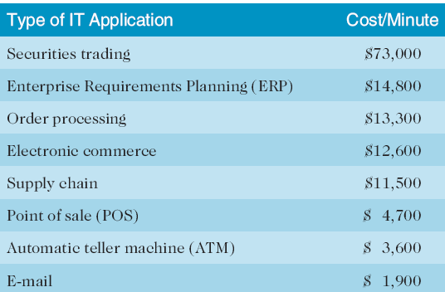
Table 7-1. Cost of Downtime for IT Applications
Source: The Standish Group International, “Trends in IT Value,” www.standishgroup.com (2008).

Slide 23
What Went Right?
Many organizations use IT to reduce operational costs
Technology has decreased the costs associated with processing an ATM transaction:
  In 1968, the average cost was $5.
  In 1978, the cost went down to $1.50
  In 1988, the cost was just a nickel.
  In 1998, it only cost a penny.
  In 2008, the cost was just half a penny!
Investing in green IT and other initiatives has helped both the environment and companies’ bottom lines. Michael Dell, CEO of Dell, reached his goal to make his company “carbon neutral” in 2008. As of March 2012, Dell had helped its customers save almost $7 billion in energy costs

Slide 24
Types of Costs and Benefits
Tangible costs or benefits are those costs or benefits that an organization can easily measure in dollars
Intangible costs or benefits are costs or benefits that are difficult to measure in monetary terms
Direct costs are costs that can be directly related to producing the products and services of the project
Indirect costs are costs that are not directly related to the products or services of the project, but are indirectly related to performing the project
Sunk cost is money that has been spent in the past; when deciding what projects to invest in or continue, you should not include sunk costs

Slide 25
More Basic Principles of Cost Management
Learning curve theory states that when many items are produced repetitively, the unit cost of those items decreases in a regular pattern as more units are produced
Reserves are dollars included in a cost estimate to mitigate cost risk by allowing for future situations that are difficult to predict
  Contingency reserves allow for future situations that may be partially planned for (sometimes called known unknowns) and are included in the project cost baseline
  Management reserves allow for future situations that are unpredictable (sometimes called unknown unknowns

Slide 26
Planning Cost Management
The project team uses expert judgment, analytical techniques, and meetings to develop the cost management plan
A cost management plan includes:
  Level of accuracy and units of measure
  Organizational procedure links
  Control thresholds
  Rules of performance measurement
  Reporting formats
  Process descriptions

Slide 27
Estimating Costs
Project managers must take cost estimates seriously if they want to complete projects within budget constraints
It’s important to know the types of cost estimates, how to prepare cost estimates, and typical problems associated with IT cost estimates

Slide 28
Cost Estimation Tools and Techniques
Basic tools and techniques for cost estimates:
  Analogous or top-down estimates: use the actual cost of a previous, similar project as the basis for estimating the cost of the current project
  Bottom-up estimates: involve estimating individual work items or activities and summing them to get a project total
  Parametric modeling uses project characteristics (parameters) in a mathematical model to estimate project costs

Slide 29
Sources of estimation error
Requirements are not sufficiently detailed
  Enlarge telephone field to accommodate direct long-distance dialing—requires 15 digits, but current phone fields are 9 characters long
    Will there be a phone number checker with that?
    Will it be the cheap or expensive version of the phone checker?
    Does the phone checker and address checker interact?
    What design tools will be used?
Unstable Requirements

Slide 30
Typical Problems with IT Cost Estimates
Estimates are done too quickly
  Off-the-cuff estimates
People lack estimating experience
Human beings are biased toward underestimation
Management desires accuracy
Unfounded optimism
Subjectivity and bias

Slide 31
Sample Cost Estimate
See pages 284-289 for a detailed example of creating a cost estimate for the Surveyor Pro project described in the opening case
Before creating an estimate, know what it will be used for, gather as much information as possible, and clarify the ground rules and assumptions for the estimate
If possible, estimate costs by major WBS categories
Create a cost model to make it easy to make changes to and document the estimate

Slide 32
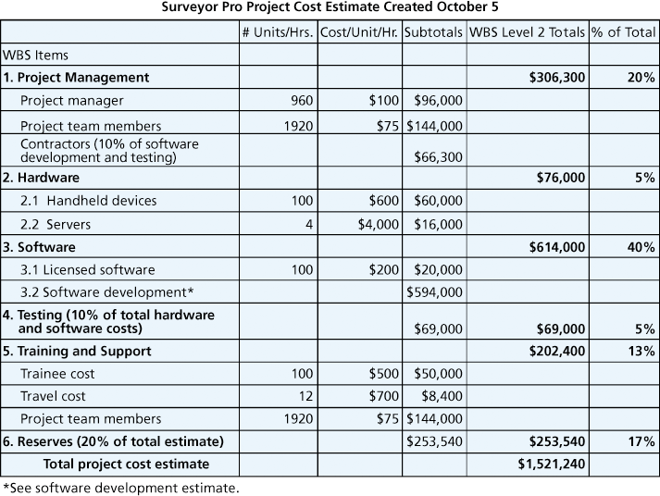
Figure 7-2. Surveyor Pro Project Cost Estimate

Slide 33
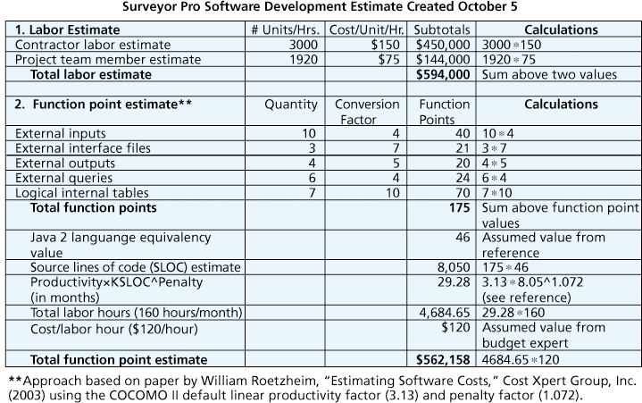
Figure 7-3. Surveyor Pro Software Development Estimate

Slide 34
Determining the Budget
Cost budgeting involves allocating the project cost estimate to individual work items over time
The WBS is a required input to the cost budgeting process since it defines the work items
Important goal is to produce a cost baseline
  a time-phased budget that project managers use to measure and monitor cost performance

Slide 35
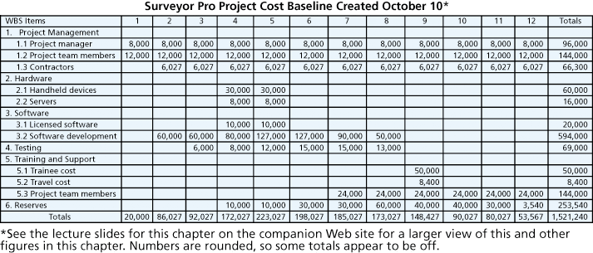
Figure 7-4. Surveyor Pro Project Cost Baseline

Slide 36
Controlling Costs
Project cost control includes
  Monitoring cost performance
  Ensuring that only appropriate project changes are included in a revised cost baseline
  Informing project stakeholders of authorized changes to the project that will affect costs
Many organizations around the globe have problems with cost control

Slide 37
Earned Value Management (EVM)—You will not be tested on this—we will cover this after the second exam
EVM is a project performance measurement technique that integrates scope, time, and cost data
Given a baseline (original plan plus approved changes), you can determine how well the project is meeting its goals
You must enter actual information periodically to use EVM
More and more organizations around the world are using EVM to help control project costs

Slide 38
Earned Value Management Terms—all of these blue background slides will not be covered on the second exam
The planned value (PV), formerly called the budgeted cost of work scheduled (BCWS), also called the budget, is that portion of the approved total cost estimate planned to be spent on an activity during a given period
Actual cost (AC), formerly called actual cost of work performed (ACWP), is the total of direct and indirect costs incurred in accomplishing work on an activity during a given period
The earned value (EV), formerly called the budgeted cost of work performed (BCWP), is an estimate of the value of the physical work actually completed
EV is based on the original planned costs for the project or activity and the rate at which the team is completing work on the project or activity to date

Slide 39
Rate of Performance
Rate of performance (RP) is the ratio of actual work completed to the percentage of work planned to have been completed at any given time during the life of the project or activity
Brenda Taylor, Senior Project Manager in South Africa, suggests this term and approach for estimating earned value
For example, suppose the server installation was halfway completed by the end of week 1. The rate of performance would be 50% because by the end of week 1, the planned schedule reflects that the task should be 100 percent complete and only 50 percent of that work has been completed

Slide 40
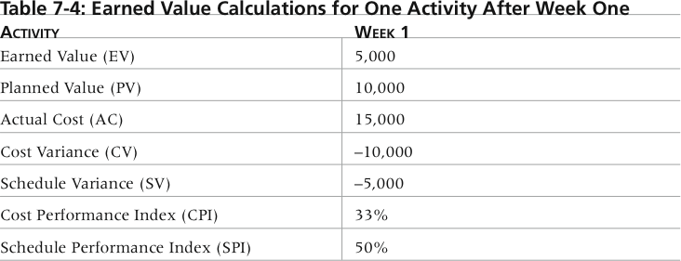
Table 7-4. Earned Value Calculations for One Activity After Week One

Slide 41
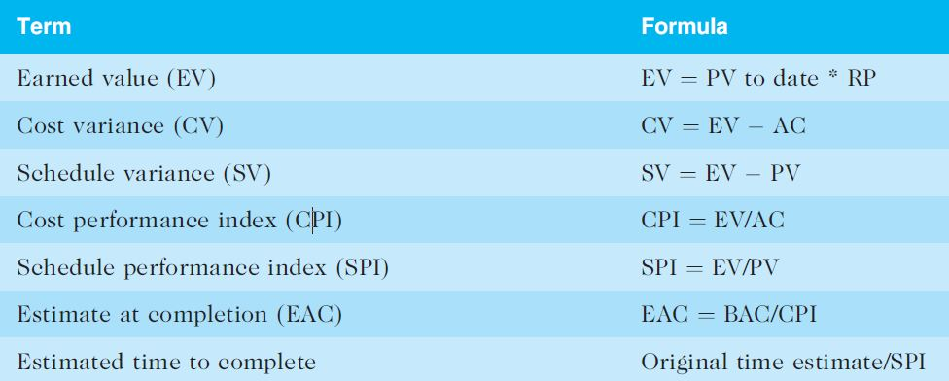
Table 7-5. Earned Value Formulas

Slide 42
Rules of Thumb for Earned Value Numbers
Negative numbers for cost and schedule variance indicate problems in those areas
CPI and SPI less than 100% indicate problems
Problems mean the project is costing more than planned (over budget) or taking longer than planned (behind schedule)
The CPI can be used to calculate the estimate at completion (EAC)—an estimate of what it will cost to complete the project based on performance to date. The budget at completion (BAC) is the original total budget for the project

Slide 43
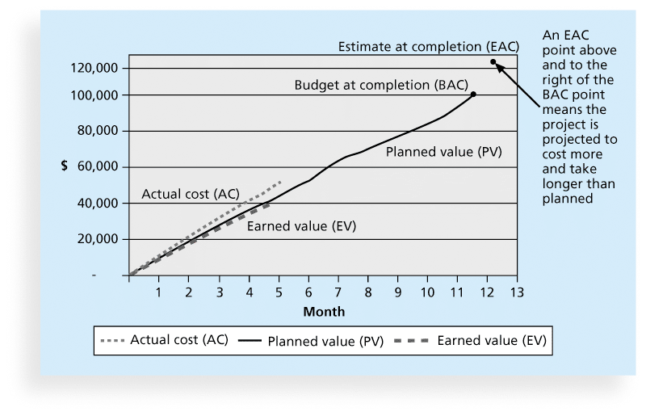
Figure 7-5. Earned Value Chart for Project after Five Months

Slide 44
Global Issues
EVM is used worldwide, and it is particularly popular in the Middle East, South Asia, Canada, and Europe
Most countries require EVM for large defense or government projects, as shown in Figure 7-6
EVM is also used in such private-industry sectors as IT, construction, energy, and manufacturing.
However, most private companies have not yet applied EVM to their projects because management does not require it, feeling it is too complex and not cost effective

Slide 45
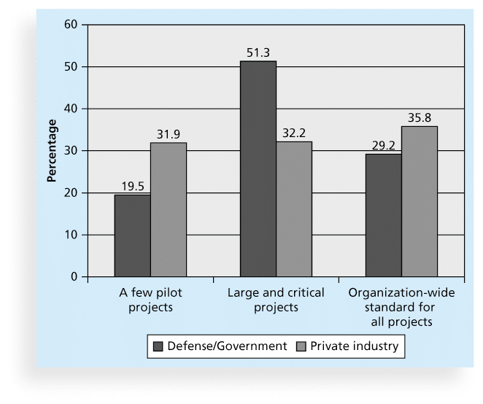
Figure 7-6. Earned Value Usage

Slide 46
Top-Down Approaches for Estimating Project Times and Costs
Consensus methods
Ratio methods
Apportion method
Function point methods for software and system projects
Learning curves
Project Estimate
Times
Costs

Slide 47
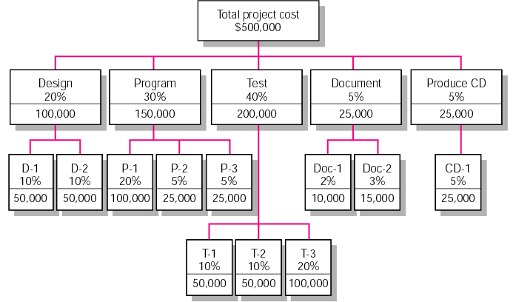
Apportion Method of Allocating Project Costs Using the Work Breakdown Structure
FIGURE 5.1

Slide 48
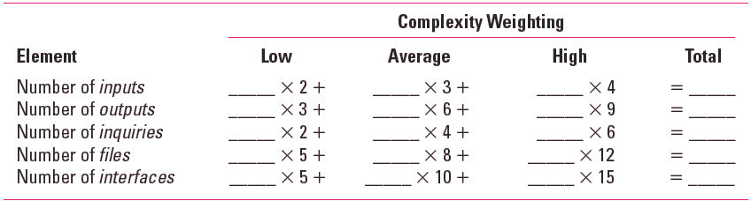
Simplified Basic Function Point Count Process for a Prospective Project or Deliverable
TABLE 5.2

Slide 49
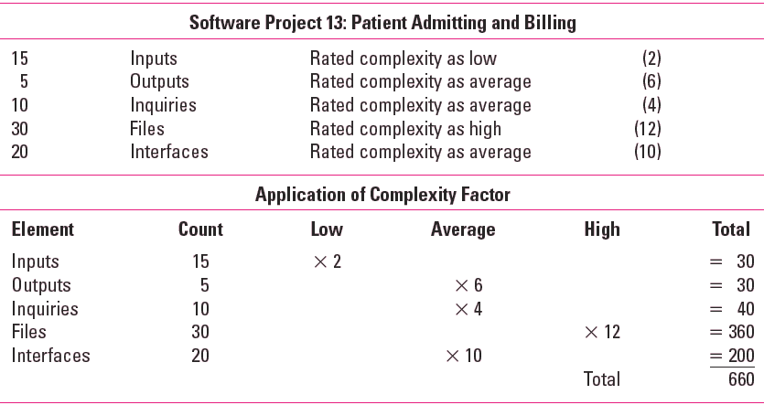
Example: Function Point Count Method
TABLE 5.3

Slide 50
Bottom-Up Approaches for Estimating Project Times and Costs
Template methods
Parametric procedures applied to specific tasks
Range estimates for
the WBS work packages
Phase estimating: A hybrid

Slide 51
Table 6-2. Types of Cost Estimates--Kerzner

Slide 52
Estimation in General—COST or TIME
History data base
Expert judgement
a Model like CoCoMo—Constructive Cost Model
  Developed by Barry Boehm

Slide 53
Project Portfolio Management
Many organizations collect and control an entire suite of projects or investments as one set of interrelated activities in a portfolio
Five levels for project portfolio management
  Put all your projects in one database
  Prioritize the projects in your database
  Divide your projects into two or three budgets based on type of investment
  Automate the repository
  Apply modern portfolio theory, including risk-return tools that map project risk on a curve

Slide 54
Benefits of Portfolio Management
Schlumberger saved $3 million in one year by organizing 120 information technology projects into a portfolio
ROI of implementing portfolio management software by IT departments:
  Savings of 6.5 percent of the average annual IT budget by the end of year one
  Improved annual average project timeliness by 45.2 percent
  Reduced IT management time spent on project status reporting by 43 percent and IT labor capitalization reporting by 55 percent
  Decreased the time to achieve financial sign-off for new IT projects by 20.4 percent, or 8.4 days

Slide 55
Best Practice
A global survey released by Borland Software in 2006 suggests that many organizations are still at a low-level of maturity in terms of how they define project goals, allocate resources, and measure overall success of their information technology portfolios. Some of the findings include the following:
  Only 22 percent of survey respondents reported that their organization either effectively or very effectively uses a project plan for managing projects
  Only 17 percent have either rigorous or very rigorous processes for project plans, which include developing a baseline and estimating schedule, cost, and business impact of projects
  Only 20 percent agreed their organizations monitor portfolio progress and coordinate across inter-dependent projects

Slide 56
Using Software to Assist in Cost Management
Spreadsheets are a common tool for resource planning, cost estimating, cost budgeting, and cost control
Many companies use more sophisticated and centralized financial applications software for cost information
Project management software has many cost-related features, especially enterprise PM software
Portfolio management software can help reduce costs

Slide 57
Chapter Summary
Project cost management is a traditionally weak area of IT projects, and project managers must work to improve their ability to deliver projects within approved budgets
Main processes include
  Plan cost management
  Estimate costs
  Determine the budget
  Control costs

Slide 59
Chapter 8:
Project Quality Management
Information Technology Project Management, Eighth Edition
Note: See the text itself for full citations.

Slide 60
Learning Objectives
Understand the importance of project quality management for information technology (IT) products and services
Define project quality management and understand how quality relates to various aspects of IT projects
Describe quality management planning and how quality and scope management are related
Discuss the importance of quality assurance
Explain the main outputs of the quality control process

Slide 61
Learning Objectives
Understand the tools and techniques for quality control, such as the Seven Basic Tools of Quality, statistical sampling, Six Sigma, and testing
Summarize the contributions of noteworthy quality experts to modern quality management
Describe how leadership, the cost of quality, organizational influences, expectations, cultural differences, and maturity models relate to improving quality in IT projects
Discuss how software can assist in project quality management

Slide 62
The Importance of Project Quality Management
Many people joke about the poor quality of IT products (see cars and computers joke on pages 312-313)
People seem to accept systems being down occasionally or needing to reboot their PCs
But quality is very important in many IT projects

Slide 63
What Went Wrong?
In 1986, two hospital patients died after receiving fatal doses of radiation from a Therac 25 machine after a software problem caused the machine to ignore calibration data
In one of the biggest software errors in banking history, Chemical Bank mistakenly deducted about $15 million from more than 100,000 customer accounts
In August 2008, the Privacy Rights Clearinghouse stated that more than 236 million data records of U.S. residents have been exposed due to security breaches since January 2005
In March 2012, Consumer Reports listed several recalls on its Web site in less than 10 days, including LED lights overheating, five different models of cars having problems

Slide 64
What Is Project Quality?
The International Organization for Standardization (ISO) defines quality as “the degree to which a set of inherent characteristics fulfils requirements” (ISO9000:2000)
Other experts define quality based on:
  Conformance to requirements: The project’s processes and products meet written specifications
  Fitness for use: A product can be used as it was intended

Slide 65
What Is Project Quality Management?
Project quality management ensures that the project will satisfy the needs for which it was undertaken
Processes include:
  Plan quality management: Identifying which quality standards are relevant to the project and how to satisfy them; a metric is a standard of measurement
  Perform quality assurance: Periodically evaluating overall project performance to ensure the project will satisfy the relevant quality standards
  Control quality: Monitoring specific project results to ensure that they comply with the relevant quality standards

Slide 66
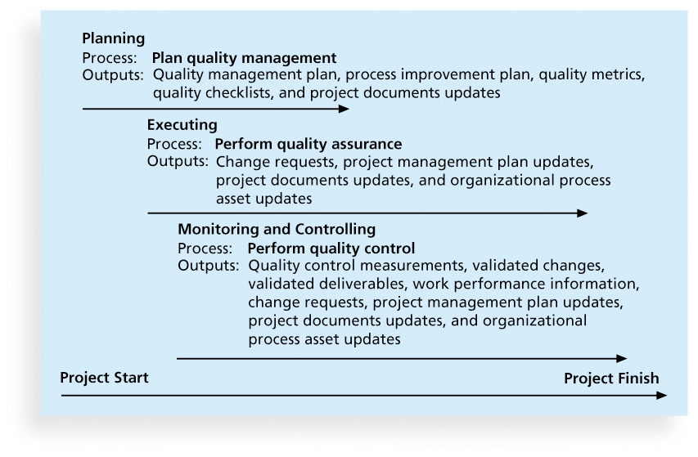
Figure 8-1. Project Quality Management Summary

Slide 67
Planning Quality
Implies the ability to anticipate situations and prepare actions to bring about the desired outcome
Important to prevent defects by:
  Selecting proper materials
  Training and indoctrinating people in quality
  Planning and using a process that ensures the appropriate outcome

Slide 68
The Costs of Quality
Costs of Good Quality
  Prevention Costs (technology, training, process design) – 3% of Annual Revenues
  Appraisal Costs (inspection, testing) – 2% to 3% of Annual Revenues
Costs of Bad Quality –
  Internal failures costs (scrap, rework)
  External failure costs (warranty claims, product returns, liability claims) – 25% to 35% of Annual Revenues
Strategy– increase spending on prevention from 3% to 5% so as to reduce External failures from 35 to 15%

Slide 69
Scope Aspects of IT Projects
Functionality is the degree to which a system performs its intended function
Features are the system’s special characteristics that appeal to users
System outputs are the screens and reports the system generates
Performance addresses how well a product or service performs the customer’s intended use
Reliability is the ability of a product or service to perform as expected under normal conditions
Maintainability addresses the ease of performing maintenance on a product

Slide 70
Who’s Responsible for the Quality of Projects?
Project managers are ultimately responsible for quality management on their projects
Several organizations and references can help project managers and their teams understand quality
  International Organization for Standardization (www.iso.org)
  IEEE (www.ieee.org)

Slide 71
Performing Quality Assurance
Quality assurance includes all the activities related to satisfying the relevant quality standards for a project
Another goal of quality assurance is continuous quality improvement
Benchmarking generates ideas for quality improvements by comparing specific project practices or product characteristics to those of other projects or products within or outside the performing organization
A quality audit is a structured review of specific quality management activities that help identify lessons learned that could improve performance on current or future projects

Slide 72
Controlling Quality
The main outputs of quality control are:
  Acceptance decisions
  Rework
  Process adjustments
There are Seven Basic Tools of Quality that help in performing quality control

Slide 73
Cause-and-Effect Diagrams
Cause-and-effect diagrams trace complaints about quality problems back to the responsible production operations
They help you find the root cause of a problem
Also known as fishbone or Ishikawa diagrams
Can also use the 5 whys technique where you repeated ask the question “Why” (five is a good rule of thumb) to peel away the layers of symptoms that can lead to the root cause

Slide 74
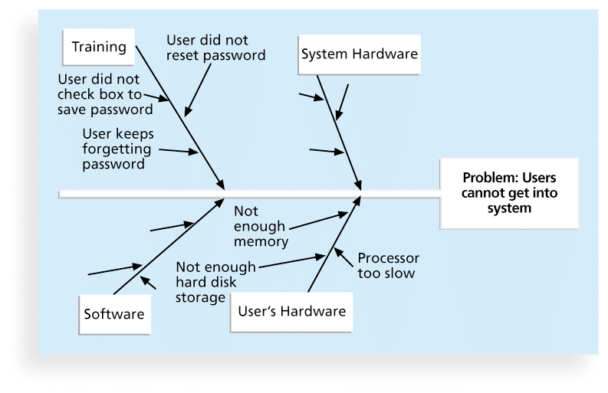
Figure 8-2. Sample Cause-and-Effect Diagram

Slide 75
Quality Control Charts
A control chart is a graphic display of data that illustrates the results of a process over time
The main use of control charts is to prevent defects, rather than to detect or reject them
Quality control charts allow you to determine whether a process is in control or out of control
  When a process is in control, any variations in the results of the process are created by random events; processes that are in control do not need to be adjusted
  When a process is out of control, variations in the results of the process are caused by non-random events; you need to identify the causes of those non-random events and adjust the process to correct or eliminate them

Slide 76
The Seven Run Rule
You can use quality control charts and the seven run rule to look for patterns in data
The seven run rule states that if seven data points in a row are all below the mean, above the mean, or are all increasing or decreasing, then the process needs to be examined for non-random problems

Slide 77
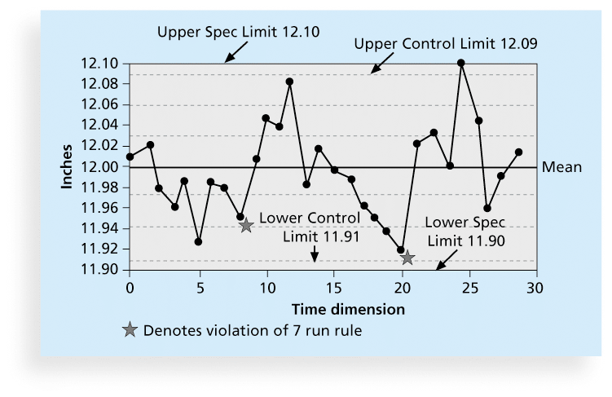
Figure 8-3. Sample Quality
Control Chart

Slide 78
Checksheet
A checksheet is used to collect and analyze data
It is sometimes called a tally sheet or checklist, depending on its format
In the example in Figure 8-4, most complaints arrive via text message, and there are more complaints on Monday and Tuesday than on other days of the week
This information might be useful in improving the process for handling complaints

Slide 79
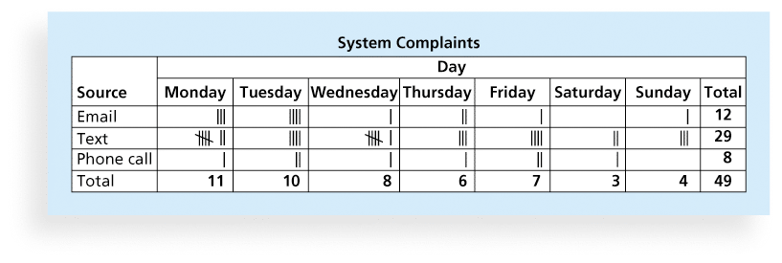
Figure 8-4. Sample Checksheet

Slide 80
Scatter diagram
A scatter diagram helps to show if there is a relationship between two variables
The closer data points are to a diagonal line, the more closely the two variables are related

Slide 81
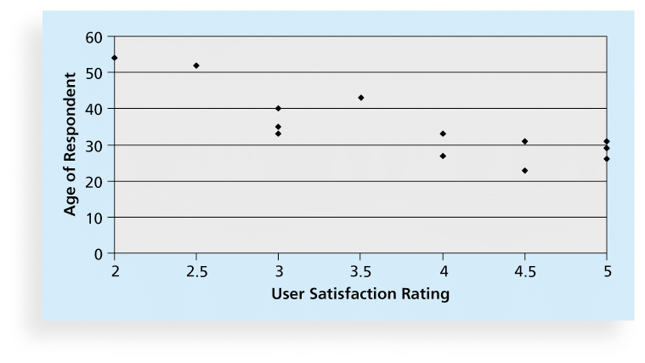
Figure 8-5. Sample Scatter Diagram

Slide 82
Histograms
A histogram is a bar graph of a distribution of variables
Each bar represents an attribute or characteristic of a problem or situation, and the height of the bar represents its frequency

Slide 83
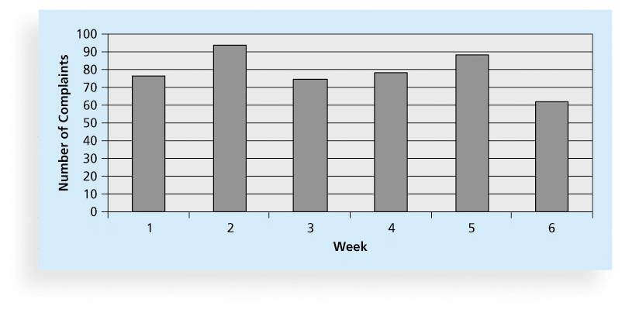
Figure 8-6. Sample Histogram

Slide 84
Pareto Charts
A Pareto chart is a histogram that can help you identify and prioritize problem areas
Pareto analysis is also called the 80-20 rule, meaning that 80 percent of problems are often due to 20 percent of the causes

Slide 85
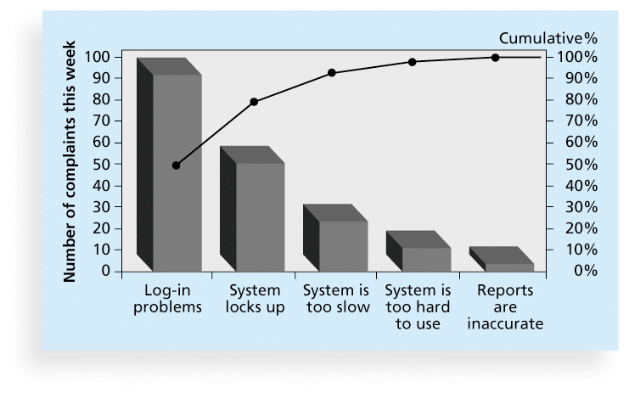
Figure 8-7. Sample Pareto Chart

Slide 86
Flowcharts
Flowcharts are graphic displays of the logic and flow of processes that help you analyze how problems occur and how processes can be improved
They show activities, decision points, and the order of how information is processed

Slide 87
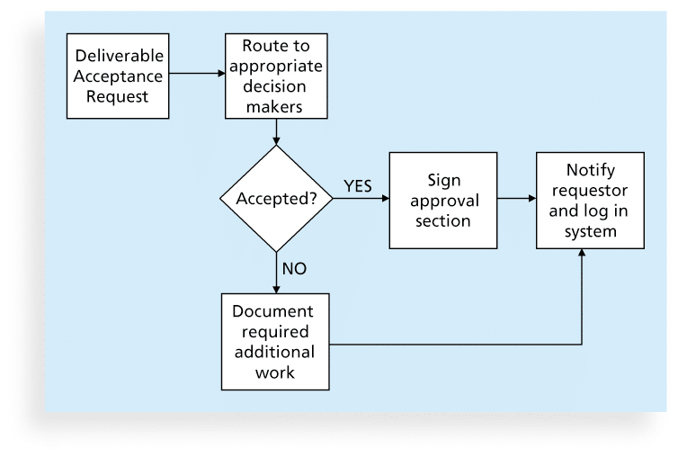
Figure 8-8. Sample Flowchart

Slide 88
Run Charts
In addition to flowcharts, run charts are also used for stratification, a technique that shows data from a variety of sources to see if a pattern emerges
A run chart displays the history and pattern of variation of a process over time.
You can use run charts to perform trend analysis and forecast future outcomes based on historical results

Slide 89
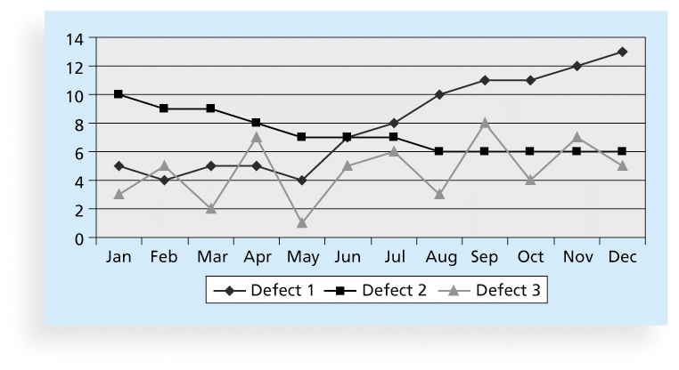
Figure 8-9. Sample Run Chart

Slide 90
Statistical Sampling
Statistical sampling involves choosing part of a population of interest for inspection
The size of a sample depends on how representative you want the sample to be
Sample size formula:
  Sample size = .25 X (certainty factor/acceptable error)²
Be sure to consult with an expert when using statistical analysis

Slide 91
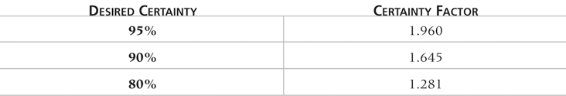
Table 8-1. Commonly Used Certainty Factors

Slide 92
Six Sigma
Six Sigma is “a comprehensive and flexible system for achieving, sustaining, and maximizing business success. Six Sigma is uniquely driven by close understanding of customer needs, disciplined use of facts, data, and statistical analysis, and diligent attention to managing, improving, and reinventing business processes”*
*Pande, Peter S., Robert P. Neuman, and Roland R. Cavanagh, The
Six Sigma Way, New York: McGraw-Hill, 2000, p. xi.

Slide 93
Basic Information on Six Sigma
The target for perfection is the achievement of no more than 3.4 defects per million opportunities
The principles can apply to a wide variety of processes
Six Sigma projects normally follow a five-phase improvement process called DMAIC

Slide 94
DMAIC
DMAIC is a systematic, closed-loop process for continued improvement that is scientific and fact based
DMAIC stands for:
  Define: Define the problem/opportunity, process, and customer requirements
  Measure: Define measures, then collect, compile, and display data
  Analyze: Scrutinize process details to find improvement opportunities
  Improve: Generate solutions and ideas for improving the problem
  Control: Track and verify the stability of the improvements and the predictability of the solution

Slide 95
How is Six Sigma Quality
Control Unique?
It requires an organization-wide commitment.
Training follows the “Belt” system
Six Sigma organizations have the ability and willingness to adopt contrary objectives, such as reducing errors and getting things done faster
It is an operating philosophy that is customer focused and strives to drive out waste, raise levels of quality, and improve financial performance at breakthrough levels

Slide 96
What Went Right?
Motorola, Inc. pioneered the adoption of Six Sigma in the 1980s and saved about $14 billion
Allied Signal/Honeywell saved more than $600 million a year by reducing the costs of reworking defects and improving aircraft engine design processes
After implementing the solutions recommended by a Six Sigma team for Baptist St. Anthony's Hospital in Amarillo, Texas, the percent of delayed cases in the radiology department dropped from 79 percent to 33 percent, delays decreased by 22 percent, and the number of orders missing or needing clarification dropped to zero from 11 percent

Slide 97
Six Sigma and Project Management
Joseph M. Juran stated, “All improvement takes place project by project, and in no other way”*
It’s important to select projects carefully and apply higher quality where it makes sense; companies that use Six Sigma do not always boost their stock values
Six Sigma projects must focus on a quality problem or gap between the current and desired performance and not have a clearly understood problem or a predetermined solution
*“What You Need to Know About Six Sigma,” Productivity Digest (December 2001), p. 38.
**Clifford, Lee, “Why You Can Safely Ignore Six Sigma,” Fortune (January 22, 2001), p. 140.

Slide 98
Six Sigma Projects Use
Project Management
The training for Six Sigma includes many project management concepts, tools, and techniques
For example, Six Sigma projects often use business cases, project charters, schedules, budgets, and so on
Six Sigma projects are done in teams; the project manager is often called the team leader, and the sponsor is called the champion

Slide 99
Six Sigma and Statistics
The term sigma means standard deviation
Standard deviation measures how much variation exists in a distribution of data
Standard deviation is a key factor in determining the acceptable number of defective units found in a population
Six Sigma projects strive for no more than 3.4 defects per million opportunities, yet this number is confusing to many statisticians

Slide 100
Six Sigma Uses a Conversion Table
Using a normal curve, if a process is at six sigma, there would be no more than two defective units per billion produced
Six Sigma uses a scoring system that accounts for time, an important factor in determining process variations
Yield represents the number of units handled correctly through the process steps
A defect is any instance where the product or service fails to meet customer requirements
There can be several opportunities to have a defect

Slide 101
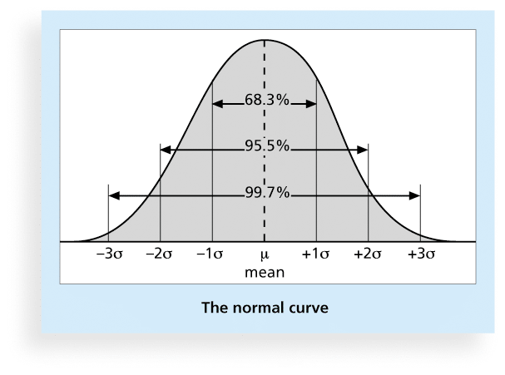
Figure 8-10. Normal Distribution and Standard Deviation

Slide 102
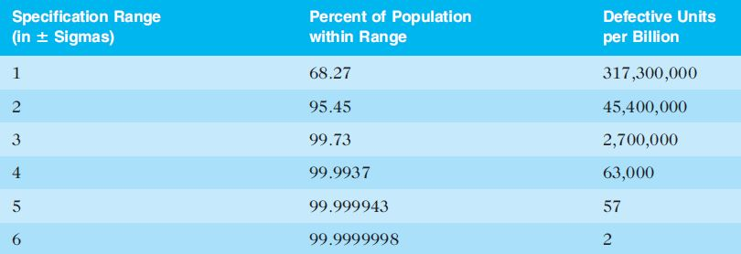
Table 8-2. Sigma and Defective Units

Slide 103
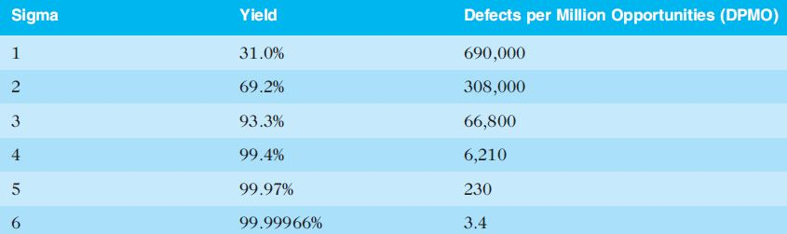
Table 8-3: Sigma Conversion Table

Slide 104
Six 9s of Quality
Six 9s of quality is a measure of quality control equal to 1 fault in 1 million opportunities
In the telecommunications industry, it means 99.9999 percent service availability or 30 seconds of down time a year
This level of quality has also been stated as the target goal for the number of errors in a communications circuit, system failures, or errors in lines of code

Slide 105
Testing
Many IT professionals think of testing as a stage that comes near the end of IT product development – Wrong!!
Testing should be done during almost every phase of the IT product development life cycle

Slide 106
Top-ten most expensive programming bugs/defects were all maintenance errors
The top-three involved changing only a single line of cost, costing their companies
  $1.6 billion
  $900 million
  $245 million
Each change was verbally assigned without any written instructions or plan for retesting

Slide 107
One type of Testing--Walkthroughs
A WALKTHROUGH after every level of design
  Architectural Design
    Walkthrough
  Database Design
    Walkthrough
  Medium-level Design
    Walkthrough
  Detailed Design
    Walkthrough
What is a Walkthrough???

Slide 108
What’s new in Testing?
TDD – Test-Driven Development
  To clarify requirements, have users/developers write the Acceptance Test Plan immediately after defining requirements (Requirements Document)
  Helps developers better understand what the user requires…
DB&T –Daily Build and Test Practice
  Promoted by Microsoft
  The Heartbeat of the development process

Slide 109
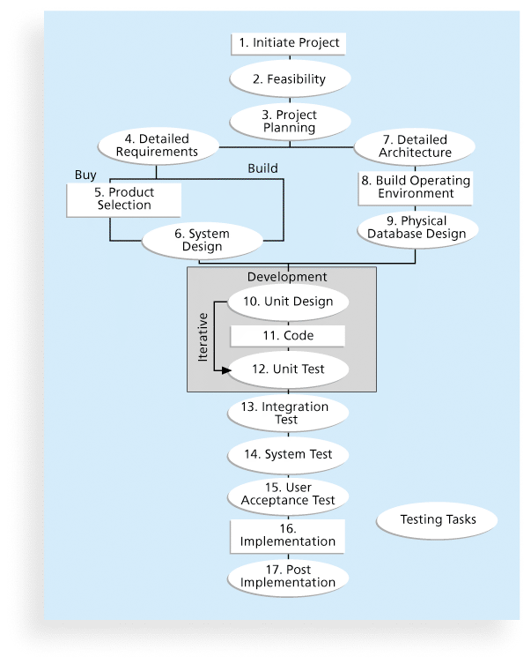
Figure 8-11. Testing Tasks in the Software Development Life Cycle

Slide 110
Types of Tests
Unit testing tests each individual component (often a program) to ensure it is as defect-free as possible
Integration testing occurs between unit and system testing to test functionally grouped components
System testing tests the entire system as one entity
Beta testing uses customers to test the product through normal usage
User acceptance testing is an independent test performed by end users prior to accepting the delivered system

Slide 111
Testing Alone Is Not Enough
Watts S. Humphrey, a renowned expert on software quality, defines a software defect as anything that must be changed before delivery of the program
Testing does not sufficiently prevent software defects because:
  The number of ways to test a complex system is huge
  Users will continue to invent new ways to use a system that its developers never considered
Humphrey suggests that people rethink the software development process to provide no potential defects when you enter system testing; developers must be responsible for providing error-free code at each stage of testing

Slide 112
This means….
Test ALL logic paths
Keep inheritance paths short and shallow
Think about what an easily testable software landscape or architecture would look like, given the language and reusable components you are deploying
Think about how you might use prevention rather than appraisal (testing) to produce defect free code

Slide 113
Modern Quality Management
Modern quality management:
  Requires customer satisfaction
  Prefers prevention to inspection
  Recognizes management responsibility for quality
Noteworthy quality experts include Deming, Juran, Crosby, Ishikawa, Taguchi, and Feigenbaum

Slide 114
Quality Experts
Deming was famous for his work in rebuilding Japan and his 14 Points for Management
Juran wrote the Quality Control Handbook and ten steps to quality improvement
Crosby wrote Quality is Free and suggested that organizations strive for zero defects
Ishikawa developed the concepts of quality circles and fishbone diagrams
Taguchi developed methods for optimizing the process of engineering experimentation
Feigenbaum developed the concept of total quality control

Slide 115
Malcolm Baldrige Award
The Malcolm Baldrige National Quality Award originated in 1987 to recognize companies that have achieved a level of world-class competition through quality management
Given by the President of the United States to U.S. businesses
Three awards each year in different categories:
  Manufacturing
  Service
  Small business
  Education and health care

Slide 116
ISO Standards
ISO 9000 is a quality system standard that:
  Is a three-part, continuous cycle of planning, controlling, and documenting quality in an organization
  Provides minimum requirements needed for an organization to meet its quality certification standards
  Helps organizations around the world reduce costs and improve customer satisfaction
See www.iso.org for more information

Slide 117
Global Issues
Many car manufacturers are proud to show and sell their electric cars (Audi, Cadillac, Chevrolet, etc.), but many people might wonder if these cars are safe
Fortunately, ISO has updated a standard on safety features in electric and hybrid cars to prevent electricity-related injuries
ISO 6469-3:2011, Electrically propelled road vehicles – protection of persons against electric shock, will help the global market for electric cars

Slide 118
Improving Information Technology Project Quality
Several suggestions for improving quality for IT projects include:
  Establish leadership that promotes quality
  Understand the cost of quality
  Focus on organizational influences and workplace factors that affect quality
  Follow maturity models

Slide 119
Leadership
As Joseph M. Juran said in 1945, “It is most important that top management be quality-minded. In the absence of sincere manifestation of interest at the top, little will happen below”*
A large percentage of quality problems are associated with management, not technical issues.
  *American Society for Quality (ASQ), (www.asqc.org/about/history/juran.html).

Slide 120
The Cost of Quality
The cost of quality is the cost of conformance plus the cost of nonconformance
  Conformance means delivering products that meet requirements and fitness for use
  Cost of nonconformance means taking responsibility for failures or not meeting quality expectations
A study reported that software bugs cost the U.S. economy $59.6 billion each year and that one third of the bugs could be eliminated by an improved testing infrastructure

Slide 121
Five Cost Categories Related to Quality
Prevention cost: Cost of planning and executing a project so it is error-free or within an acceptable error range
Appraisal cost: Cost of evaluating processes and their outputs to ensure quality
Internal failure cost: Cost incurred to correct an identified defect before the customer receives the product
External failure cost: Cost that relates to all errors not detected and corrected before delivery to the customer
Measurement and test equipment costs: Capital cost of equipment used to perform prevention and appraisal activities

Slide 122
Media Snapshot
A 2007 study by Nucleus Research Inc. estimated that spam management costs U.S. businesses more than $71 billion annually in lost productivity or $712 per employee
One e-mail security firm estimated that spam accounts for 95 percent of total e-mail volume worldwide
In 2008, Reuters reported that spyware and phishing cost consumers $7.1 billion in 2007, up from $2 billion the previous year
A 2011 report estimated that “10% of Americans have had their identities stolen, and on average, each of those individuals lost around $5,000. The cost to businesses worldwide adds up to a staggering $221 billion each year.”

Slide 123
Organizational Influences, Workplace Factors, and Quality
Study by DeMarco and Lister showed that organizational issues had a much greater influence on programmer productivity than the technical environment or programming languages
Programmer productivity varied by a factor of one to ten across organizations, but only by 21 percent within the same organization
Study found no correlation between productivity and programming language, years of experience, or salary.
A dedicated workspace and a quiet work environment were key factors to improving programmer productivity

Slide 124
Expectations and Cultural Differences in Quality
Project managers must understand and manage stakeholder expectations.
Expectations also vary by:
  Organization’s culture
  Geographic regions

Slide 125
Maturity Models
Maturity models are frameworks for helping organizations improve their processes and systems
  The Software Quality Function Deployment Model focuses on defining user requirements and planning software projects
  The Software Engineering Institute’s Capability Maturity Model Integration is a process improvement approach that provides organizations with the essential elements of effective processes

Slide 126
CMMI Levels
CMMI levels, from lowest to highest, are:
  Incomplete
  Performed
  Managed
  Defined
  Quantitatively Managed
  Optimizing
Companies may not get to bid on government projects unless they have a CMMI Level 3

Slide 127
PMI’s Maturity Model
PMI released the Organizational Project Management Maturity Model (OPM3) in December 2003
Model is based on market research surveys sent to more than 30,000 project management professionals and incorporates 180 best practices and more than 2,400 capabilities, outcomes, and key performance indicators
Addresses standards for excellence in project, program, and portfolio management best practices and explains the capabilities necessary to achieve those best practices

Slide 128
Best Practice
OPM3 provides the following example to illustrate a best practice, capability, outcome, and key performance indicator:
  Best practice: Establish internal project management communities
  Capability: Facilitate project management activities
  Outcome: Local initiatives, meaning the organization develops pockets of consensus around areas of special interest
  Key performance indicator: Community addresses local issues

Slide 129
Using Software to Assist in Project Quality Management
Spreadsheet and charting software helps create Pareto diagrams, fishbone diagrams, and so on
Statistical software packages help perform statistical analysis
Specialized software products help manage Six Sigma projects or create quality control charts
Project management software helps create Gantt charts and other tools to help plan and track work related to quality management

Slide 130
Chapter Summary
Project quality management ensures that the project will satisfy the needs for which it was undertaken
Main processes include:
  Plan quality
  Perform quality assurance
  Perform quality control

