Slide 1

Chapter 1:
Introduction to Project Management
Information Technology Project Management, Eighth Edition
Note: See the text itself for full citations.

Slide 2
TODAY:
The Pre-proposal—due Tuesday 1/31/2017
The General Project Lifecycle
The Software Development Lifecycle
  Predictive
  Adaptive
Some risk-considerations relative to projects
Schwalbe, Chapters 1 and 2

Slide 3
The Pre-proposal (Statement Of Work--SOW)
A way to allow everyone in the organization to submit project suggestions
  Strongly supported by project-driven organizational cultures
A short, crisp information piece for review by managers who decide what projects to fund

Slide 4
The Pre-proposal
States what is to be done
Why it should be done
What business value it will provide to the enterprise
Endeavors to secure senior management approval and the resources to develop a detailed plan

Slide 5
Pre-proposal should consist of:
  Discussion of problem or opportunity
  Purpose or goal of project
  Objectives
  Success criteria
  Assumptions/Risks/Obstacles
ALL ON A SINGLE PAGE
See Chapter 11 material

Slide 6
Some ideas for term projects…
The use of the cloud to re-vitalize ERP systems
  Leading to further data integration and more visibility at less cost
  Using the cloud for automated database backup
Mobile apps for marketing and sales professionals
  Providing them with important client information before the client interview/appointment
    Client’s interests, motivations – alignment with our mission/vision
    Client’s sales history?
Mobile apps for new product conceptualization and development
  Gathering requirements while ‘in the field’

Slide 7
Still more ideas for projects
Mobile apps for Decision Support
  Integrated with Skype, FaceBook , Twitter, Face Time, etc.
  Allowing for distributed voting and data collection
Mobile apps for Business Intelligence
Mobile apps for 3D printers

Slide 8
Learning Objectives
Understand the growing need for better project management, especially for information technology (IT) projects
Explain what a project is, provide examples of IT projects, list various attributes of projects, and describe the triple constraint of project management
Describe project management and discuss key elements of the project management framework, including project stakeholders, the project management knowledge areas, common tools and techniques, and project success
Notes:
Remember construction project have at least an 80% success probability….IT projects are 30%--up from 16% in the 1990’s

Slide 9
Learning Objectives
Discuss the relationship between project, program, and portfolio management and the contributions each makes to enterprise success
Understand the role of project managers by describing what they do, what skills they need, and career opportunities for IT project managers
Describe the project management profession, the role of professional organizations like the Project Management Institute (PMI), the importance of certification and ethics, and the advancement of project management software

Slide 10
Introduction
Many organizations today have a new or renewed interest in project management
Worldwide IT spending was $3.8 trillion in 2014, a 3.2 percent increase from 2013 spending
The Project Management Institute estimates demand for 15.7 million project management jobs from 2010 to 2020, with 6.2 million of those jobs in the United States
Notes:
How many of those 6.2 million jobs are filled now?? Maybe 3.1 million.

Slide 11
Project Management Statistics
In 2013 (the most recent year of PMI’s salary survey), the average salary in U.S. dollars for someone in the project management profession was $108,000 per year in the United States; $134,658 in Australia, (the highest-paid country); and $24,201 in Egypt (the lowest-paid country)
The top skills/competencies employers look for in new college graduates are all related to project management: team-work, decision-making, problem-solving, and verbal communications
Organizations waste $109 million for every $1 billion spent on projects, according to PMI’s Pulse of the Profession® report

Slide 12
Motivation for Studying Information Technology (IT) Project Management
IT Projects have a terrible track record, as described in the What Went Wrong?
A 1995 Standish Group study (CHAOS) found that only 16.2% of IT projects were successful in meeting scope, time, and cost goals; over 31% of IT projects were canceled before completion
A PricewaterhouseCoopers study found that overall half of all projects fail and only 2.5% of corporations consistently meet their targets for scope, time, and cost goals for all types of project.

Slide 13
Advantages of Using Formal
Project Management
Better control of financial, physical, and human resources
Improved customer relations
Shorter development times
Lower costs
Higher quality and increased reliability
Higher profit margins
Improved productivity
Better internal coordination
Higher worker morale

Slide 14
What Is a Project?
A project is “a temporary endeavor undertaken to create a unique product, service, or result” (PMBOK® Guide, Fifth Edition, 2013)
Operations is work done to sustain the business
Projects end when their objectives have been reached or the project has been terminated
Projects can be large or small and take a short or long time to complete

Slide 15
Examples of IT Projects
A team of students creates a smartphone application and sells it online
A company develops a driverless car
A government group develops a system to track child immunizations
A global bank acquires other financial institutions and needs to consolidate systems and procedures

Slide 16
Top Strategic Technologies for 2012 (Gartner)
Computing everywhere
  Mobile computing
The Internet of things
3D printing
Advanced, pervasive, and invisible analytics
Notes:
The needs of mobile users in diverse contexts and environments will continue to drive companies to develop new products and services.
4. the challenge is turning all that data into the right information to the right persons at the right time.

Slide 17
Media Snapshot: Unproductive Apps
Gartner predicted that by 2014, there would be more than 70 billion mobile application downloads every year, but it was almost double
Facebook is by far the most downloaded app, and the most popular category of all apps continues to be games
The challenge is to develop useful apps and get workers to focus on them instead of the many distracting options available

Slide 18
1.2b Project Attributes
A project
  has a unique purpose
  is temporary
  is developed using progressive elaboration (PMBOK)
  requires resources, often from various areas
  should have a primary customer or sponsor
    The project sponsor usually provides the direction and funding for the project
  involves uncertainty
Notes:
PROGRESSIVE ELABORATION—projects are often defined broadly and then as they begin and as time passes, the specific details of the project become clearer. Therefore, a project team should develop initial PLANS and then update them with more detail based on new information.

Slide 19
Project Hierarchy
VISION
MEASURABLE GOALS
DELIVERABLES WITH SPECIFIC DUE DATES
TASKS, ACTIVITIES
Notes:
Vision should be compelling, galvanizing and widely bought into. In 1963 Pres. Kennedy embarked this country on the goal of putting men on the moon by the end of the decade…..and we did it for a mere 10 billion $. That vision was compelling, galvanizing

Slide 20
Project and Program Managers
Project managers work with project sponsors, project team, and other people involved in a project to meet project goals
Program: group of related projects managed in a coordinated way to obtain benefits and control not available from managing them individually (PMBOK® Guide, Fifth Edition, 2013)
Program managers oversee programs; often act as bosses for project managers
Notes:
Draw diagrams showing relationships between portfolios, programs, projects and their managers.

Slide 21
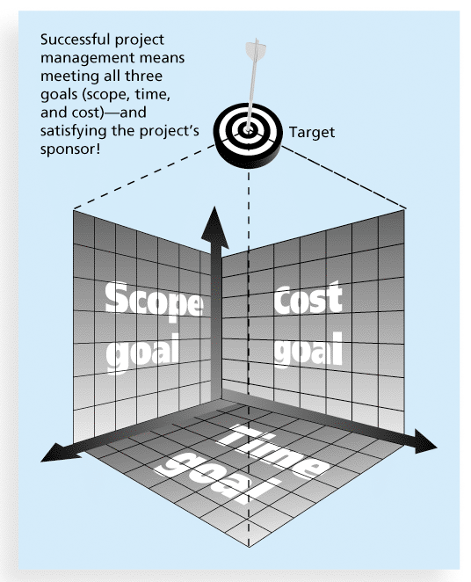
1.2c Figure 1-1 The Triple Constraint of Project Management
Notes:
Draw your simpler diagram between scope, cost and time. Explain what SCOPE is. SCOPE is defined by the requirements of the project deliverable. What are the requirements? The specific functionality and features you as a customer require of the project.

Slide 22
What is Project Management?
Project management is “the application of knowledge, skills, tools and techniques to project activities to meet project requirements” (PMBOK® Guide, Fourth Edition, 2013)
Project managers strive to meet the triple constraint (project scope, time, and cost goals) and also facilitate the entire process to meet the needs and expectations of project stakeholders

Slide 23
PM Knowledge Areas
Core Knowledge Areas
Facilitating Knowledge Areas
Project
Stakeholder Management

Slide 24
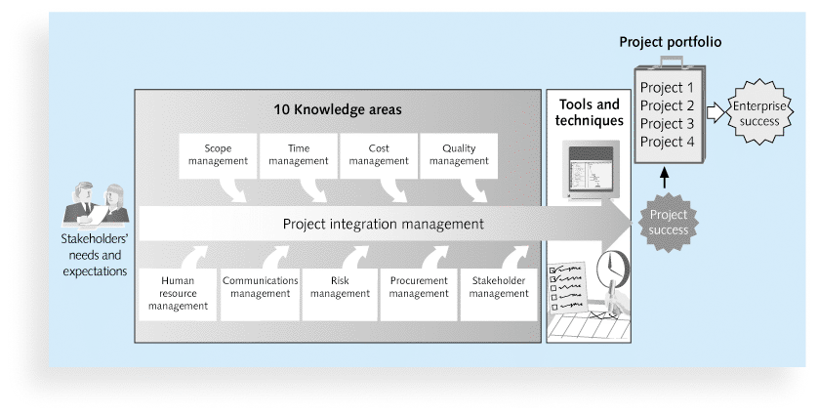
1.3 Figure 1-2 Project Management Framework (PMBOK)

Slide 25
1.3a Project Stakeholders
Stakeholders are the people involved in or affected by project activities
Stakeholders include
  the project sponsor
  the project manager
  the project team
  support staff
  customers
  users
  suppliers
  opponents to the project
Notes:
Project sponsor is in red because he is often the person funding the project.

Slide 26
1.3b Project Management Knowledge Areas
Knowledge areas describe the key competencies that project managers must develop
Project managers must have knowledge and skills in all 10 knowledge areas (project integration, scope, time, cost, quality, human resource, communications, risk, procurement, and stakeholder management)
This text includes an entire chapter on each knowledge area and is patterned after PMBOK in that regard.
Notes:
Write them out—integration knowledge management, core: scope, time, cost and quality
Facilitating: human resources, communications, risk, procurement, stakeholders

Slide 27
1.3c Project Management Tools and Techniques
Project management tools and techniques assist project managers and their teams in various aspects of project management
Some specific ones include
  Project charter, scope statement, and WBS (scope)
  Gantt charts, network diagrams, critical path analysis, critical chain scheduling (time)
  Cost estimates and earned value management (cost)
  Meetings, review boards, baselines
  See Table 1-1 for many more
Notes:
Its tools and techniques that separates us from cavemen. As the world becomes more complex, it becomes even more important for project managers to use complexity coping tools and techniques. Tools that help us understand causality and how it affects behavior are important. For example, there are some people who believe that global climate change is responsible for middle-eastern terrorism.

Slide 28
1.3c Super Tools
“Super tools” are those tools that have high use and high potential for improving project success, such as:
  Software for task scheduling (such as project management software)
  Scope statements
  Requirements analyses
  Lessons-learned reports
  History Database
Tools already extensively used that have been found to improve project importance include:
  Progress reports
  Kick-off meetings
  Gantt charts
  Change requests

Slide 29
What Went Right? Improved Project Performance
The Standish Group’s CHAOS studies show improvements in IT projects in the past decade:
  The number of successful IT projects has more than doubled, from 16 percent in 1994 to 39 percent in 2012
  The number of failed projects decreased from 31 percent in 1994 to 18 percent in 2012
  Success rates were much higher for small projects than large ones – 76 percent versus 10 percent

Slide 30
1.3d Project Success
There are several ways to define project success:
  The project met scope, time, and cost goals
  The project satisfied the customer/sponsor
  The results of the project met its main objective, such as making or saving a certain amount of money, providing a good return on investment, or simply making the sponsors happy

Slide 31
1.3 Table 1-2: What Helps Projects Succeed?*
1. Executive (top management) support/commitment
2. User involvement
3. Clear business objectives
4. Emotional maturity
5. Optimizing scope
6. Agile process
7. Project management expertise
8. Skilled resources
9. Execution
10. Tools and infrastructure
*The Standish Group, “CHAOS Manifesto 2013: Think Big,
Act Small” (2013).

Slide 32
1.3 Top Three Reasons Why Federal Technology Projects Succeed
Adequate funding
Staff expertise
Engagement from all stakeholders

Slide 33
1.3 What the Winners Do…
Recent research findings show that companies that excel in project delivery capability:
  Use an integrated project management toolbox (use standard/advanced PM tools, lots of templates)
  Grow project leaders, emphasizing business and soft skills
  Develop a streamlined project delivery process
  Measure project health using metrics, like customer satisfaction or return on investment
Notes:
Item 1: What is a template?? All of this relates to maturity.
In regard to item number 2, companies that excel in project management often grow or develop their project managers internally, providing them with career opportunities, training and mentoring. To do this requires a PMO—Project Management Office
Good project managers use the health measures of their superiors (project sponsor, or program manager or CIO regardless of whether these are implied or explicit. They take the time to understand what their superior’s measures of success and performance are…which may NOT be the stated measures.

Slide 34
1.4 Program and Project Portfolio Management
A program is “a group of related projects managed in a coordinated way to obtain benefits and control not available from managing them individually” (PMBOK® Guide, Fifth Edition, 2013)
A program manager provides leadership and direction for the project managers heading the projects within the program
Examples of common programs in the IT field include infrastructure, applications development, and user support
Notes:
Infrastructure = more wireless Internet access, upgrading hardware and software, enhancing computer security and developing and maintaining corporate standards
Applications development = updating an ERP system or a CRM system, purchasing a new component for the ERP system, etc.
User support = a better email system project, or a project to provide technical training for users
PROGRAM MANAGERS often have review meetings with the project managers to coordinate the varied projects. Program managers are often former project managers and they will mentor their project managers.

Slide 35
Project Portfolio Management
As part of project portfolio management, organizations group and manage projects and programs as a portfolio of investments that contribute to the entire enterprise’s success
Portfolio managers help their organizations make wise investment decisions by helping to select and analyze projects from a strategic perspective
Notes:
Portfolio managers must have good financial competencies, since most of their decisions are based on financial considerations, such as ROI or IRR. They make selection decisions about which projects will get funded, given funding limitations, based on anticipated ROI.

Slide 36
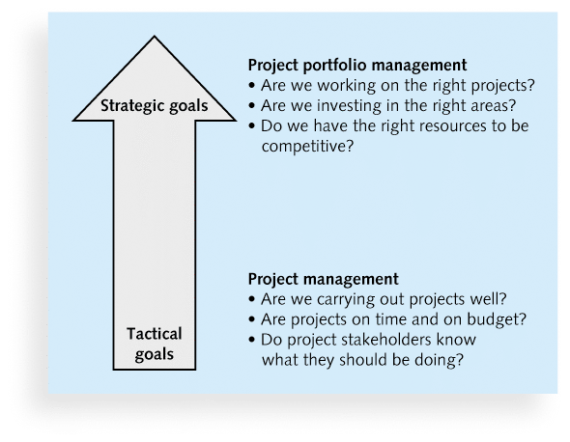
Figure 1-3. Project Management Compared to Project Portfolio Management

Slide 37
Best Practice
A best practice is “an optimal way recognized by industry to achieve a stated goal or objective”*
Robert Butrick suggests that organizations need to follow basic principles of project management, including these two mentioned earlier in this chapter:
  Make sure your projects are driven by your strategy. Be able to demonstrate how each project you undertake fits your business strategy, and screen out unwanted projects as soon as possible
  Engage your stakeholders. Ignoring stakeholders often leads to project failure. Be sure to engage stakeholders at all stages of a project, and encourage teamwork and commitment at all times
*Project Management Institute, Organizational Project Management Maturity Model
(OPM3) Knowledge Foundation (2003), p. 13.

Slide 38
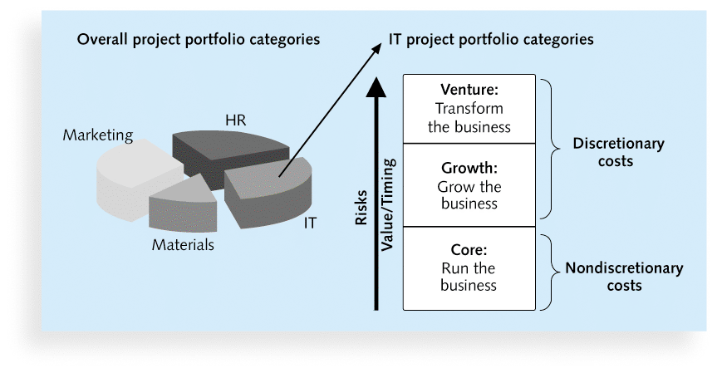
Figure 1-4. Sample Project Portfolio Approach

Slide 39
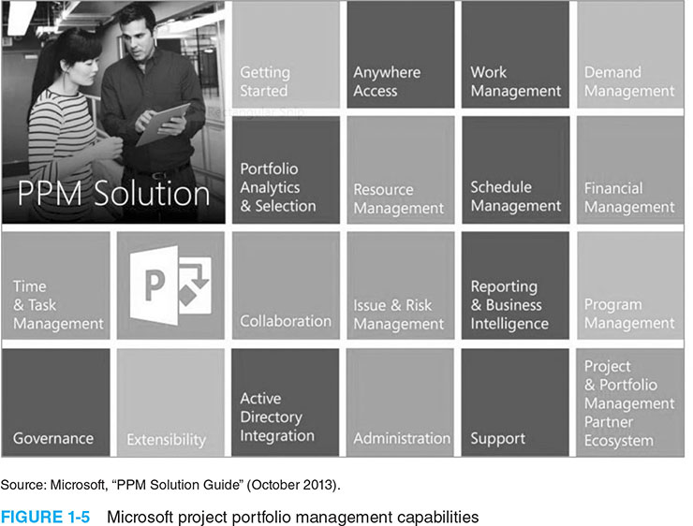
Figure 1-5. Microsoft project portfolio management capabilities

Slide 40
1.5 The Role of the Project Manager
Job descriptions vary, but most include responsibilities like planning, scheduling, coordinating, and working with people to achieve project goals (motivating, mentoring, coaching, collaborating, communicating, connecting—all with positive charisma)
Project managers are organized, passionate and goal-oriented. They build POSITIVE professional relationships with stakeholders.
Notes:
Must work closely with the other stakeholders on a project, especially the sponsor and the project team
Project managers are organized, passionate, and goal-oriented. They drive business results by leading projects and they are also change agents who work well under pressure and enjoy challenging work environments.

Slide 41
1.5b Suggested Skills for Project Managers
The Project Management Body of Knowledge, PMBOK
Application area knowledge, standards, and regulations
Project environment knowledge
General management knowledge, skills and acumen
Soft skills or human relations skills—how to motivate people

Slide 42
Table 1-3 Ten Most Important Skills and Competencies for Project Managers
1. People skills
2. Leadership
3. Listening
4. Integrity, ethical behavior, consistent
5. Strong at building trust
6. Verbal communication
7. Strong at building teams
8. Conflict resolution, conflict management
9. Critical thinking, problem solving
10. Understands, balances priorities

Slide 43
Different Skills Needed in Different Situations
Large projects: Leadership, relevant prior experience, planning, people skills, verbal communication, and team-building skills were most important
High uncertainty projects: Risk management, expectation management, leadership, people skills, and planning skills were most important
Very novel projects: Leadership, people skills, having vision and goals, self confidence, expectations management, and listening skills were most important

Slide 44
Importance of Leadership Skills
Effective project managers provide leadership by example
A leader focuses on long-term goals and big-picture objectives (a visionary) while inspiring people to reach those goals
A manager deals with the day-to-day details of meeting specific goals—a people-person and a paper-pusher
Project managers often take on the role of both leader and manager

Slide 45
Careers for IT Project Managers
In a 2014 survey, IT executives listed the “ten hottest skills” they planned to hire for in 2015
Project management was second only to programming and application development
Even if you choose to stay in a technical role, you still need project management knowledge and skills to help your team and organization

Slide 46
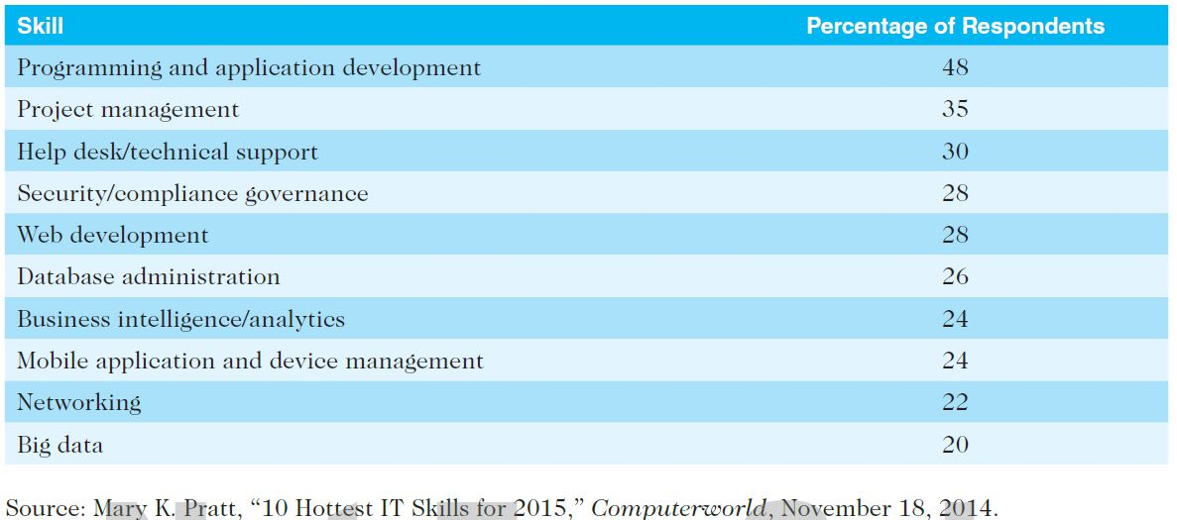
Table 1-4. Ten Hottest IT Skills

Slide 47
The Project Management Profession
The profession of project management is growing at a very rapid pace
It is helpful to understand the history of the field, the role of professional societies like the Project Management Institute, and the growth in project management software

Slide 48
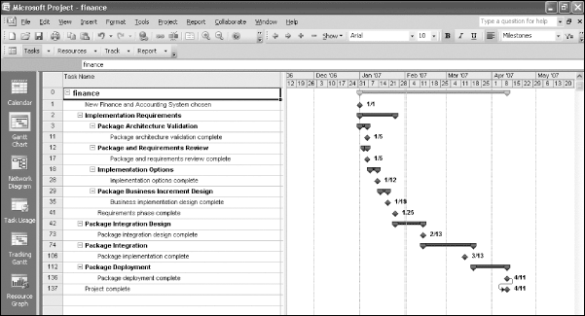
Figure 1-6. Sample Gantt Chart Created with Project 2013

Slide 49
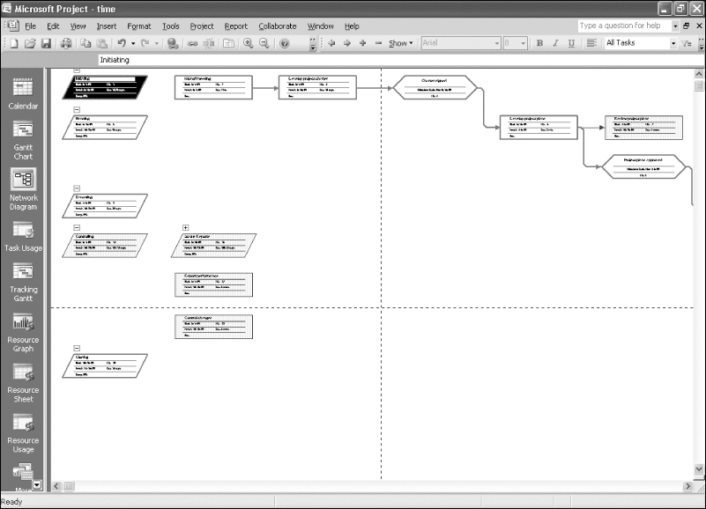
Figure 1-7. Sample Network Diagram Created with Project 2013

Slide 50
1.6a Project Management Offices
In the 100s, many companies began creating PMOs to help them handle the increasing number and complexity of projects
A Project Management Office (PMO) is an organizational group responsible for coordinating the project management function throughout an organization
  They train, mentor and reward project management expertise
  They use incubators and simulators to build strong PM competencies into their best people
Notes:
If your organization does not have a PMO, start one. The first thing any PMO should do is begin the collection of a history database.

Slide 51
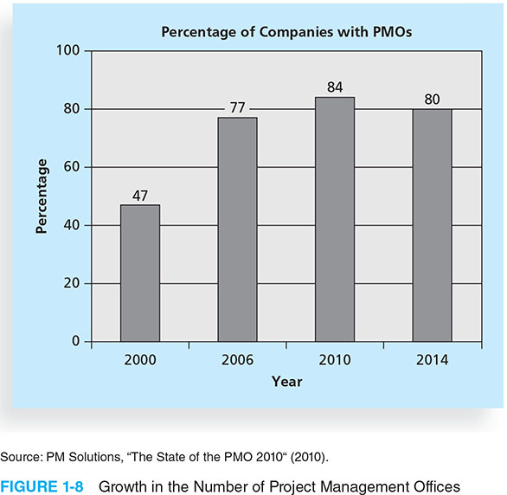
Figure 1-8. Growth in the Number of Project Management Offices

Slide 52
1.6a Global Issues
Several global dynamics are forcing organizations to rethink their practices:
  Talent development for project and program managers is a top concern
  Good project portfolio management is crucial in tight economic conditions
  Basic project management techniques are core competencies
  Organizations want to use more agile approaches to project management
  Benefits realization of projects is a key metric

Slide 53
1.6b The Project Management Institute
The Project Management Institute (PMI) is an international professional society for project managers founded in 1969
PMI has continued to attract and retain members, reporting more than 449,000 members worldwide by late 2014
There are communities of practices in many areas, like information systems, financial services, and health care
Project management research and certification programs continue to grow
Students can join PMI at a reduced fee and earn the Certified Associate in Project Management (CAPM) certification (see www.pmi.org for details)

Slide 54
1.6c Project Management Certification
PMI provides certification as a Project Management Professional (PMP)
A PMP has documented sufficient project experience, agreed to follow a code of ethics, and passed the PMP exam
The number of people earning PMP certification is increasing quickly

Slide 55
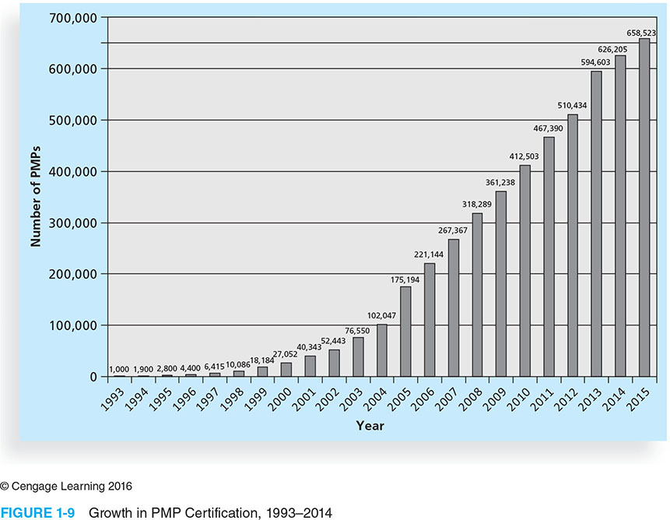
Figure 1-9 Growth in PMP Certification, 1993-2015

Slide 56
1.6d Ethics in Project Management
Ethics, loosely defined, is a set of principles that guide our decision making based on personal values of what is “right” and “wrong”
Project managers often face ethical dilemmas
In order to earn PMP certification, applicants must agree to PMI’s Code of Ethics and Professional Conduct
Several questions on the PMP exam are related to professional responsibility, including ethics

Slide 57
1.6e Project Management Software
There are hundreds of different products to assist in performing project management
Three main categories of tools:
  Low-end tools: Handle single or smaller projects well, cost under $200 per user
  Midrange tools: Handle multiple projects and users, cost $200-$1,000 per user, Project 2013 most popular
  High-end tools: Also called enterprise project management software, often licensed on a per-user basis
Several free or open-source tools are also available

Slide 58
Chapter Summary
A project is a temporary endeavor undertaken to create a unique product, service, or result
Project management is the application of knowledge, skills, tools, and techniques to project activities to meet project requirements
A program is a group of related projects managed in a coordinated way
Project portfolio management involves organizing and managing projects and programs as a portfolio of investments
Project managers play a key role in helping projects and organizations succeed
The project management profession continues to grow and mature

Slide 59
Chapter 2:
The Project Management and Information Technology Context
Information Technology Project Management, Eighth Edition
Note: See the text itself for full citations.

Slide 60
Learning Objectives
Describe the systems view of project management and how it applies to information technology (IT) projects
Understand organizations, including the four frames, organizational structures, and organizational culture
Explain why stakeholder management and top management commitment are critical for a project’s success

Slide 61
Learning Objectives
Understand the concept of a project phase (Stage) and the project life cycle
Discuss the unique attributes and diverse nature of IT projects
Describe recent trends affecting IT project management, including globalization, outsourcing, virtual teams, and agile project management

Slide 62
Projects Cannot Be Run
In Isolation
Projects must operate in a broad organizational environment
Project managers need to use systems thinking:
  taking a holistic view of carrying out projects within the context of the organization--all stakeholders, perspectives, frames, viewpoints
Senior managers must make sure projects continue to support current business needs

Slide 63
A Systems View of Project Management
A systems approach emerged in the 1950s to describe a more analytical approach to management and problem solving
Three parts include:
  Systems philosophy: an overall model for thinking about things as systems
  Systems analysis: problem-solving approach
  Systems management: address business, technological, and organizational issues before making changes to systems
Notes:
This is the view of holism---giving consideration to all---all stakeholders, all frames---the structural frame, the political frame, the human resources frame, the symbolic frame…all perspectives, all views, all frames….

Slide 64
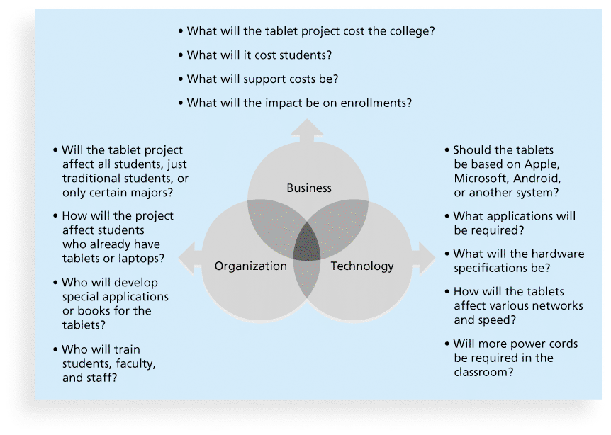
Figure 2-1. Three Sphere Model for Systems Management

Slide 65
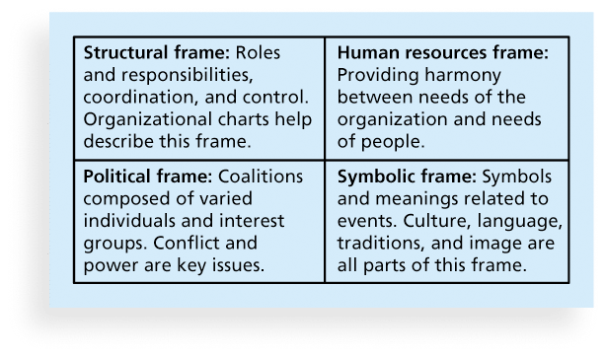
Figure 2-2. Perspectives on Organizations

Slide 66
What Went Wrong?
In a paper titled “A Study in Project Failure,” two researchers examined the success and failure of 214 IT projects over an eight-year period in several European countries.
The researchers found that only one in eight (12.5 percent) were considered successful in terms of meeting scope, time, and cost goals.
The authors said that the culture within many organizations is often to blame
Among other things, people often do not discuss important leadership, stakeholder, and risk management issues

Slide 67
Organizational Structures
3 basic organization structures
  Functional: functional managers report to the CEO
  Project: program managers report to the CEO
  Matrix: middle ground between functional and project structures; personnel often report to two or more bosses; structure can be weak, balanced, or strong matrix
Notes:
You need to ask your recruiter what organizational structure is prevalent at their firm? If it is a PROJECT ORGANIZATION, YOU NEED TO ASK WHAT HAPPENS TO MY JOB AFTER THE PROJECT IS COMPLETE? You definitely have less job security if the structure is a project one.

Slide 68
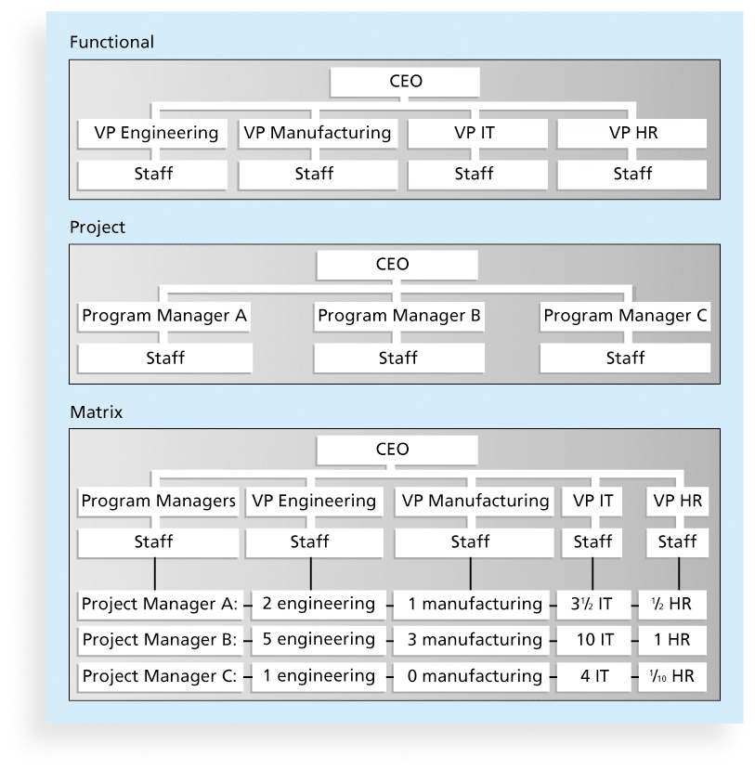
Figure 2-3. Functional, Project, and Matrix Organizational Structures
Notes:
Ask you recruiter what their organizational structure is….!!

Slide 69
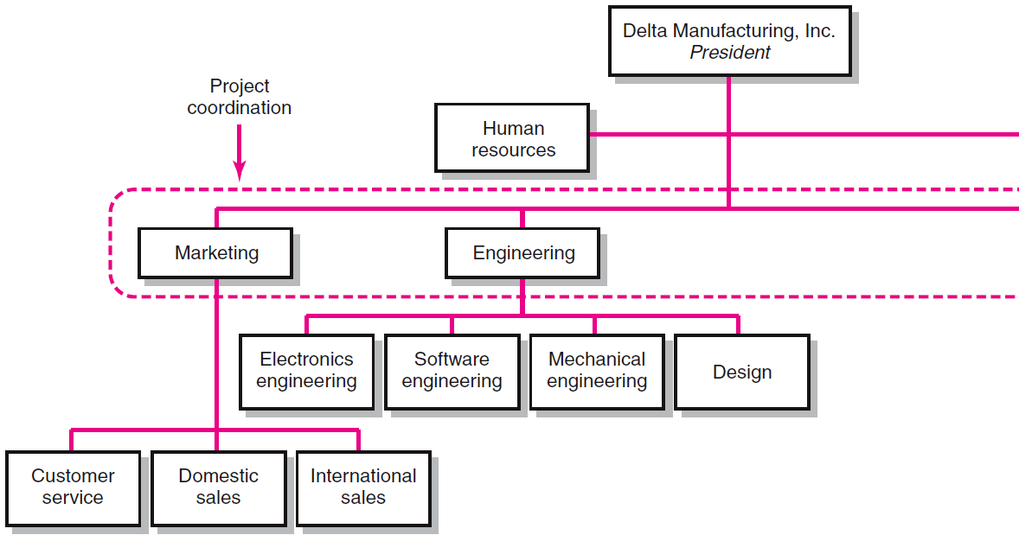
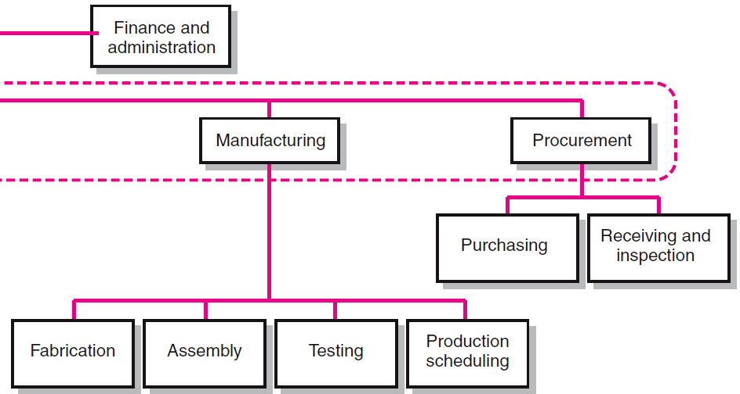
Functional Organizations

Slide 70
Functional Organization of Projects
Advantages
  No Structural Change
  Flexibility
  In-Depth Expertise
  Easy Post-Project Transition
Disadvantages
  Lack of Focus
  Poor Integration
  Slow
  Lack of Ownership

Slide 71
Project Management Structures (cont’d)
Organizing Projects: Dedicated Teams
  Teams operate as separate units under the leadership of a full-time project manager.
  In a projectized organization where projects are the dominant form of business, functional departments are responsible for providing support for its teams.

Slide 72
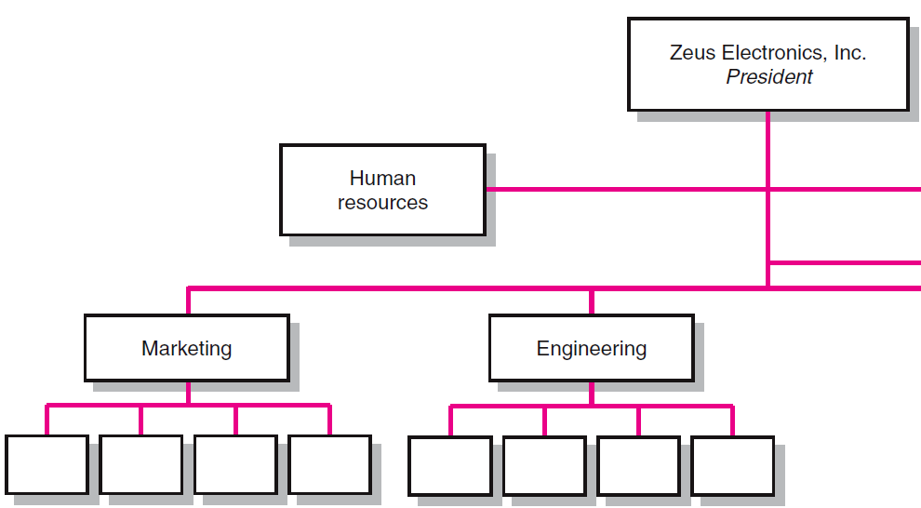
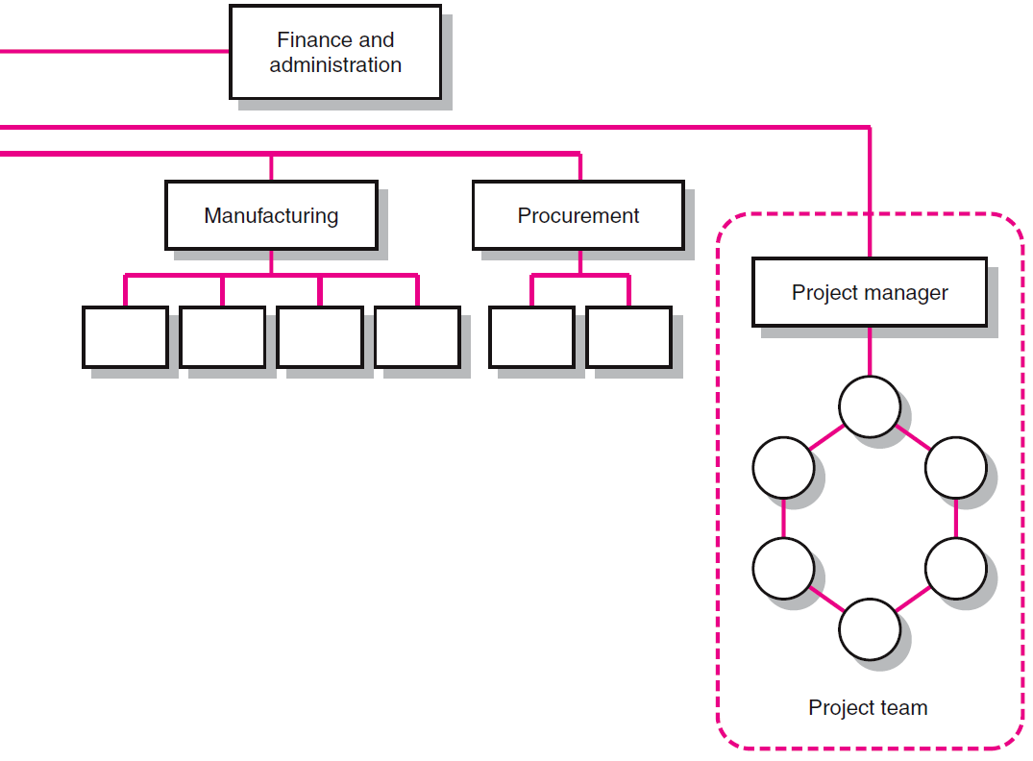
Dedicated Project Team

Slide 73
Project Organization: Dedicated Team
Advantages
  Simple
  Fast
  Cohesive
  Cross-Functional Integration
Disadvantages
  Expensive
  Internal Strife
  Limited Technological Expertise
  Difficult Post-Project Transition

Slide 74
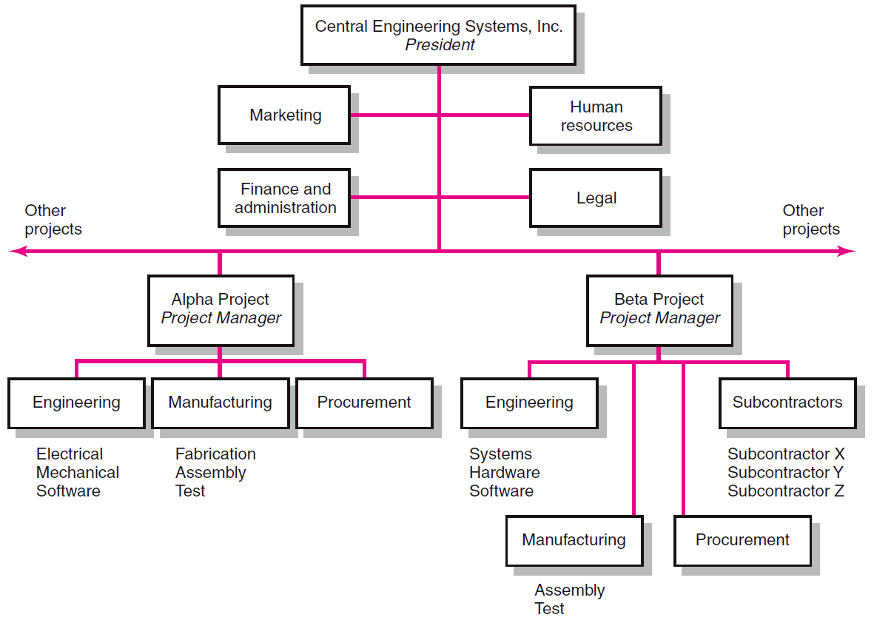
Projectized Organizational Structure

Slide 75
Project Management Structures (cont’d)
Organizing Projects: Matrix Structure
  Hybrid organizational structure (matrix) is overlaid on the normal functional structure.
    Two chains of command (functional and project)
    Project participants report simultaneously to both functional and project managers.
  Matrix structure optimizes the use of resources.
    Allows for participation on multiple projects while performing normal functional duties.
    Achieves a greater integration of expertise and project requirements.

Slide 76
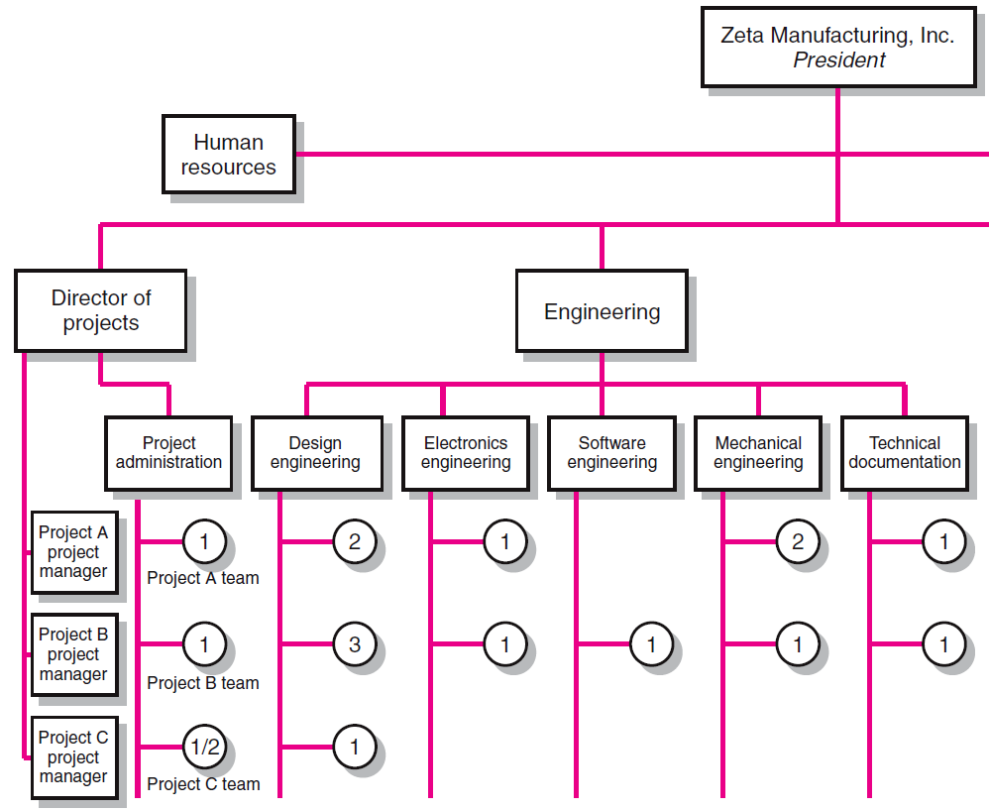
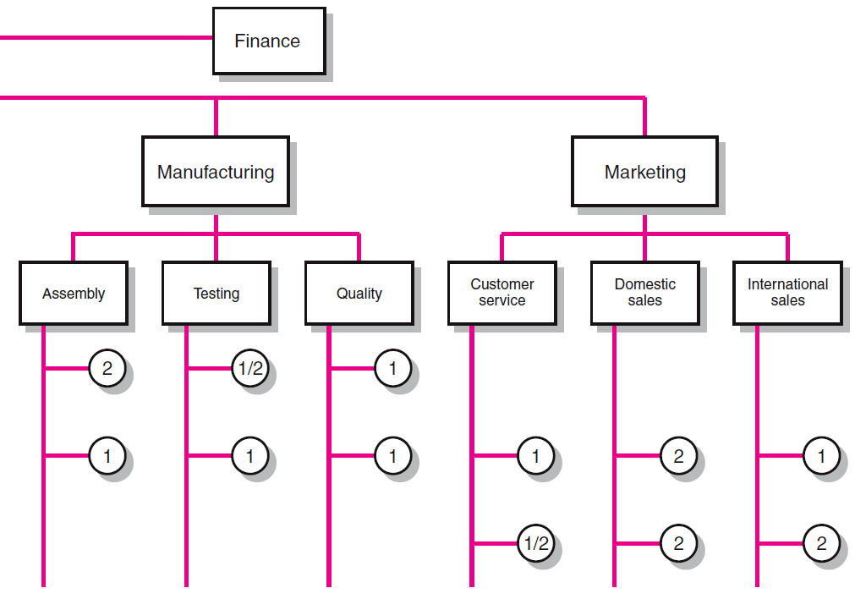
Matrix Organization Structure

Slide 77
Division of Project Manager and Functional Manager Responsibilities in a Matrix Structure
Project Manager Negotiated Issues Functional Manager
What has to be done? Who will do the task? How will it be done?
When should the task be done? Where will the task be done?
How much money is available Why will the task be done? How will the project involvement
to do the task? impact normal functional activities?
How well has the total project Is the task satisfactorily How well has the functional
been done? completed? input been integrated?

Slide 78
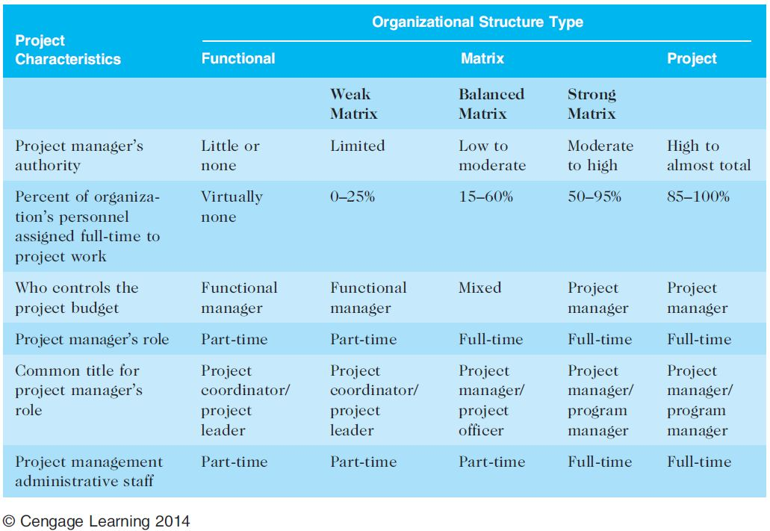
Table 2-1. Organizational Structure Influences on Projects

Slide 79
2.2c Organizational Culture
Organizational culture is a set of shared assumptions, values, and behaviors that characterize the functioning of an organization
Many experts believe the underlying causes of many companies’ problems are not the structure or staff, but the culture
Challenge the CONVENTIONAL WISDOM when it comes to organizational culture.

Slide 80
2.2c Ten Characteristics of Organizational Culture
Member identity*
Group emphasis*
People focus
Unit integration*
Control
Risk tolerance*
Reward criteria*
Conflict tolerance*
Means-ends orientation
Open-systems focus*
*Project work is most successful in an organizational culture where these items in red are strong/high and other items are balanced.

Slide 81
2.3 Stakeholder Management
Project managers must take time to identify, understand, and manage relationships with all project stakeholders
Senior executives/top management are very important stakeholders
See Chapter 13, Project Stakeholder Management, for more information

Slide 82
Media Snapshot
The media have often reported on mismanaged IT projects, including the disastrous launch of the website healthcare.gov in October 2013—they spent > $300M on a website that did not work
Forbes ran an article on called “Healthcare.gov: Diagnosis: The Government Broke Every Rule of Project Management”
President Obama formed the “Obama Trauma Team” of star performers from several organizations to help fix the site

Slide 83
2.3a The Importance of Top Management Commitment
People in top management positions are key stakeholders in projects
A very important factor in helping project managers successfully lead projects is the level of commitment and support they receive from top management
Without top management commitment, many projects will fail—without top management commitment, PM’s will not get the resources they need.
Some projects have a senior manager called a champion who acts as a key proponent for a project.
Notes:
Are you aware that 80% of business today are what we call SME’s (< 500 EMPLOYEES). Many of these do have a PMO, don’t have a CIO and are not focused on maturity concepts. Indeed, this can be true of firms with 5000-10000 employees, making 500M in revenues a year….So ask…when you do your recruiting….

Slide 84
2.3a How Top Management Can Help Project Managers
Providing adequate resources
Approving unique project needs in a timely manner
Getting cooperation from other parts of the organization
Mentoring and coaching on leadership issues
Notes:
Often there is undiscovered work in the middle of a project, requiring expensive expertise, or additional hardware or software…You have to outsource some of the work….will top management commit to this or will they just cancel the project??

Slide 85
2.3a Best Practice
IT governance addresses the authority and control for key IT activities in organizations, including IT infrastructure, IT use, and project management
A lack of IT governance can be dangerous, as evidenced by three well-publicized IT project failures in Australia (Sydney Water’s customer relationship management system, the Royal Melbourne Institute of Technology’s academic management system, and One.Tel’s billing system)
Notes:
According to Weill and Ross, firms with superior IT governance systems have 20% higher profits than firms with poor governance.

Slide 86
2.3a Need for Organizational Commitment to Information Technology (IT)
If the organization has a negative attitude toward IT, it will be difficult for an IT project to succeed
Having a Chief Information Officer (CIO) at a high level in the organization helps IT projects
  Must be a visionary—lead through vision and example
  Must not be a command-and-control person
Assigning non-IT people to IT projects also encourages more commitment
Notes:
Again, many firms

Slide 87
2.3c The Need for Organizational Standards
Standards and guidelines help project managers be more effective
Senior management can encourage
  the use of standard forms and software for project management
  the development and use of guidelines for writing project plans or providing status information
  the creation of a project management office or center of excellence

Slide 88
2.4 Project Phases and the Project Life Cycle
A project life cycle is a collection of project phases that defines
  what work will be performed in each phase
  what deliverables will be produced and when
  who is involved in each phase, and
  how management will control and approve work produced in each phase
A deliverable is a product or service produced or provided as part of a project
Notes:
Draw the lifecycle and show where specific deliverables are created…..Initiating, Planning, Executing, Closing

Slide 89
2.4 More on Project Phases
In early phases of a project life cycle
  resource needs are usually lowest
  the level of uncertainty (risk) is highest
  project stakeholders have the greatest opportunity to influence the project
In middle phases of a project life cycle
  the certainty of completing a project improves
  more resources are needed
The final phase of a project life cycle focuses on
  ensuring that project requirements were met
  the sponsor approves completion of the project

Slide 90
2.4a Product Life Cycles PMBOK
Products also have life cycles
The Systems Development Life Cycle (SDLC) is a framework for describing the phases involved in developing and maintaining information systems
Systems development projects can follow
  Predictive life cycle: the scope of the project can be clearly articulated and the schedule and cost can be predicted
  Adaptive Software Development (ASD) life cycle: requirements cannot be clearly expressed, projects are mission driven and component based, using time-based cycles to meet target dates

Slide 91
2.4a Predictive Life Cycle Models
Waterfall model: has well-defined, linear stages of systems development and support
Spiral model: shows that software is developed using an iterative or spiral approach rather than a linear approach
Incremental build model: provides for progressive development of operational software
Prototyping model: used for developing prototypes to clarify user requirements
Rapid Application Development (RAD) model: used to produce systems quickly without sacrificing quality using time-boxes

Slide 92
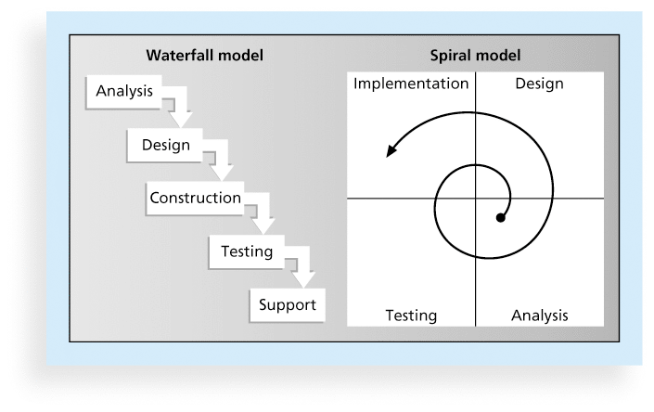
Figure 2-5. Waterfall and Spiral Life Cycle Models

Slide 93
The WaterFall Model

Slide 94
Adaptive/Agile Life Cycle Models
Extreme Programming (XP): Developers program in pairs and must write the tests for their own code. XP teams include developers, managers, and users
Scrum: Repetitions of iterative development are referred to as sprints, which normally last thirty days. Teams often meet every day for a short meeting, called a scrum, to decide what to accomplish that day. Works best for object-oriented technology projects and requires strong leadership to coordinate the work

Slide 95
The Seven Phases of the Waterfall Model
Definition -- 10%
Analysis -- 15%
Design -- 15%
Programming -- 15%
  Preparation and programming--10%
  module testing--5%
System Test -- 25%
Acceptance Testing -- 5%
Operation -- 15%
At the end of every phase, a deliverable is expected and a phase exit or kill point is put in place

Slide 96
2.4a Agile Software Development
Is an Adaptive Lifecycle approach
Is a time-boxed approach, usually
Agile software development has become popular to describe new approaches that focus on close collaboration between programming teams and business experts
See the last section of this chapter and Chapter 3 for more information on agile, also Burns, Ch 4
Includes Scrum, Extreme programming and RUP

Slide 97
The Importance of Project Phases and Management Reviews
A project should successfully pass through each of the project phases in order to continue on to the next
Management reviews, also called phase exits or kill points, should occur after each phase to evaluate the project’s progress, likely success, and continued compatibility with organizational goals
Notes:
Show kill points on lifecycle model

Slide 98
What Went Right?
"The real improvement that I saw was in our ability to⎯in the words of Thomas Edison⎯know when to stop beating a dead horse.…Edison's key to success was that he failed fairly often; but as he said, he could recognize a dead horse before it started to smell...In information technology we ride dead horses⎯failing projects⎯a long time before we give up. But what we are seeing now is that we are able to get off them; able to reduce cost overrun and time overrun. That's where the major impact came on the success rate.”*
Many organizations, like Huntington Bancshares, Inc., use an executive steering committee to help keep projects on track.
Some projects still go on a long time before being killed, like Blizzard’s Titan game project.
*Cabanis, Jeannette, "'A Major Impact': The Standish Group's Jim Johnson On Project Management and IT Project Success," PM Network, PMI, Sep.1998, p. 7

Slide 99
2.5 The Context of IT Projects
IT projects can be very diverse in terms of size, complexity, products produced, application area, and resource requirements
IT project team members often have diverse backgrounds and skill sets—not all are actually IT types.
IT projects use diverse technologies that change rapidly. Even within one technology area, people must be highly specialized

Slide 100
2.6 Recent Trends Affecting IT Project Management
Globalization
Outsourcing: Outsourcing is when an organization acquires goods and/or sources from an outside source. Offshoring is sometimes used to describe outsourcing from another country
Virtual teams/distributed teams: A virtual team is a group of individuals who work across time and space using communication technologies
Agile project management

Slide 101
2.6a Important Issues and Suggestions Related to Globalization
Issues
  Communications
  Trust
  Common work practices
  Tools
Suggestions
  Employ greater project discipline
  Think global but act local
  Keep project momentum going
  Use newer tools and technology
Notes:
An Indian developer was told by his American Project manager that he was to thoroughly test the module before going live with it. But when the product went live, there were still many bugs. The project manager said “I though I told you to thoroughly test that module.” “I did,” said the Indian developer, “and I found all the defects you are now having problems with. But you didn’t ask me to fix any of those defects.”

Slide 102
2.6b Outsourcing
Organizations remain competitive by using outsourcing to their advantage, such as finding ways to reduce costs
Their next challenge is to make strategic IT investments with outsourcing by improving their enterprise architecture to ensure that IT infrastructure and business processes are integrated and standardized (See Suggested Readings)
Project managers should become more familiar with negotiating contracts and other outsourcing issues
Notes:
Internal IT teams and departments find themselves competing with outside IT firms for the same projects…and if they loose, they may lose their jobs.

Slide 103
2.6b Global Issues
Outsourcing also has disadvantages. For example, Apple benefits from manufacturing products in China, using FoxConn—FoxConn had significant human rights violations—people working 32 hrs at a time without sleep and then committing suicide

Slide 104
2.6c Virtual Teams Advantages
Increasing competiveness and responsiveness by having a team of workers available 24/7
Lowering costs because many virtual workers do not require office space or support beyond their home offices.
Providing more expertise and flexibility by having team members from across the globe working any time of day or night
Increasing the work/life balance for team members by eliminating fixed office hours and the need to travel to work.

Slide 105
2.6c Virtual Team Disadvantages
Isolating team members
Increasing the potential for communications problems
Reducing the ability for team members to network and transfer information informally
Increasing the dependence on technology to accomplish work
See text for a list of factors that help virtual teams succeed, including team processes, trust/relationships, leadership style, and team member selection

Slide 106
2.6d Agile Project Management
Agile means being able to move quickly and easily, but some people feel that project management, as they have seen it used, does not allow people to work quickly or easily.
Early software development projects often used a waterfall approach, as defined earlier in this chapter. As technology and businesses became more complex, the approach was often difficult to use because requirements were unknown or continuously changing.
Agile today means using a method based on iterative and incremental development, in which requirements and solutions evolve through collaboration.
See the Resources tab from www.pmtexts.com for more info

Slide 107
2.6d Agile Makes Sense for Some Projects, But Not All
Many seasoned experts in project management warn people not to fall for the hype associated with Agile.
For example, J. Leroy Ward, Executive Vice President at ESI International, said that “Agile will be seen for what it is … and isn’t….Project management organizations embracing Agile software and product development approaches will continue to grow while being faced with the challenge of demonstrating ROI through Agile adoption.”*
*J. Leroy Ward, “The Top Ten Project Management Trends for 2011,” projecttimes.com
(January 24, 2011).

Slide 108
2.6e Manifesto for Agile Software Development
In February 2001, a group of 17 people that called themselves the Agile Alliance developed and agreed on the Manifesto for Agile Software Development, as follows:
“We are uncovering better ways of developing software by doing it and helping others do it. Through this work we have come to value:
Individuals and interactions over processes and tools
Working software over comprehensive documentation
Customer collaboration over contract negotiation
Responding to change over following a plan”*
*Agile Manifesto, www.agilemanifesto.org.

Slide 109
2.6f Scrum
According to the Scrum Alliance, Scrum is the leading agile development method for completing projects with a complex, innovative scope of work.
The term was coined in 1986 in a Harvard Business Review study that compared high-performing, cross-functional teams to the scrum formation used by rugby teams.

Slide 110
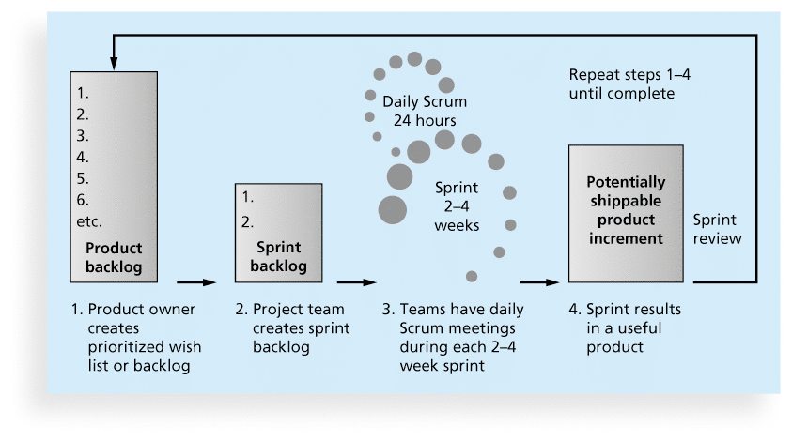
Figure 2-6. Scrum Framework

Slide 111
2.6f Kanban
Technique that can be used in conjunction with scrum
Developed in Japan by Toyota Motor Corporation
Uses visual cues to guide workflow
Kanban cards show new work, work in progress, and work completed
Allows the customer to PULL projects from the Scrum list through the development process.

Slide 112
2.6g Agile, the PMBOK® Guide, and a New Certification
The PMBOK® Guide describes best practices for what should be done to manage projects.
Agile is a methodology that describes how to manage projects.
The Project Management Institute (PMI) recognized the increased interest in Agile, and introduced a new certification in 2011 called Agile Certified Practitioner (ACP).
Seasoned project managers understand that they have always had the option of customizing how they run projects, but that project management is not easy, even when using Agile.

Slide 113
Chapter Summary
Project managers need to take a systems approach when working on projects
Organizations have four different frames: structural, human resources, political, and symbolic
The structure and culture of an organization have strong implications for project managers
Projects should successfully pass through each phase of the project life cycle
Project managers need to consider several factors due to the unique context of information technology projects
Recent trends affecting IT project management include globalization, outsourcing, virtual teams, and Agile

