Slide 1
Chapter 6: Project Time Management
Information Technology Project Management, Eighth Edition
Note: See the text itself for full citations.

Slide 2
PMI Student Chapter Meeting Tonight
Rm BA 105, beginning at 7 pm
Jonathan Blackwell, MBA is the speaker. He's a management consultant here in Lubbock with Nashwell LLC, a firm specializing in advertising content management. He's also applying to enter a Ph.D. in management at Rawls.
Jonathan innovates by working with strategic partners to find win-win opportunities to optimize organizations.

Slide 3
Review Questions 1
Which of the following is not a best practice that can help in avoiding scope problems on IT projects?
A. Keep the scope realistic.
B. Use off-the-shelf hardware and software whenever possible (REUSE)
C. Follow good project management practices
D. Don’t involve too many users in scope management

Slide 4
Review Questions 2
________ refer(s) to all the work involved in creating the products of the project and the processes used to create them.
A. Deliverables
B. Milestones
C. Scope
D. Product development

Slide 5
Review Question 3
Which tool or technique for collecting requirements is often the most expensive and time consuming?
A. Interviews
B. Focus groups
C. Surveys
D. Observation

Slide 6
Review Question 4
A ________ is a deliverable-oriented grouping (a delineation) of the work involved in a project that defines its total scope
A. scope statement
B. WBS
C. WBS dictionary
D. work package

Slide 7
Review Question 5
Assume that you have a project with major categories called initiating, planning, executing and closing. What level of the WBS would these items fall under?
A. 0
B. 1
C. 2
D. 3

Slide 8
Review question 6
Scope ________ is often achieved by a customer inspection and then sign-off on the key deliverables.
A. acceptance
B. validation
C. completion
D. close-out

Slide 9
Review Question 7
Which of the following is not a suggestion for improving user input?
A. Develop a good project selection process for IT projects.
B. Have users on the project team.
C. Co-locate users with developers.
D. Only have meetings as needed, not on a regular basis.

Slide 10
Review Question 8
Project management software helps you develop a ________, which serves as a basis for creating Gantt charts, assigning resources, and allocating costs.
A. project plan
B. schedule
C. WBS
D. deliverable

Slide 11
Review Question 9
Every knowledge management area has a ________ and a ________ process.
A. monitoring, controlling
B. verifying, validating
C. planning, controlling
D. describing, delineating
E. micro, macro

Slide 12
Review Question 10
Activities ________ and are synonymous with ________.
are instants in time, milestones
have time duration, tasks
are the fundamental building blocks for schedules, steps
all of the above
B and C only

Slide 13
Question 11
Match the following:
Budget Time Management
Schedule Scope Management
WBS Cost Management
Gantt Chart
Network Chart

Slide 14
Learning Objectives
Understand the importance of project schedules and good project time management
Discuss the process of planning schedule management
Define activities as the basis for developing project schedules
Describe how project managers use network diagrams and dependencies to assist in activity sequencing
Understand the relationship between estimating resources and project schedules
Explain how various tools and techniques help project managers perform activity duration estimates

Slide 15
Learning Objectives
Use a Gantt chart for planning and tracking schedule information, find the critical path for a project, and describe how critical chain scheduling and the Program Evaluation and Review Technique (PERT) affect schedule development
Discuss how reality checks and discipline are involved in controlling and managing changes to the project schedule
Describe how project management software can assist in project time management and review words of caution before using this software

Slide 16
Importance of Project Schedules
Managers often cite delivering projects on time as one of their biggest challenges.
Time has the least amount of flexibility; it passes no matter what happens on a project.
Schedule issues are the main reason for conflicts on projects, especially during the second half of projects.

Slide 17
Individual Work Styles and Cultural Differences Cause Schedule Conflicts
One dimension of the Meyers-Briggs Type Indicator focuses on peoples’ attitudes toward structure and deadline.
Some people prefer to follow schedules and meet deadlines while others do not (J vs. P).
Different cultures and even entire countries have different attitudes about schedules.

Slide 18
Media Snapshot
In contrast to the 2002 Salt Lake City Winter Olympic Games (see Chapter 4’s Media Snapshot), planning and scheduling was very different for the 2004 Summer Olympic Games held in Athens, Greece.
Many articles were written before the opening ceremonies predicting that the facilities would not be ready in time. …many people were pleasantly surprised by the amazing opening ceremonies, beautiful new buildings, and state-of-the-art security and transportation systems in Athens.
The Greeks even made fun of critics by having construction workers pretend to still be working as the ceremonies began.

Slide 19
Project Time Management Processes
Plan schedule management: determining the policies, procedures, and documentation that will be used for planning, executing, and controlling the project schedule
Define activities: identifying the specific activities that the project team members and stakeholders must perform to produce the project deliverables
Sequence activities: identifying and documenting the relationships between project activities
Estimate activity resources: estimating how many resources a project team should use to perform project activities
Estimate activity durations: estimating the number of work periods that are needed to complete individual activities
Develop the schedule: analyzing activity sequences, activity resource estimates, and activity duration estimates to create the project schedule
Control the schedule: controlling and managing changes to the project schedule
Notes:
Is the project time-constrained—meaning project must be finished by a certain due date, but resources are whatever you need
Or is the project resource constrained….time is flexible, but you will have only five team members to complete the project.

Slide 20
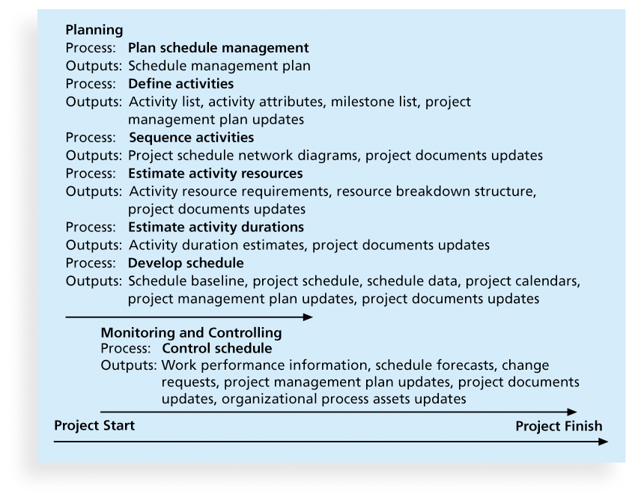
Figure 6-1. Project Time Management Summary
Notes:
This knowledge area is totally driven by activites and milestones.

Slide 21
The Generic Process
Tools and Techniques
Inputs
Outputs
Practice
Let’s remind ourselves that PMBOK does NOT provide very much detail as to the ‘practice’ that goes inside the box.

Slide 22
Plan Schedule Management Process
Tools and Techniques
Expert Judgment
Analytical techniques
Meetings
Plan Schedule Management
Inputs
Outputs
Project Management Plan
Project Charter
Enterprise Environmental Factors
Organizational Process Assets
Schedule Management Plan

Slide 23
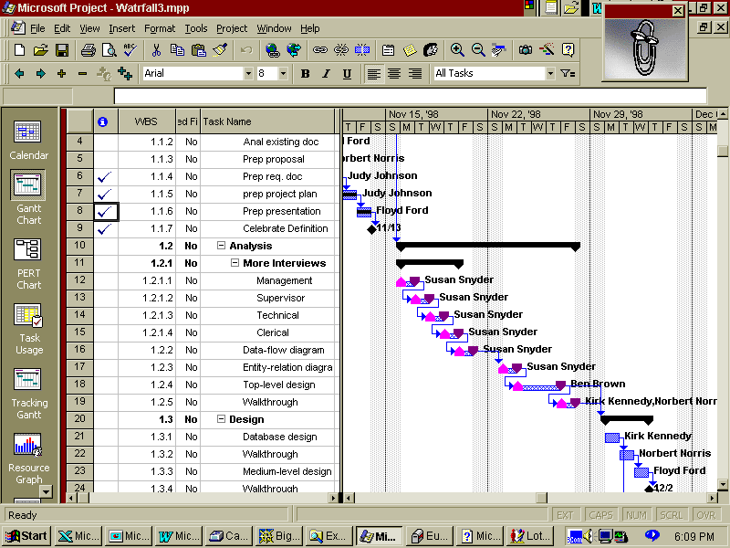

Slide 24
Inputs
Project Management Plan, PMP
Project Charter
Enterprise Environmental Factors, EEF
Organizational Process Assets, OPA
For planning processes, these inputs almost always appear, especially the one’s in red
When was the PMP (Project Management Plan) first addressed?

Slide 25
Plan Schedule Management
The project team uses expert judgment, analytical techniques, and meetings to develop the schedule management plan.
A schedule management plan includes:
Project schedule model development
The scheduling methodology
Level of accuracy and units of measure
Control thresholds
Rules of performance measurement
Reporting formats
Process descriptions

Slide 26
Define Activities Process
An activity or task is an element of work normally derived from the work breakdown structure (WBS) that has an expected duration, a cost, and resource requirements.
Activity definition involves developing a more detailed WBS and supporting explanations to understand all the work to be done so you can develop realistic cost and duration estimates.
Activities are further breakdowns of work packages.

Slide 27
Define Activities Process
Tools and Techniques
Expert Judgment
Analytical techniques
Meetings
Define Activities
Inputs
Outputs
Schedule Management Plan
Scope Baseline
Enterprise Environmental Factors
Organizational Process Assets
Activities List
Activity attributes
Milestone list
Project management plan updates

Slide 28
Activity Lists and Attributes
An activity list is a tabulation of activities to be included on a project schedule that includes
the activity name
an activity identifier or number
a brief description of the activity
Activity attributes provide more information such as predecessors, successors, logical relationships, leads and lags, resource requirements, constraints, imposed dates, and assumptions related to the activity.

Slide 29
Milestones
A milestone is a significant event that normally has no duration.
It often takes several activities and a lot of work to complete a milestone.
They’re useful tools for setting schedule goals and monitoring progress.
Examples include obtaining customer sign-off on key documents or completion of specific products, deliverables.

Slide 30
What Went Wrong?
At the U.S. Federal Bureau of Investigation (FBI), poor time management was one of the reasons behind the failure of Trilogy, a “disastrous, unbelievably expensive piece of vaporware, which was more than four years in the (un)making. The system was supposed to enable FBI agents to integrate intelligence from isolated information silos within the Bureau.”*
In May 2006, the Government Accounting Agency said that the Trilogy project failed at its core mission of improving the FBI’s investigative abilities and was plagued with missed milestones and escalating costs. Sentinel replaced Trilogy in 2007.
During a test exercise in 2011, Sentinel experienced two outages, and the FBI determined that the current hardware structure was inadequate. Unfortunately, history seemed to repeat itself as troubles still loomed with Sentinel in 2012
*Roberts, Paul, “Frustrated contractor sentenced for hacking FBI to speed deployment,”
InfoWorld Tech Watch, (July 6, 2006).

Slide 31
Sequence Activities Process
Involves reviewing activities and determining dependencies
A dependency or relationship is the sequencing of project activities or tasks.
You must determine dependencies in order to use critical path analysis.

Slide 32
Sequence Activities Process
Tools and Techniques
Expert Judgment
Analytical techniques
Meetings
Sequence Activities
Inputs
Outputs
Schedule Management Plan
Scope Baseline
Enterprise Environmental Factors
Organizational Process Assets
Activities List
Activity attributes
Milestone list
Project management plan updates

Slide 33
Three types of Dependencies
Mandatory dependencies: inherent in the nature of the work being performed on a project, sometimes referred to as hard logic
Discretionary dependencies: defined by the project team., sometimes referred to as soft logic and should be used with care since they may limit later scheduling options
External dependencies: involve relationships between project and non-project activities

Slide 34
Another Taxonomy of Project Dependency Types
Technical or Logic Constraints
Constraints related to the networked sequence in which project activities must occur.
Physical Constraints
Activities that cannot occur in parallel or are affected by contractual or environmental conditions.
Resource Constraints
The absence, shortage, or unique interrelationship and interaction characteristics of resources that require a particular sequencing of project activities
Kinds of Resource Constraints
People, materials, equipment

Slide 37
Precedence Diagramming Method

Slide 38
Activity-on-Arrow (AOA) Method Arrow Diagramming Method (ADM)

Slide 39
Network Diagrams
Network diagrams are the preferred technique for showing activity sequencing.
A network diagram is a schematic display of the logical relationships among, or sequencing of, project activities.
Two main formats are the Arrow Diagramming Method (ADM) and the Precedence Diagramming Methods (PDM)
PDM is by far the most used

Slide 40
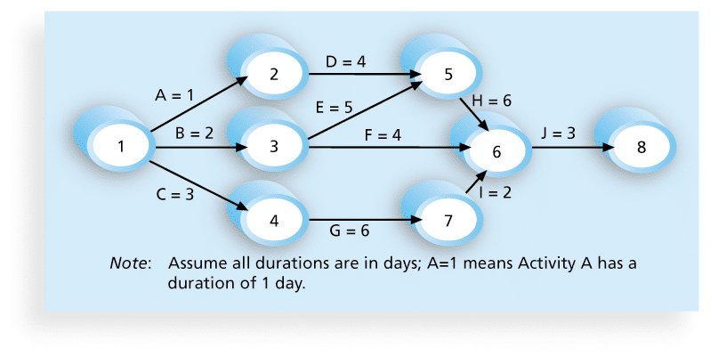
Figure 6-2. Network Diagram for Project X

Slide 41
Arrow Diagramming Method (ADM)
Also called activity-on-arrow (AOA) network diagrams
Activities are represented by arrows
Nodes or circles are the starting and ending points of activities
Can only show finish-to-start dependencies

Slide 42
Process for Creating AOA Diagrams
1. Find all of the activities that start at node 1. Draw their finish nodes and draw arrows between node 1 and those finish nodes. Put the activity letter or name and duration estimate on the associated arrow
2. Continuing drawing the network diagram, working from left to right. Look for bursts and merges. Bursts occur when a single node is followed by two or more activities. A merge occurs when two or more nodes precede a single node
3. Continue drawing the project network diagram until all activities are included on the diagram that have dependencies
4. As a rule of thumb, all arrowheads should face toward the right, and no arrows should cross on an AOA network diagram

Slide 43
Precedence Diagramming Method (PDM)
Activities are represented by boxes.
Arrows show relationships between activities.
More popular than ADM method and used by project management software
Better at showing different types of dependencies

Slide 44
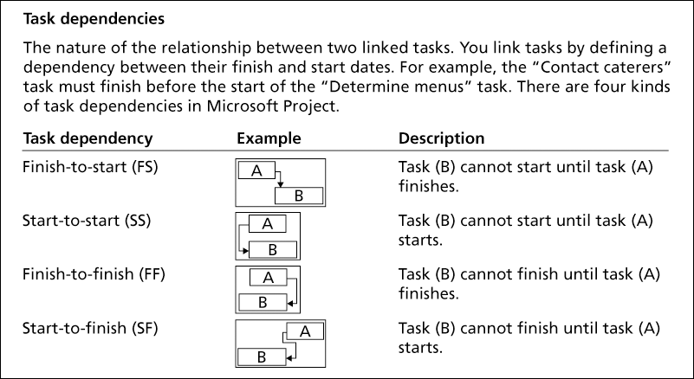
Figure 6-3. Task Dependency Types

Slide 45
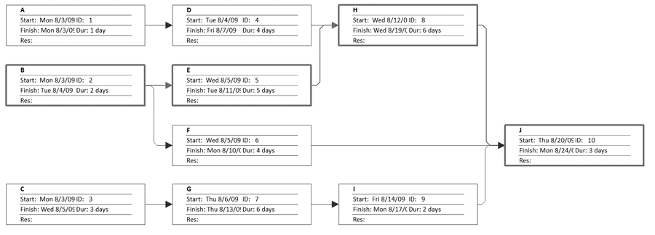
Figure 6-4. Sample PDM Network Diagram

Slide 46
Estimate Activity Resources Process
Before estimating activity durations, you must have a good idea of the quantity and type of resources that will be assigned to each activity; resources are people, equipment, and materials.
Consider important issues in estimating resources
How difficult will it be to do specific activities on this project?
What is the organization’s history in doing similar activities?
Are the required resources available?
A Resource Breakdown Structure is a hierarchical structure that identifies the project’s resources by category and type.

Slide 47
Estimate Activity Resources Process
Tools and Techniques
Expert Judgment
Alternative analysis
Published estimation data
Bottom-up estimating
Estimate Activity Resources
Inputs
Outputs
Schedule Management Plan
Activity List/activity attributes
Resource calendars
Risk register
Enterprise Environmental Factors
Organizational Process Assets
Activity resource Requirements
Resource Breakdown structure
Project documents updates

Slide 48
Project Documents
Project Charter
WBS
Resource Breakdown Structure—identifies a project’s required resources by category and type
Gantt charts
Network charts
Risk register
Lessons learned
All the project documents/databases

Slide 49
Estimate Activity Duration Process
Duration includes the actual amount of time worked on an activity plus elapsed time.
Effort is the number of workdays or work hours required to complete a task.
Effort does not normally equal duration.
People doing the work should help create estimates, and an expert should review them.

Slide 50
Estimate Activity Duration Process
Tools and Techniques
Expert Judgment
Analogous estimating
Parametric estimating
Estimate Activity Duration
Inputs
Outputs
Schedule Management Plan
Activity List/activity attributes
Resource calendars
Risk register
Enterprise Environmental Factors
Organizational Process Assets
Activities duration estimates
Project documents updates

Slide 52
Three-Point Estimates
Instead of providing activity estimates as a discrete number, such as four weeks, it’s often helpful to create a three-point estimate
an estimate that includes an optimistic, most likely, and pessimistic estimate, such as three weeks for the optimistic, four weeks for the most likely, and five weeks for the pessimistic estimate
Three-point estimates are needed for PERT and Monte Carlo simulations.

Slide 53
Develop the Schedule Process
Uses results of the other time management processes to determine the start and end date of the project
Looks for concurrency opportunities, given resource limitations
Ultimate goal is to create a realistic project schedule that provides a basis for monitoring project progress for the time dimension of the project
Important tools and techniques include Gantt charts, critical path analysis, and critical chain scheduling, and PERT analysis

Slide 54
Develop Schedule Process
Tools and Techniques
Schedule network analysis
CPM/CCM/PERT
Resource optimization techniques
Modeling techniques
Develop Schedule
Inputs
Outputs
Schedule Management Plan
Activity List/activity attributes
Project schedule network diagrams
Resource calendars
Enterprise Environmental Factors
Organizational Process Assets
Schedule baseline
Project schedule
Schedule data
Project calendars
Project documents updates

Slide 55
Gantt Charts
Gantt charts provide a standard format for displaying project schedule information by listing project activities and their corresponding start and finish dates in a calendar format.
Symbols include:
A black diamond: a milestone
Thick black bars: summary tasks
Lighter horizontal bars: durations of tasks
Arrows: dependencies between tasks

Slide 56
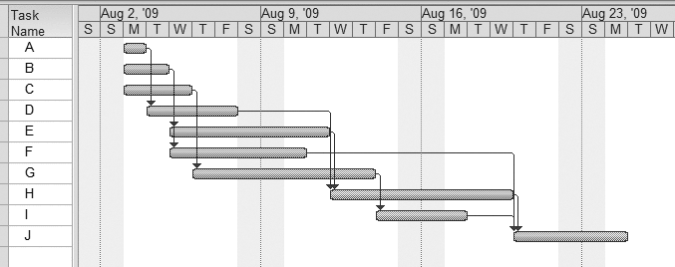
Figure 6-5. Gantt Chart for Project X

Slide 57
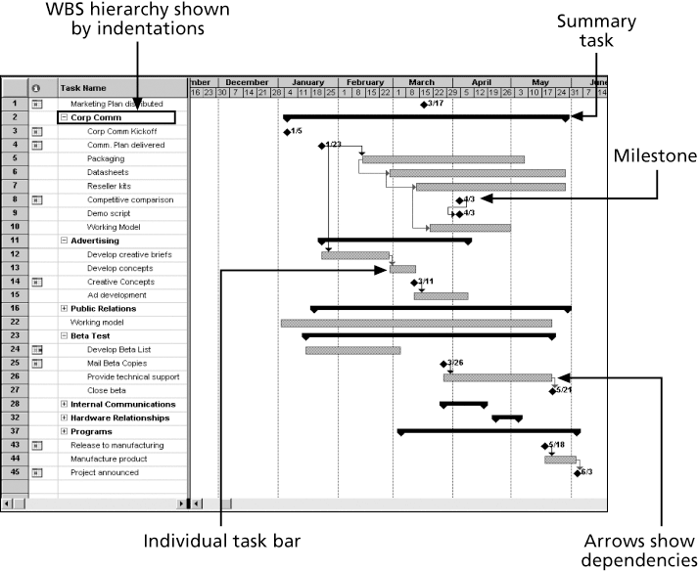
Figure 6-6. Gantt Chart for Software Launch Project

Slide 58
Adding Milestones to Gantt Charts
Many people like to focus on meeting milestones, especially for large projects.
Milestones emphasize important events or accomplishments on projects.
Normally, you create a milestone by entering tasks with a zero duration, or you can mark any task as a milestone.

Slide 59
Two Methods for Scheduling
Critical Path Method (CPM)
Uses AON (Activity-on-Node) Diagrams
Also known as PDM (Precedence Diagramming Method) Diagrams
Is deterministic (no probabilities or probability questions))
Enables a determination of the critical path and slack
Probabilistic Evaluation and Review Technique (PERT)
Uses AOA (Activity-on-Arrow) Diagrams
Is Probabilistic – uses three estimates for each activity duration
Can address probability questions to it…”What is the probability project will be finished by January 1, 2018??”

Slide 60
Best Practice
Schedule risk is inherent in the development of complex systems. Luc Richard, the founder of www.projectmangler.com, suggests that project managers can reduce schedule risk through project milestones, a best practice that involves identifying and tracking significant points or achievements in the project. The five key points of using project milestones include the following:
1. Define milestones early in the project and include them in the Gantt chart to provide a visual guide
2. Keep milestones small and frequent
3. The set of milestones must be all-encompassing
4. Each milestone must be binary, meaning it is either complete or incomplete.
5. Carefully monitor the critical path

Slide 61
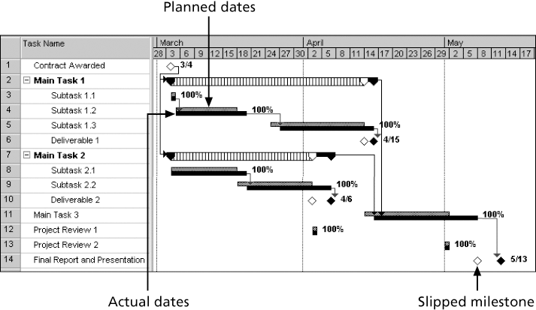
Figure 6-7. Sample Tracking Gantt Chart

Slide 62
Critical Path Method (CPM)
CPM is a network diagramming technique used to predict total project duration.
A critical path for a project is the series of activities that determines the earliest time by which the project can be completed.
The critical path is the longest path through the network diagram and has the least amount of slack or float.
Slack or float is the amount of time an activity may be delayed without delaying a succeeding activity or the project finish date.

Slide 63
Calculating the Critical Path
First develop a good network diagram
Add the duration estimates for all activities on each path through the network diagram
The longest path is the critical path
If one or more of the activities on the critical path takes longer than planned, the whole project schedule will slip unless the project manager takes corrective action

Slide 64
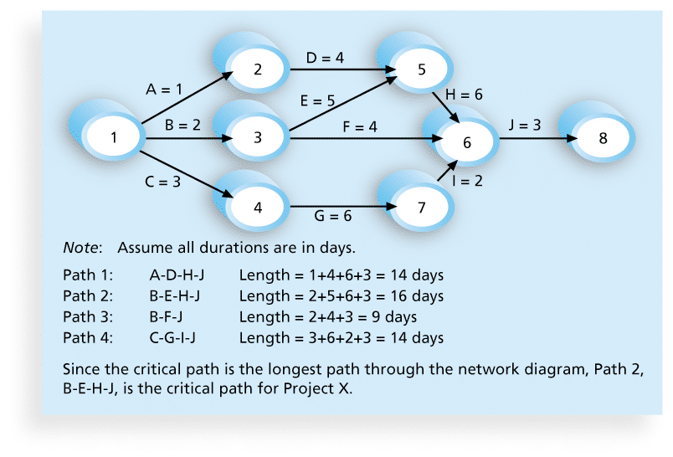
Figure 6-8. Determining the Critical Path for Project X

Slide 65
More on the Critical Path
A project team at Apple computer put a stuffed gorilla on the top of the cubicle of the person currently managing critical task
The critical path is not the one with all the critical activities; it only accounts for time
Remember the example of growing grass being on the critical path for Disney’s Animal Kingdom
There can be more than one critical path if the lengths of two or more paths are the same
The critical path can change as the project progresses

Slide 66
Critical Path Method Network
9
D
11
0
Edit
Paper
9
2
11
0
A
1
1
B
6
6
C
9
9
E
10
11
G
12
0
Identify
Topic
0
Research
Topic
0
Draft
Paper
1
Create
Graphics
0
Final
Draft
0
1
1
1
5
6
6
3
9
10
1
11
11
1
12
9
F
10
Legend
1
References
ES
ID
EF
10
1
11
SL
Description
LS
DUR
LF
Group Term Paper

Slide 67
Forward Pass Computation
9
D
11
Edit
Paper
Always start at 0
EF =
ES+DUR
EF =
ES+DUR
EF =
ES+DUR
2
EF =
ES+DUR
0
A
1
1
B
6
6
C
9
9
E
10
11
G
12
Identify
Topic
Research
Topic
Draft
Paper
Create
Graphics
Final
Draft
1
5
3
1
1
9
F
10
Legend
References
ES
ID
EF
1
SL
Description
LS
DUR
LF
Group Term Paper

Slide 68
Backward Pass Computation
Legend
ES
ID
EF
Group Term Paper
9
D
11
SL
Description
Edit
Paper
LS
DUR
LF
9
2
11
0
A
1
1
B
6
6
C
9
9
E
10
11
G
12
Identify
Topic
0
Research
Topic
Draft
Paper
Create
Graphics
Final
Draft
0
1
1
1
5
6
6
3
9
10
1
11
11
1
12
LS =
LF - DUR
LS =
LF - DUR
LS =
LF - DUR
LS =
LF - DUR
EF=LF
9
F
10
1
References
10
1
11

Slide 69
Determining Total Slack
9
D
11
SL =
LS – ES
or
LF - EF
SL =
LS – ES
or
LF - EF
SL =
LS – ES
or
LF - EF
0
Edit
Paper
9
2
11
0
A
1
1
B
6
6
C
9
9
E
10
11
G
12
0
Identify
Topic
0
Research
Topic
0
Draft
Paper
1
Create
Graphics
0
Final
Draft
0
1
1
1
5
6
6
3
9
10
1
11
11
1
12
9
F
10
Legend
1
References
ES
ID
EF
CRITICAL PATH?
10
1
11
SL
Description
LS
DUR
LF
Group Term Paper

Slide 70
Using Critical Path Analysis to Make Schedule Trade-offs
Free slack or free float is the amount of time an activity can be delayed without delaying the early start of any immediately following activities.
Total slack or total float is the amount of time an activity may be delayed from its early start without delaying the planned project finish date.
A forward pass through the network diagram determines the early start and finish dates.
A backward pass determines the late start and finish dates.

Slide 71
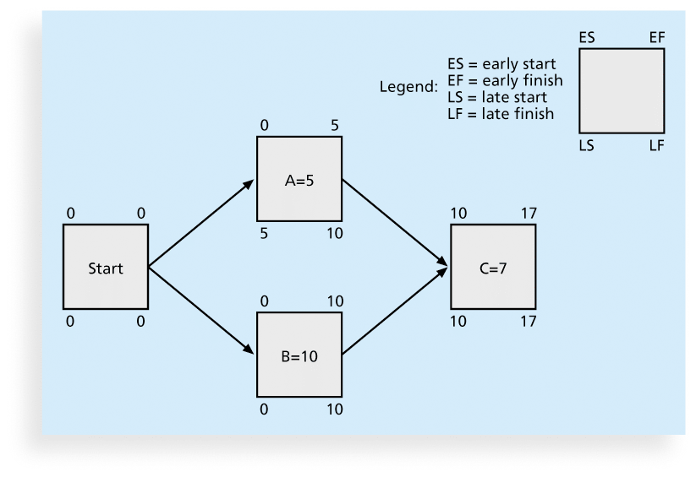
Figure 6-9. Calculating Early and Late Start and Finish Dates

Slide 72
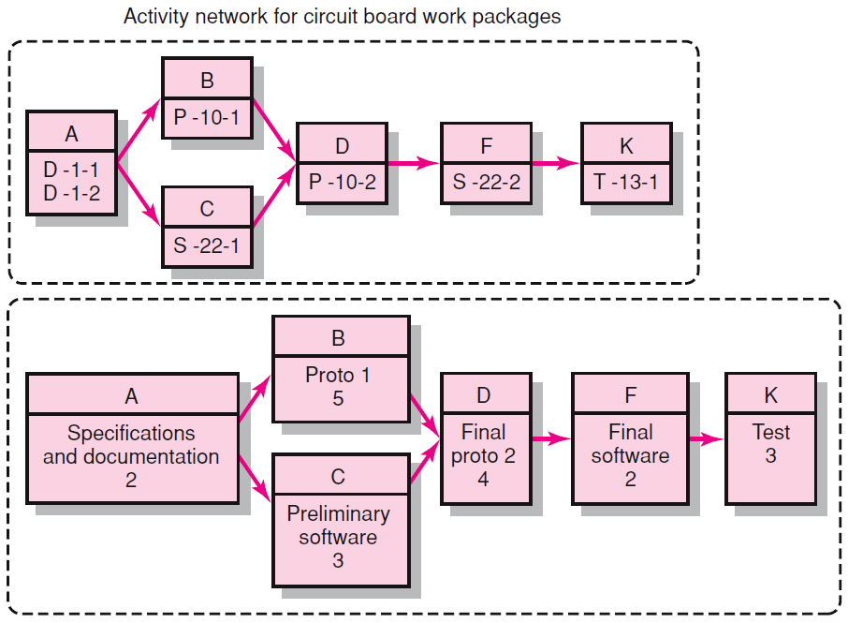
WBS/Work Package to Network (cont’d)

Slide 73
Constructing a Project Network
Terminology
Activity: an element of the project that requires time.
Merge Activity: an activity that has two or more preceding activities on which it depends.
Parallel (Concurrent) Activities: Activities that can occur independently and, if desired, not at the same time.
A
B
D
C

Slide 74
Constructing a Project Network (cont’d)
Terminology
Path: a sequence of connected, dependent activities.
Critical path: the longest path through the activity network that allows for the completion of all project-related activities; the shortest expected time in which the entire project can be completed. Delays on the critical path will delay completion of the entire project.
C
A
B
D
(Assumes that minimum of A + B > minimum of C in length of times to complete activities.)

Slide 75
Constructing a Project Network (cont’d)
Terminology
Event: a point in time when an activity is started or completed. It does not consume time.
Burst Activity: an activity that has more than one activity immediately following it (more than one dependency arrow flowing from it).
Two Approaches
Activity-on-Node (AON)
Uses a node to depict an activity.
Activity-on-Arrow (AOA)
Uses an arrow to depict an activity.
B
A
C
D

Slide 76
Basic Rules to Follow in Developing Project Networks
Networks typically flow from left to right.
An activity cannot begin until all preceding connected activities are complete.
Arrows indicate precedence and flow and can cross over each other.
Each activity must have a unique identify number that is greater than any of its predecessor activities.
Looping is not allowed.
Conditional statements are not allowed.
Use common start and stop nodes.

Slide 77
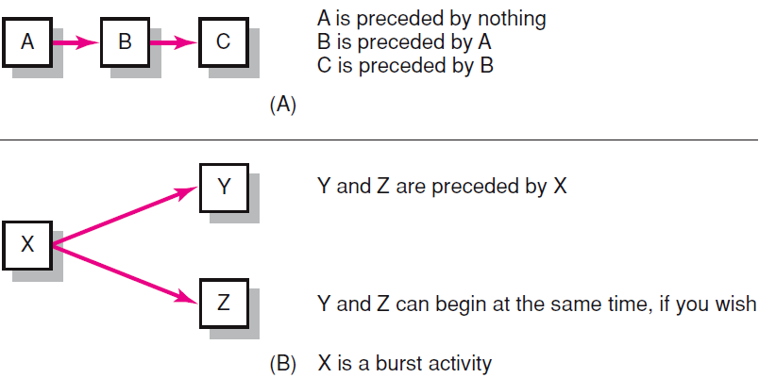
Activity-on-Node Fundamentals

Slide 78
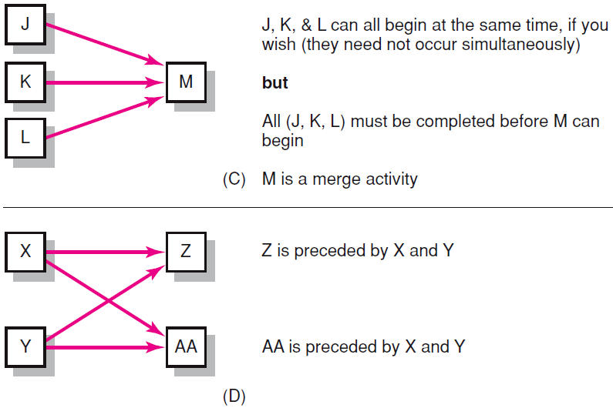
Activity-on-Node Fundamentals (cont’d)

Slide 79
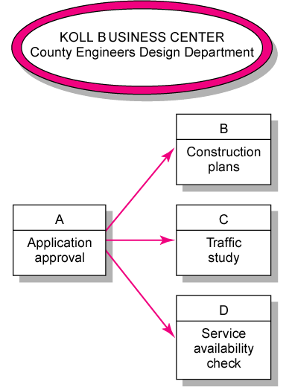
Koll Business Center—Partial Network

Slide 80
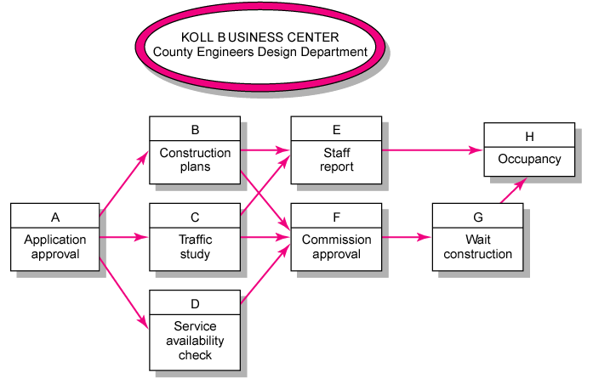
Koll Business Center—Complete Network

Slide 81
Table 6-1. Free and Total Float or Slack for Project X

Slide 82
Using the Critical Path to Shorten a Project Schedule
Three main techniques for shortening schedules
Shortening durations of critical activities/tasks by adding more resources or changing their scope.
Crashing activities by obtaining the greatest amount of schedule compression for the least incremental cost.
Fast tracking activities by doing them in parallel or overlapping them.

Slide 83
Importance of Updating Critical Path Data
It is important to update project schedule information to meet time goals for a project.
The critical path may change as you enter actual start and finish dates.
If you know the project completion date will slip, negotiate with the project sponsor.

Slide 84
Critical Chain Scheduling
Critical chain scheduling
a method of scheduling that considers limited resources when creating a project schedule and includes buffers to protect the project completion date
Uses the Theory of Constraints (TOC)
a management philosophy developed by Eliyahu M. Goldratt and introduced in his book The Goal.
Attempts to minimize multitasking
when a resource works on more than one task at a time

Slide 85
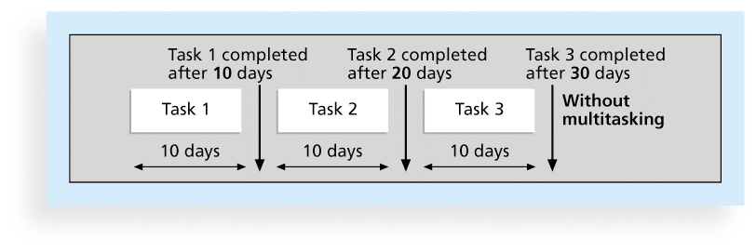
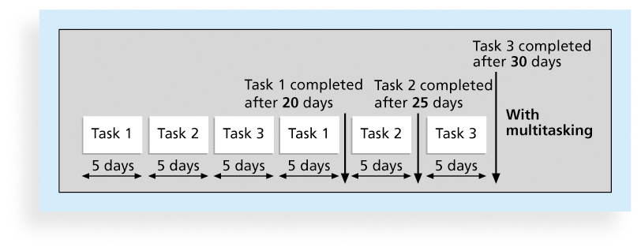
Figures 6-10.a and b. Multitasking Example

Slide 86
Buffers and Critical Chain
A buffer is additional time to complete a task.
Murphy’s Law states that if something can go wrong, it will.
Parkinson’s Law states that work expands to fill the time allowed.
In traditional estimates, people often add a buffer to each task and use it if it’s needed or not.
Critical chain scheduling removes buffers from individual tasks and instead creates
a project buffer or additional time added before the project’s due date
feeding buffers or additional time added before tasks on the critical path

Slide 87
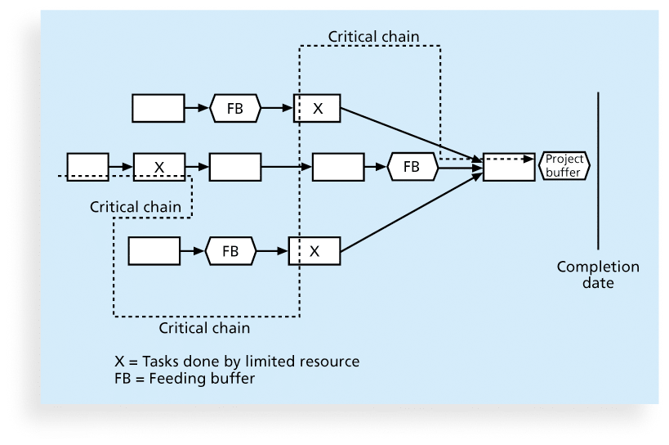
Figure 6-11. Example of Critical Chain Scheduling

Slide 88
Program Evaluation and Review Technique (PERT)
PERT is a network analysis technique used to estimate project duration when there is a high degree of uncertainty about the individual activity duration estimates.
PERT uses probabilistic time estimates
duration estimates based on using optimistic, most likely, and pessimistic estimates of activity durations, or a three-point estimate

Slide 89
PERT Formula and Example
PERT weighted average =
optimistic time + 4X most likely time + pessimistic time
6
Example:
PERT weighted average =
8 workdays + 4 X 10 workdays + 24 workdays = 12 days 6
where optimistic time= 8 days
most likely time = 10 days, and
pessimistic time = 24 days
Therefore, you’d use 12 days on the network diagram instead of 10 when using PERT for the above example

Slide 90
Schedule Control Suggestions
Perform reality checks on schedules
Allow for contingencies
Don’t plan for everyone to work at 100% capacity all the time
Hold progress meetings with stakeholders and be clear and honest in communicating schedule issues

Slide 91
Control Schedule Process
Goals are to know the status of the schedule, influence factors that cause schedule changes, determine that the schedule has changed, and manage changes when they occur.
Tools and techniques include
Progress reports
A schedule change control system
Project management software, including schedule comparison charts like the tracking Gantt chart
Variance analysis, such as analyzing float or slack
Performance management, such as earned value (chapter 7)

Slide 92
Control Schedule Process
Tools and Techniques
Schedule network analysis
CPM/CCM/PERT
Resource optimization techniques
Modeling techniques
Control Schedule
Inputs
Outputs
Schedule Management Plan
Activity List/activity attributes
Project schedule network diagrams
Resource calendars
Enterprise Environmental Factors
Organizational Process Assets
Schedule baseline
Project schedule
Schedule data
Project calendars
Project documents updates

Slide 93
Reality Checks on Scheduling
First review the draft schedule or estimated completion date in the project charter
Prepare a more detailed schedule with the project team
Make sure the schedule is realistic and followed
Alert top management well in advance if there are schedule problems

Slide 94
Working with People Issues
Strong leadership helps projects succeed more than good PERT charts.
Project managers should use
empowerment
incentives
discipline
negotiation

Slide 95
Global Issues
Mittal Steel Poland earned Poland’s Project Excellence Award in 2007 for implementing a SAP system.
Derek Prior, research director at AMR Research, identified three things the most successful SAP implementation projects do to deliver business benefits:
Form a global competence centre
Identify super-users for each location
Provide ongoing involvement of managers in business processes so they feel they own these processes

Slide 96
Using Software to Assist in Time Management
Software for facilitating communications helps people exchange schedule-related information
Decision support models help analyze trade-offs that can be made
Project management software can help in various time management areas

Slide 97
What Went Right?
Microsoft lists dozens of examples of how customers benefit from using Project 2010. One such customer, Amdocs, a global provider of customer experience systems (CES) software, wanted to help its IT project teams work more efficiently
Employees now have Web-based access from any location, managers have better project visibility, and the company can extend the centralized solution to include more users and applications. Amdocs can now deploy Project Server 2010 in less than a day, or 50 percent faster. Only one person is needed to manage the shared infrastructure.

Slide 98
Words of Caution on Using Project Management Software
Many people misuse project management software because they don’t understand important concepts and have not had training.
You must enter dependencies to have dates adjust automatically and to determine the critical path.
You must enter actual schedule information to compare planned and actual progress.

Slide 99
Chapter Summary
Project time management is often cited as the main source of conflict on projects, and most IT projects exceed time estimates
Main processes include
Plan schedule management
Define activities
Sequence activities
Estimate activity resources
Estimate activity durations
Develop schedule
Control schedule

