Slide 1
Chapter 5: Project Scope Management
Information Technology Project Management, Eighth Edition
Note: See the text itself for full citations.

Slide 2
Where to send your requirements Docs
Email them to ISQS4350@gmail.com
Put your section # in the file name and in the subject line along with the name of project
Ex: LIFE_COACH_003
8 am class is section 3
9:30 am class is section 1
12:30 pm class is section 2

Slide 3
Learning Objectives
Understand the importance of good project scope management
Describe the process of planning scope management
Discuss methods for collecting and documenting requirements to meet stakeholder needs and expectations
Explain the scope definition process and describe the contents of a project scope statement
Discuss the process for creating a work breakdown structure using the analogy, top-down, bottom-up, and mind-mapping approaches

Slide 4
Learning Objectives
Explain the importance of validating scope and how it relates to defining and controlling scope
Understand the importance of controlling scope and approaches for preventing scope-related problems on information technology (IT) projects
Describe how software can assist in project scope management

Slide 5
What is Project Scope Management?
Scope refers to all the work involved in creating the products of the project and the processes used to create them.
A deliverable is a product produced as part of a project, such as hardware or software, planning documents, or meeting minutes.
Project scope management includes the processes involved in defining and controlling what is or is not included in a project.

Slide 6
Project Scope Management Processes
Plan scope management: determining how the project’s scope and requirements will be managed
Collect requirements: defining and documenting the features and functions of the products produced during the project as well as the processes used for creating them
Define scope: reviewing the project charter, requirements documents, and organizational process assets to create a scope statement
Create the WBS: subdividing the major project deliverables into smaller, more manageable components
Validate scope: formalizing acceptance of the project deliverables
Control scope: controlling changes to project scope throughout the life of the project

Slide 7
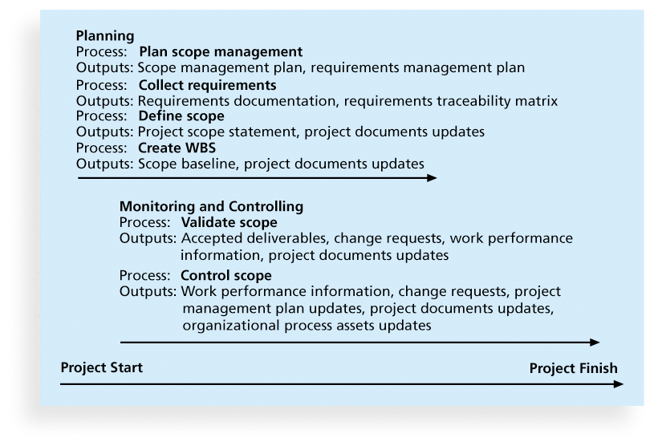
Figure 5-1. Project Scope Management Summary

Slide 8
Six Processes
Planning
Plan Scope Management
Collect Requirements
Define Scope
Create WBS
Monitoring and Controlling
Validate Scope
Control Scope

Slide 9
The Generic Process
Tools and Techniques
Inputs
Outputs
Process

Slide 10
Planning Scope Management
The project team uses expert judgment and meetings to develop two important outputs: the scope management plan and the requirements management plan.
The scope management plan is a subsidiary part of the project management plan.

Slide 11
Plan Scope Management Process
Tools and Techniques
Expert Judgment
Meetings
Plan Scope Management
Inputs
Outputs
Project Management Plan
Project Charter
Enterprise Environmental Factors
Organizational Process Assets
Scope Management Plan
Requirements Management Plan
Project Management Plan Updated

Slide 13
Inputs
Project Management Plan, PMP
Project Charter
Enterprise Environmental Factors, EEF
Organizational Process Assets, OPA
For planning processes, these inputs almost always appear, especially the one’s in red
When was the PMP (Project Management Plan) first addressed?

Slide 14
Planning Processes
Plan Scope Management
Plan Schedule (Time) Management
Plan Cost Management
Plan Quality Management
Plan Human Resource Management
Plan Communications Management
Plan Risk Management
Plan Procurement Management
Plan Stakeholder Management

Slide 15
Outputs
Scope Management Plan
Requirements Management Plan
Project Management Plan Updated

Slide 16
Scope Management Plan Contents
How the detailed project scope statement will be prepared
How the WBS will be created
How the WBS will be maintained and approved
How formal acceptance of the completed project deliverables will be handled
How requests for changes to the project scope will be handled

Slide 17
Requirements Management Plan
The PMBOK® Guide, Fifth Edition, describes requirements as “conditions or capabilities that must be met by the project or present in the product, service, or result to satisfy an agreement or other formally imposed specification”.
The requirements management plan documents how project requirements will be analyzed, documented, and managed.

Slide 18
Collecting Requirements Process
For some IT projects, it is helpful to divide requirements development into categories called elicitation, analysis, specification, and validation.
It is important to use an iterative approach to defining requirements since they are often unclear early in a project.

Slide 19
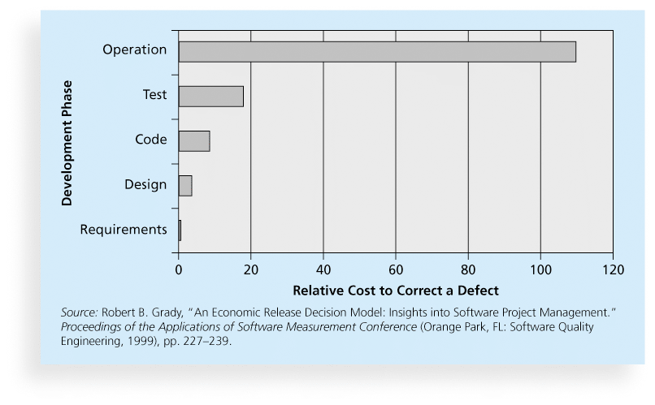
Figure 5-2. Relative Cost to Correct a Software Requirement Defect

Slide 20
Collect Requirements Process
Tools and Techniques
Interview Stakeholders
Focus groups
Facilitated workshops
Questionnaires
Surveys
Group Creativity Techniques
Group decision-making techniques
Prototypes
Benchmarking
Context diagrams
Document analysis
Inputs
Collect Requirements
Scope Management Plan
Requirements Management Plan
Stakeholder Management Plan
Project Charter
Stakeholder Register
Outputs
Requirements documentation
Requirements traceability matrix

Slide 23
Methods for Collecting Requirements (Tools and Techniques)
Interviewing
Focus groups and facilitated workshops
Using group creativity and decision-making techniques
Questionnaires and surveys
Observation
Prototyping
Benchmarking, or generating ideas by comparing specific project practices or product characteristics to those of other projects or products inside or outside the performing organization, can also be used to collect requirements.

Slide 24
Statistics on Requirements for Software Projects (2011 Survey)*
Eighty-eight percent of the software projects involved enhancing existing products instead of creating new ones.
Eighty-six percent of respondents said that customer satisfaction was the most important metric for measuring the success of development projects.
Eighty-three percent of software development teams still use Microsoft Office applications such as Word and Excel as their main tools to communicate requirements.
*John Simpson, “2011: The State of Requirements Management” (2011).

Slide 25
What Went Right?
Genesys Telecommunications Laboratories uses Accept software, a product planning and innovation management application and winner of the Excellence in Product Management Award from 2006–2008.
Accept helps them instill a consistent, repeatable, and predictable process for new product definition and development.
They can define what information comprises a requirement and enforce discipline around that process.

Slide 26
Requirements Traceability Matrix
A requirements traceability matrix (RTM) is a table that lists requirements, various attributes of each requirement, and the status of the requirements to ensure that all requirements are addressed.
Table 5-1. Sample entry in an RTM

Slide 27
Defining (Define) Scope
Project scope statements should include at least a product scope description, product user acceptance criteria, and detailed information on all project deliverables. It is also helpful to document other scope-related information, such as the project boundaries, constraints, and assumptions. The project scope statement should also reference supporting documents, such as product specifications.
As time progresses, the scope of a project should become more clear and specific.

Slide 28
Define Scope Process
Tools and Techniques
Expert Judgment
Product Analysis
Alternatives generation
Facilitated Workshops
Define Scope
Inputs
Outputs
Scope Management Plan
Project Charter
Requirements documentation
Organizational Process Assets
Project scope statement
Project documents Updates

Slide 30
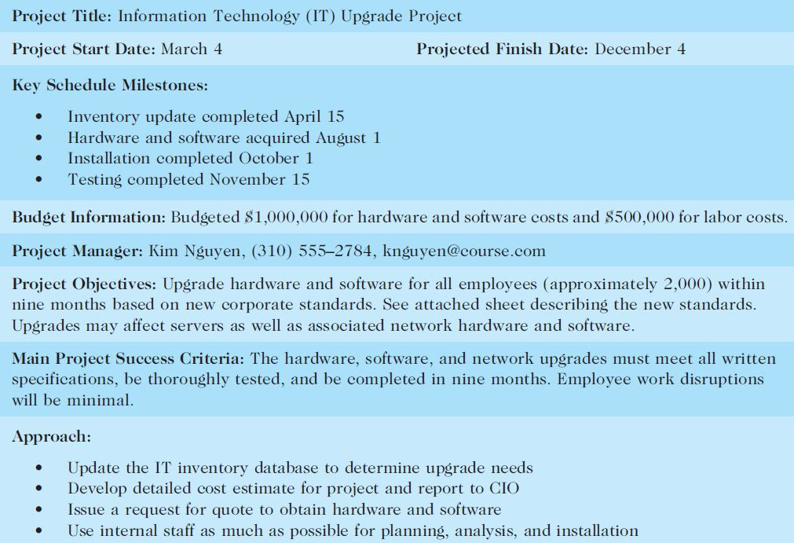
Table 5-2. Sample Project Charter (partial)

Slide 31
Table 5-3: Further Defining Project Scope

Slide 32
Media Snapshot
Many people enjoy watching television shows like Trading Spaces, where participants have two days and $1,000 to update a room in their neighbor’s house. Since the time and cost are set, it’s the scope that has the most flexibility.
Although most homeowners are very happy with work done on the show, some are obviously disappointed. Part of agreeing to be on the show includes signing a release statement acknowledging that you will accept whatever work has been done.
Too bad you can’t get sponsors for most projects to sign a similar release form. It would make project scope management much easier!

Slide 33
Creating the Work Breakdown Structure (WBS)
A WBS is a deliverable-oriented grouping of the work involved in a project that defines the total scope of the project.
WBS is a foundation document that provides the basis for planning and managing project schedules, costs, resources, and changes.
Decomposition is subdividing project deliverables into smaller pieces.
A work package is a task at the lowest level of the WBS.
The scope baseline includes the approved project scope statement and its associated WBS and WBS dictionary.

Slide 34
Create Work Breakdown Structure Process
Tools and Techniques
Decomposition
Expert Judgment
Create Work Breakdown Structure
Inputs
Outputs
Scope Management Plan
Project scope statement
Requirements documentation
Enterprise Environmental Factors
Organizational Process Assets
Scope baseline
Project Documents Updates

Slide 36
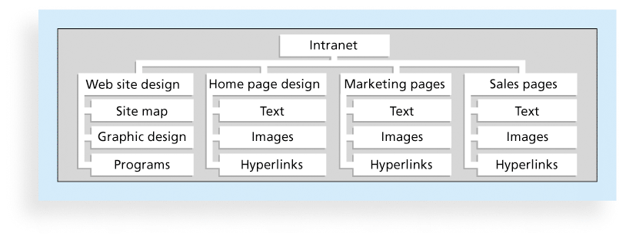
Figure 5-3. Sample Intranet WBS Organized by Product

Slide 37
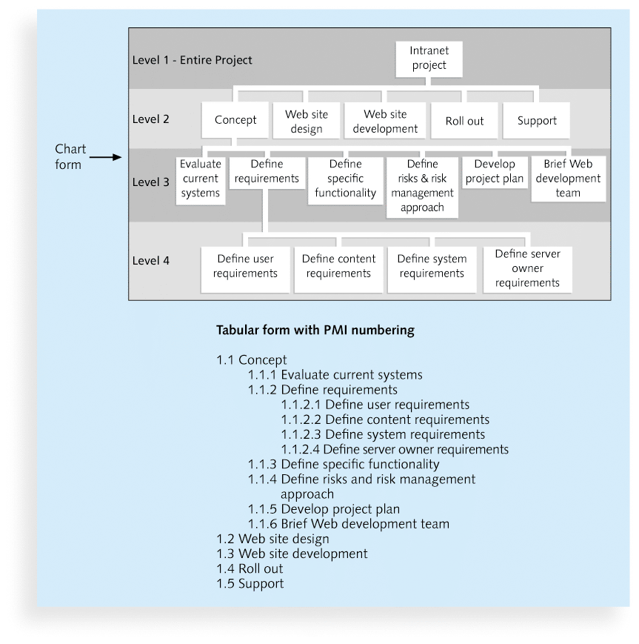
Figure 5-4. Sample Intranet WBS Organized by Phase

Slide 38
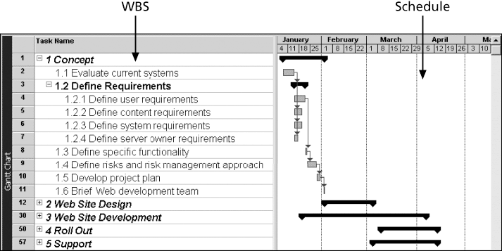
Figure 5-5. Intranet WBS and Gantt Chart in Microsoft Project

Slide 39
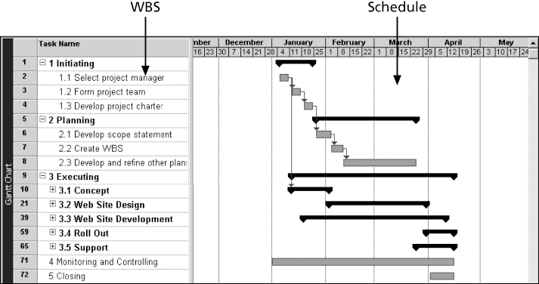
Figure 5-6. Intranet Gantt Chart Organized by Project Management Process Groups

Slide 40
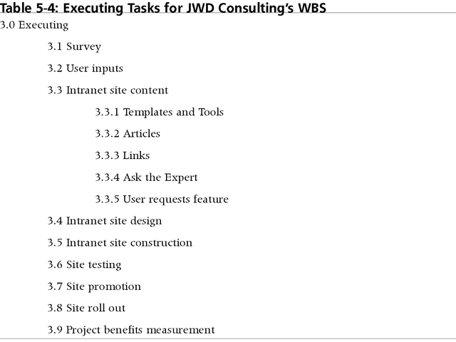
Table 5-4: Executing Tasks for JWD Consulting’s WBS

Slide 41
Approaches to Developing WBSs
Using guidelines: Some organizations, like the DOD, provide guidelines for preparing WBSs
The analogy approach: Review WBSs of similar projects and tailor to your project
The top-down approach: Start with the largest items of the project and break them down
The bottom-up approach: Start with the specific tasks and roll them up
Mind-mapping approach: Mind mapping is a technique that uses branches radiating out from a core idea to structure thoughts and ideas.

Slide 42
Figure 5-7. Sample Mind-Mapping Approach for Creating a WBS

Slide 43
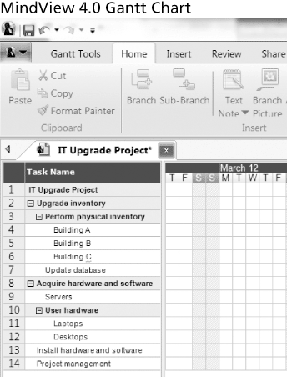
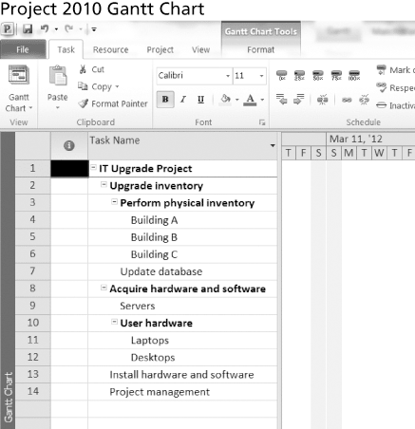
Figure 5-8. Gantt Charts With WBS Generated From a Mind Map

Slide 44
The WBS Dictionary and Scope Baseline
Many WBS tasks are vague and must be explained more so people know what to do and can estimate how long it will take and what it will cost to do the work.
A WBS dictionary is a document that describes detailed information about each WBS item.

Slide 45
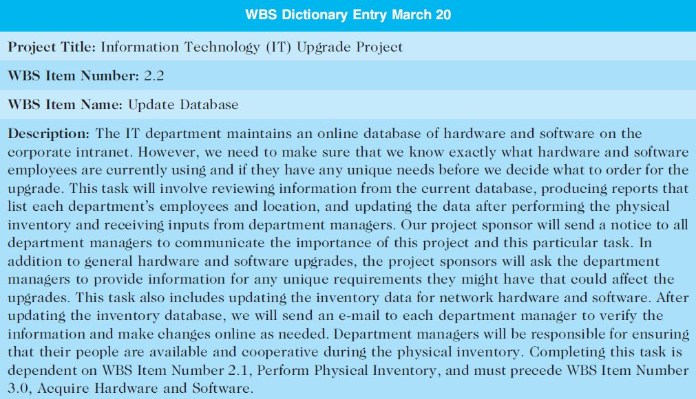
Table 5-5. Sample WBS Dictionary Entry

Slide 46
Advice for Creating a WBS and WBS Dictionary
A unit of work should appear at only one place in the WBS.
The work content of a WBS item is the sum of the WBS items below it.
A WBS item is the responsibility of only one individual, even though many people may be working on it.
The WBS must be consistent with the way in which work is actually going to be performed; it should serve the project team first, and other purposes only if practical.

Slide 47
Advice for Creating a WBS and WBS Dictionary (cont’d)
Project team members should be involved in developing the WBS to ensure consistency and buy-in.
Each WBS item must be documented in a WBS dictionary to ensure accurate understanding of the scope of work included and not included in that item.
The WBS must be a flexible tool to accommodate inevitable changes while properly maintaining control of the work content in the project according to the scope statement.

Slide 48
What Went Wrong?
A project scope that is too broad and grandiose can cause severe problems.
Scope creep and an overemphasis on technology for technology’s sake resulted in the bankruptcy of a large pharmaceutical firm, Texas-based FoxMeyer Drug.
In 2001, McDonald’s fast-food chain initiated a project to create an intranet that would connect its headquarters with all of its restaurants to provide detailed operational information in real time. After spending $170 million on consultants and initial implementation planning, McDonald’s realized that the project was too much to handle and terminated it.

Slide 49
Validating Scope
It is very difficult to create a good scope statement and WBS for a project.
It is even more difficult to verify project scope and minimize scope changes.
Scope validation involves formal acceptance of the completed project deliverables.
Acceptance is often achieved by a customer inspection and then sign-off on key deliverables.

Slide 50
Validate Scope Process
Tools and Techniques
Inspection
Group Decision-making techniques
Validate Scope
Inputs
Outputs
Project Management Plan
Requirements documentation
Requirements traceability matrix
Work performance data
Accepted deliverables
Change requests
Work performance information
Project documents updates

Slide 52
Global Issues
Many countries have had difficulties controlling the scope of large projects, especially those that involve advanced technologies and many different users.
For example, the state government of Victoria, Australia, has a Web site for its public .transportation smart card at www.myki.com.au.
There were many problems in developing and implementing the smart card.

Slide 53
Controlling Scope
Control Scope involves controlling changes to the project scope.
Goals of scope control are to
influence the factors that cause scope changes
assure changes are processed according to procedures developed as part of integrated change control, and
manage changes when they occur
Variance is the difference between planned and actual performance.

Slide 54
Control Scope Process
Tools and Techniques
Variance analysis
Control Scope
Inputs
Outputs
Project Management Plan
Requirements documentation
Requirements traceability matrix
Organizational Process Assets
Work performance information
Change requests
Project management plan updates
Project documents updates
Organizational process assets updates

Slide 56
Best Practices for Avoiding Scope Problems
1. Keep the scope realistic. Don’t make projects so large that they can’t be completed. Break large projects down into a series of smaller ones
2. Involve users in project scope management. Assign key users to the project team and give them ownership of requirements definition and scope verification
3. Use off-the-shelf hardware and software whenever possible. Many IT people enjoy using the latest and greatest technology, but business needs, not technology trends, must take priority
4. Follow good project management processes. As described in this chapter and others, there are well-defined processes for managing project scope and others aspects of projects

Slide 57
Suggestions for Improving User Input
Develop a good project selection process and insist that sponsors are from the user organization
Have users on the project team in important roles
Have regular meetings with defined agendas, and have users sign off on key deliverables presented at meetings
Deliver something to users and sponsors on a regular basis
Don’t promise to deliver when you know you can’t
Co-locate users with developers

Slide 58
Suggestions for Reducing Incomplete and Changing Requirements
Develop and follow a requirements management process
Use techniques such as prototyping, use case modeling, and JAD to get more user involvement
Put requirements in writing and keep them current
Create a requirements management database for documenting and controlling requirements

Slide 59
Suggestions for Reducing Incomplete and Changing Requirements (cont’d)
Provide adequate testing and conduct testing throughout the project life cycle
Review changes from a systems perspective
Emphasize completion dates to help focus on what’s most important
Allocate resources specifically for handling change requests/enhancements like NWA did with ResNet

Slide 60
Using Software to Assist in Project Scope Management
Word-processing software helps create several scope-related documents.
Spreadsheets help to perform financial calculations, weighed scoring models, and develop charts and graphs.
Communication software like e-mail and the Web help clarify and communicate scope information.
Project management software helps in creating a WBS, the basis for tasks on a Gantt chart.
Specialized software is available to assist in project scope management.

Slide 61
Chapter Summary
Project scope management includes the processes required to ensure that the project addresses all the work required, and only the work required, to complete the project successfully.
Main processes include
Define scope management
Collect requirements
Define scope
Create WBS
Validate scope
Control scope

