Slide 1
Chapter 12: Project Procurement Management
Information Technology Project Management, Seventh Edition
Note: See the text itself for full citations.

Slide 2
Recitation over Risk, Ch. 11
A person who is risk-________ receives greater satisfaction when more payoff is at stake and is willing to pay a penalty to take risks. (averse, seeking, neutral, aware)
Which risk management process involves prioritizing risks based on their probability and impact of occurrence? (plan risk management, identify risks, perform qualitative risk analysis, perform quantitative risk analysis)

Slide 3
Recitation—Soft Competencies
Communication
Problem solving
Team work
Listening
Ability to adapt to new technologies and languages
Time management
Ability to transfer requirements to the app
Multitasking
Verbal communication
Ability to visualize and conceptualize

Slide 4
Recitation over Risk, Ch. 11
Your project involves using a new release of a common software application, but if that release is not available, your team has ________ plans to use the current release. (contingency, fallback, reserve, mitigation)
Which risk identification tools involves deriving a consensus among a panel of experts by using anonymous input regarding future events? (risk breakdown structure, brainstorming, interviewing, Delphi technique)

Slide 5
Recitation over Risk, Ch 11
A risk ________ is a document that contains results of various risk management processes, and is often displayed in a table or spreadsheet format. (management plan, register, breakdown structure, probability/impact matrix)
_________ are indicators or symptoms of actual risk events, such as a cost overrun on early activities being a symptom activities of poor cost estimates. (Probabilities, Impacts, Watch list items, Triggers)

Slide 6
Recitation on Risk, Ch. 11
Suppose there is a 30 percent chance that you will lose $10,000 and a 70 percent chance that you will earn $100,000 on a particular project. What is the project’s EMV (Expected Monetary Value)? (-$30,000; $70,000; $100,000; $67,000; -$70,000 or none of these)

Slide 7
Recitation—Name four risk responses for negative risks
Risk avoidance
Just use the old system; don’t do anything
Risk acceptance
Have a backup or contingency plan
Risk transference
Purchase insurance or a warranty
Risk mitigation
Reduce the impact or the probability of occurrence

Slide 8
Recitation—Name four risk responses for positive risks
Risk exploitation
Focus on the upside potential
Risk sharing
Find a partner to share with
Risk enhancement
Increase the upside potential
Risk acceptance
Run with the risk

Slide 9
Learning Objectives
Understand the importance of project procurement management and the increasing use of outsourcing for information technology (IT) projects
Describe the work involved in planning procurements for projects, including determining the proper type of contract to use and preparing a procurement management plan, statement of work, source selection criteria, and make-or-buy analysis
Discuss how to conduct procurements and strategies for obtaining seller responses, selecting sellers, and awarding contracts

Slide 10
Learning Objectives (cont’d)
Understand the process of controlling procurements by managing procurement relationships and monitoring contract performance
Describe the process of closing procurements
Discuss types of software that are available to assist in project procurement management

Slide 11
Importance of Project Procurement Management
Procurement means acquiring goods and/or services from an outside source.
Other terms include purchasing and outsourcing
Experts predict that global spending on computer software and services will continue to grow.
People continue to debate whether offshore outsourcing helps their own country or not.

Slide 12
Debates on Outsourcing
Some companies, such as Wal-Mart, prefer to do no outsourcing at all, while others do a lot of outsourcing. GM recently announced plans to switch from outsourcing 90% of IT service to only 10%.
Most organizations do some form of outsourcing to meet their IT needs and spend most money within their own country.
The U.S. temporary workforce continues to grow as people work for temporary job agencies so they can more easily move from company to company.

Slide 13
Your Federal Gov and its deficits
It runs a budget deficit of nearly a trillion $ a year
$1 trillion = $1000 billion
As a country we run a trade deficit of $750 billion a year
What is the relationship between the budget deficit and the national debt?
Our national debt is nearly $20 trillion
WHAT CAN THE FEDERAL GOVERNMENT do?

Slide 14
Here is what the Federal Gov. can do?
Pro-actively create jobs in this country
By renegotiating trade agreements
Discourage off-shoring of jobs/encourage those offshore jobs to come back
Making sure no trading partner is ‘cheating’
Developing its own resources on federally owned lands—uranium, oil, lumber, etc.
Put our trading partners on notice—we expect balanced trade
Repatriate 4 trillion dollars of private sector capital held overseas by not taxing it
So companies can invest their capital here and create jobs

Slide 15
IT Outsourcing Market Continues to Grow
U.S. companies are transferring more work abroad, especially in the areas of IT infrastructure, application development and maintenance, and innovation processes.
India, China, and the Philippines are the preferred locations for outsourcing, and Latin America is growing in popularity.
A shortage of qualified personnel, not cost savings, is the top reason for global outsourcing of IT services.

Slide 16
Why Outsource?
To access skills and technologies
To reduce both fixed and recurrent costs
To allow the client organization to focus on its core business
To provide flexibility
To increase accountability
Notes:
Do we have the resources in-house, do we have the capacity in-house, is there someone outd ltdhere who can do the project better, faster, cheaper than we can??

Slide 17
Why not outsource?
The work relates to a core competence, which is a way the firm maintains a competitive advantage in its marketplace—don’t outsource this
Apple uses its own proprietary microprocessor in its iphones—it does not use Samsung for this although it does use Samsung for DRAMs, SRAMs, etc. This is so even though Samsung is a major competitor
Apple uses a different vendor for its lithium-ion battery
Hang on to your core competencies—the stuff that gives you an edge over your competition
This is your ‘secret sauce’

Slide 18
Buyer vs. Seller
Buyer is the firm doing the procuring
The company that has decided to outsource some of its work
Seller is…
Supplier
Contractor
The firm to whom work has been outsourced

Slide 19
Outsourcing vs. Offshoring
Offshoring may not be outsourcing—if the job stays within the company
Example: BP taking jobs from Tulsa to Argentina, but still jobs within BP
Outsourcing may not be offshoring
Example: Onshore Technology Services recruits workers from low income rural America and trains them to do high-value IT specialties
The US has some 40 million people who are out of work ages 25 to 64
This is depression era percentages – 25% to 28%
When a high-value technology job goes off-shore, our country loses—there is erosion of the tax base-resulting in larger deficits and more national debt

Slide 20
Contracts
A contract is a mutually binding agreement that obligates the seller to provide the specified products or services and obligates the buyer to pay for them.
Contracts can clarify responsibilities and sharpen focus on key deliverables of a project.
Because contracts are legally binding, there is more accountability for delivering the work as stated in the contract.
A recent trend in outsourcing is the increasing size of contracts.
Notes:
Schwalbe talks about a project for which she served as project manager in which the contractor delivered their hardware LATE. She read over the contract with the contractor to see if there was any way to get leverage to prevent this from happening…There was none…even though the contract was approved by the firm’s legal department. THERE WEE NO INCENTIVES FOR FINISHING THEIR PART ON OR AHEAD OF TIME!!

Slide 21
What Went Wrong?
In 2011, New York City’s mayor, Michael Bloomberg, acknowledged that City Hall had mismanaged its major IT projects and vowed to improve their oversight
For example, prosecutors said the $700 million price tag for the CityTime payroll system was inflated by fraud, and the mayor demanded $600 million back from the main contractor
The automated personnel system, Nycaps, suffered significant delays and cost overruns due to leadership issues, increasing from an original estimate of $66 million to over $363 million

Slide 22
Project Procurement Management Processes
Project procurement management: Acquiring goods and services for a project from outside the performing organization
Processes include:
Plan procurement management: Determining what to procure and when and how to do it
Conduct procurements: Obtaining seller responses, selecting sellers, and awarding contracts
Control procurements: Managing relationships with sellers, monitoring contract performance, and making changes as needed
Close procurements: Completing and settling each contract or agreement, including resolving of any open items

Slide 23
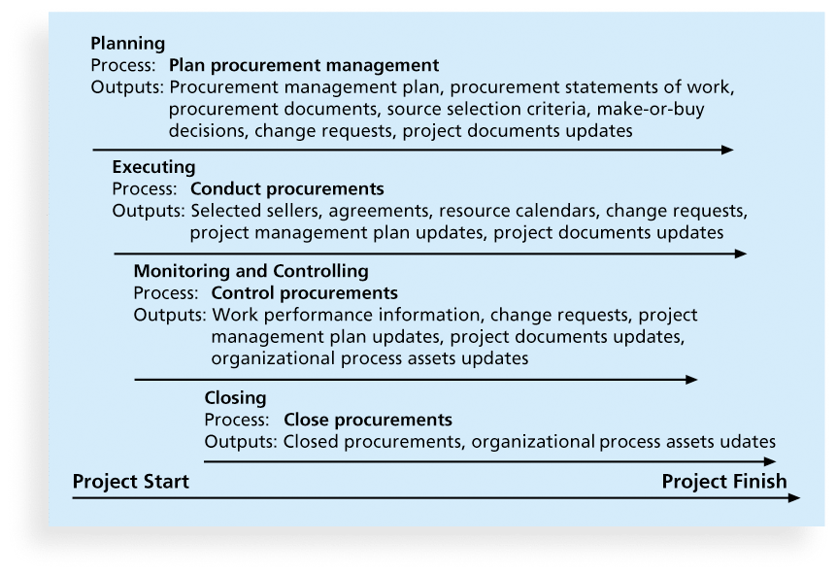
Figure 12-1. Project Procurement Management Summary

Slide 24
Plan Procurement Management
Identifying which project needs can best be met by using products or services outside the organization
If there is no need to buy any products or services from outside the organization, then there is no need to perform any of the other procurement management processes.

Slide 25
What Went Right?
Several organizations, such as The Boots Company PLC in England, outsource their IT services to save money compared with the cost of running the systems themselves.
Carefully planning procurement can also save millions of dollars, as the U.S. Air Force did by using a unit pricing strategy for a large office automation project.

Slide 26
Types of Contracts
Different types of contracts can be used in different situations:
Fixed price or lump sum contracts: Involve a fixed total price for a well-defined product or service
Cost reimbursable contracts: Involve payment to the seller for direct and indirect costs
Time and material contracts: Hybrid of both fixed price and cost reimbursable contracts, often used by consultants
Unit price contracts: Require the buyer to pay the seller a predetermined amount per unit of service
A single contract can actually include all four of these categories, if it makes sense for that particular procurement.

Slide 27
Point of Total Assumption
The Point of Total Assumption (PTA) is the cost at which the contractor assumes total responsibility for each additional dollar of contract cost.
Contractors (Sellers) do not want to reach the point of total assumption, because it hurts them financially, so they have an incentive to prevent cost overruns.
The PTA is calculated with the following formula:
PTA = (ceiling price – target price)/government share + target cost

Slide 28
Cost Reimbursable Contracts
Cost plus incentive fee (CPIF): The buyer pays the supplier for allowable performance costs plus a predetermined fee and an incentive bonus.
Cost plus fixed fee (CPFF): The buyer pays the supplier for allowable performance costs plus a fixed fee payment usually based on a percentage of estimated costs.
Cost plus percentage of costs (CPPC): The buyer pays the supplier for allowable performance costs plus a predetermined percentage based on total costs.
Notes:
In cost reimbursable contracts, the seller gets paid for all direct and indirect costs incurred. The first type of contract is like going out for dinner. You pay the basic price plus a tip that considers the quality of
the food, the service and the overall experience itself.
The US Federal Gov will not do the latter type of contract because there is every incentive to run the project as long as possible.

Slide 29
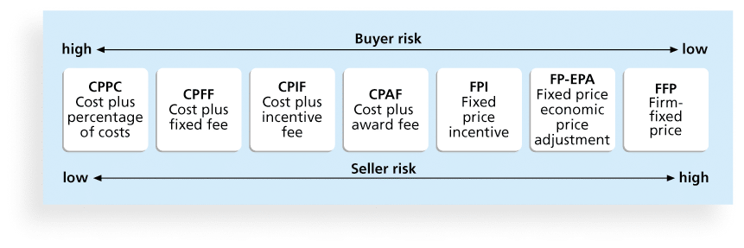
Figure 12-2. Contract Types Versus Risk

Slide 30
Media Snapshot
Contract incentives can be extremely effective. On August 1, 2007, tragedy struck Minneapolis, Minnesota, when a bridge on I-35W collapsed, killing 13 motorists, injuring 150 people, and leaving a mass of concrete and steel in the river and on its banks.
Peter Sanderson, project manager for the joint venture of Flatiron-Manson led his team in completing the project. The contractors earned $25 million in incentive fees on top of their $234 million contract for completing the bridge three months ahead of schedule.
MnDOT justified the incentive payment by saying that each day the bridge was closed it cost road users more than $400,000.

Slide 31
Contract Clauses
Contracts should include specific clauses to take into account issues unique to the project.
Can require various educational or work experience for different pay rights
A termination clause is a contract clause that allows the buyer or supplier (seller) to end the contract.

Slide 32
Tools and Techniques for Planning Purchases and Acquisitions
Expert judgment
Market research
Make-or-buy analysis: General management technique used to determine whether an organization should make or perform a particular product or service inside the organization or buy from someone else
Do we have the resources in-house, do we have the capacity in-house, is there someone out there who can do the project better, faster, cheaper than we can??
Notes:
Do we have the resources in-house, do we have the capacity in-house, is there someone out there who can do the project better, faster, cheaper than we can??

Slide 33
Make-or-Buy Example
Assume you can lease an item you need for a project for $800/day. To purchase the item, the cost is $12,000 plus a daily operational cost of $400/day.
How long will it take (in days) for the purchase cost to be the same as the lease cost?

Slide 34
Make-or Buy Solution
Set up an equation so both options, purchase and lease, are equal
In this example, use the following equation. Let d be the number of days to use the item:
$12,000 + $400d = $800d
Subtracting $400d from both sides, you get:
$12,000 = $400d
Dividing both sides by $400, you get:
d = 30
If you need the item for more than 30 days, it is more economical to purchase it.

Slide 35
Procurement Management Plan
Describes how the procurement processes will be managed, from developing documentation for making outside purchases or acquisitions to contract closure
Contents vary based on project needs.

Slide 36
Contract Statement of Work (SOW)
A statement of work is a description of the work required for the procurement.
If a SOW is used as part of a contract to describe only the work required for that particular contract, it is called a contract statement of work.
A SOW is a type of scope statement.
A good SOW gives bidders a better understanding of the buyer’s expectations.

Slide 37
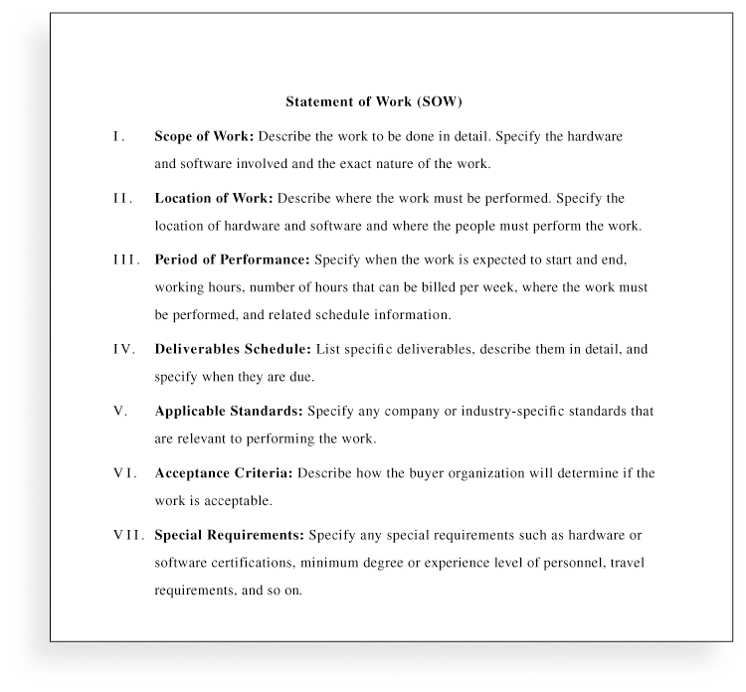
Figure 12-3. Statement of Work (SOW) Template

Slide 38
Procurement Documents
Request for Proposals: Used to solicit proposals from prospective sellers
A proposal is a document prepared by a seller when there are different approaches for meeting buyer needs.
Requests for Quotes: Used to solicit quotes or bids from prospective suppliers
A bid, also called a tender or quote (short for quotation), is a document prepared by sellers providing pricing for standard items that have been clearly defined by the buyer .

Slide 39
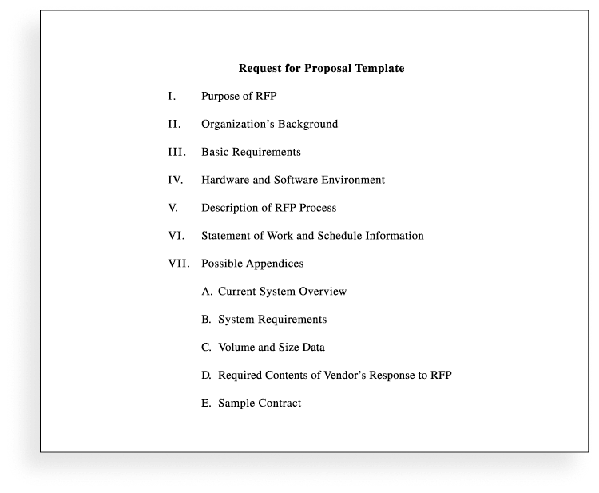
Figure 12-4. Request for Proposal (RFP) Template

Slide 40
Source Selection Criteria
It’s important to prepare some form of evaluation criteria, preferably before issuing a formal RFP or RFQ.
Beware of proposals that look good on paper; be sure to evaluate factors, such as past performance and management approach
Can require a technical presentation as part of a proposal

Slide 41
Conducting Procurements
Deciding whom to ask to do the work
Sending appropriate documentation to potential
sellers
Obtaining proposals or bids
Selecting a seller based on his proposal or bid
Awarding a contract

Slide 42
Approaches for Procurement
Organizations can advertise to procure goods and services in several ways:
Approaching the preferred vendor
Approaching several potential vendors
Advertising to anyone interested
A bidders’ conference can help clarify the buyer’s expectations.

Slide 43
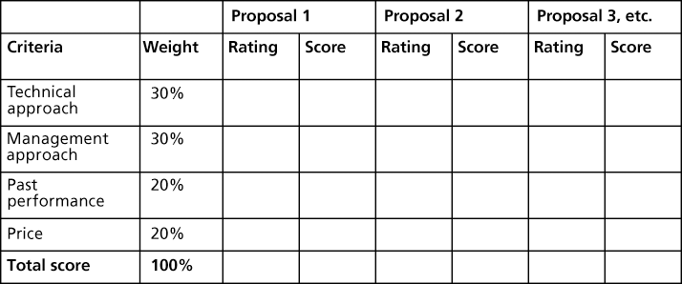
Figure 12-5. Sample Proposal Evaluation Sheet

Slide 44
Seller Selection
Organizations often do an initial evaluation of all proposals and bids and then develop a short list of potential sellers for further evaluation.
Sellers on the short list often prepare a best and final offer (BAFO).
Final output is a contract signed by the buyer and the selected seller.

Slide 45
Controlling Procurements
Ensures that the seller’s performance meets contractual requirements
Contracts are legal relationships, so it is important that legal and contracting professionals be involved in writing and administering contracts
It is critical that project managers and team members watch for constructive change orders, which are oral or written acts or omissions by someone with actual or apparent authority that can be construed to have the same effect as a written change order.
Notes:
Ya gotta get the lawyers involved….

Slide 46
Global Issues
A recent trend is to hire people in rural areas of the same country to perform work, often at less cost. Rural sourcing uses two simple premises: Smaller towns need jobs, and workers there often charge 25 to 50 percent less than their urban counterparts.
Onshore Technology Services recruits workers from low-paying jobs and gives them intensive training in IT specialties. The company employs 65 people in IT centers in the rural Missouri towns of Macon, Lebanon, and Joplin
CrossUSA recruits older IT workers who are nearing retirement and want to enjoy a small-town quality of life. The company has 100 employees in Sebeka, Minnesota (population 700) and Eveleth, Minnesota (population 3,000)

Slide 47
Suggestions for Change Control in Contracts
Changes to any part of the project need to be reviewed, approved, and documented by the same people in the same way that the original part of the plan was approved.
Evaluation of any change should include an impact analysis. How will the change affect the scope, time, cost, and quality of the goods or services being provided?
Changes must be documented in writing. Project team members should also document all important meetings and telephone phone calls.

Slide 48
Suggestions for Change Control in Contracts (cont’d)
Project managers and teams should stay closely involved to make sure the new system will meet business needs and work in an operational environment.
Have backup plans
Use tools and techniques, such as a contract change control system, buyer-conducted performance reviews, inspections and audits, and so on

Slide 49
Best Practice
Accenture developed a list of best practices from experienced outsourcers throughout the world:
Build in Broad Business Outcomes Early and Often
Hire a Partner, Not Just a Provider
It’s More Than a Contract, It’s a Business Relationship
Leverage Gain-Sharing
Use Active Governance
Assign a Dedicated Executive
Focus Relentlessly on Primary Objectives

Slide 50
Closing Procurements
Involves completing and settling contracts and resolving any open items
The project team should:
Determine if all work was completed correctly and satisfactorily
Update records to reflect final results
Archive information for future use
The contract itself should include requirements for formal acceptance and closure.

Slide 51
Tools to Assist in Contract Closure
Procurement audits identify lessons learned in the procurement process.
Negotiated settlements help close contracts more smoothly.
A records management system provides the ability to easily organize, find, and archive procurement-related documents.

Slide 52
Using Software to Assist in Project Procurement Management
Word processing software helps write proposals and contracts, spreadsheets help evaluate suppliers, databases help track suppliers, and presentation software helps present procurement-related information.
E-procurement software does many procurement functions electronically.
Organizations also use other Internet tools to find information on suppliers or auction goods and services.

Slide 53
Chapter Summary
Project procurement management involves acquiring goods and services for a project from outside the performing organization
Processes include:
Plan procurement management
Conduct procurements
Control procurements
Close procurements

