Slide 1
Review for Final in ISQS 4350
Final will take place:
OO1: Thursday, May 11, 2017, 7.30-10.00 a.m., this room
003: Monday, May 15, 2017, 7.30-10.00 a.m., this room
002: Tuesday, May 16, 2017, 1.30-4.00 p.m., this room

Slide 2
Format
Up to 100 multiple choice worth 60%
3 discussion problems worth 40%
Exam is closed notes/closed book
Exam will be comprehensive
60% of the exam will cover material since Exam 2

Slide 3
Bring
Pencils
Calculator
Orange Scantron sheet

Slide 4
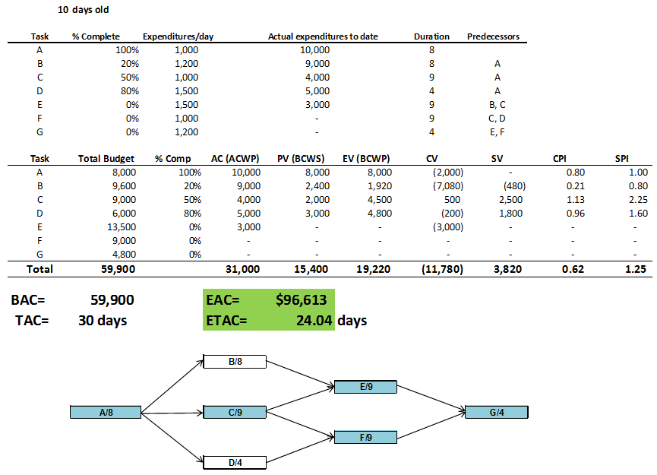
Problem 12-13

Slide 5
Conclusion to B: Problem 12-13
The project appears to be over budget but ahead of schedule based on the EVA analysis. When examining the Critical Path, we see the project is indeed ahead of schedule because critical task C is performing well in terms of cost and schedule. In this case the two criteria are consistent.

Slide 6
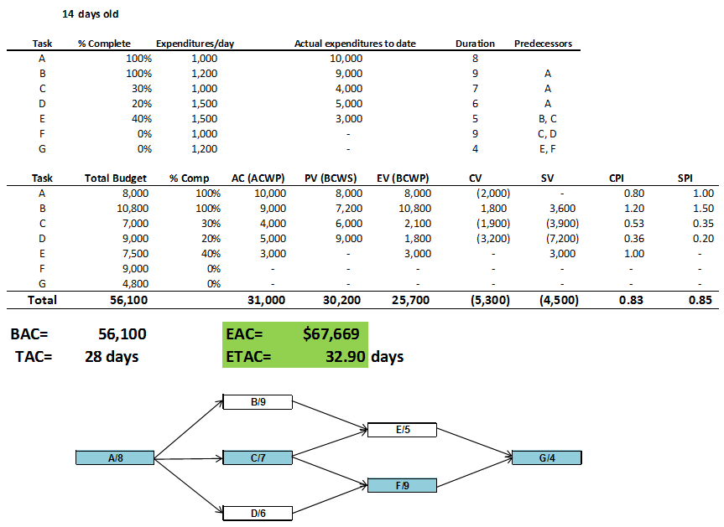
Problem 12-19

Slide 7
Conclusion to B: Problem 12-19
From the EVA, the project appears to be behind schedule and over budget. When we examine the Critical Path, we see the project is indeed behind schedule because critical task C is behind schedule and over budget. In this case the two criteria (EVA and critical path) are consistent.

Slide 8
Possible Discussion Questions
Name five characteristics of a project
Successful project management entails what exactly
Name five phases of the project lifecycle
Show their sequence
Why is project management important
Name four core knowledge areas
Name five facilitating knowledge areas

Slide 9
More Discussion Questions
What is the tenth knowledge area and what is its purpose
Name some things we do poorly in projects
What term do we use to describe an event at which a major deliverable is completed?
What device or construct is often used to initiate a project?
What steps are used to launch critical chain project management?

Slide 10
More Discussion Questions
Name five or more ways to finish projects fast and frugal
Name three or more ways to motivate project players
Name some things you should not do to motivate project players
Draw Maslow’s needs hierarchy showing the names of all five levels
List Covey’s SEVEN habits

Slide 11
Typical Discussion Problems
Construct an activity on node network chart from a table; Determine duration, ES, EF, LS, LF and mark the critical path
Perform earned value analysis: BCWP, BCWS, ACWP, CV, SV, EV, PV, AC, CI, SI
Perform crashing of networks
What are the five phases that make up the CMMI?
Illustrate the tradeoff triangle
Assuming that half the durations are safety, redraw a project network showing all feeding and project buffers and their lengths

Slide 12
Multiple Choice
Chapters 9-12 of Schwalbe
Not chapter 13 of Schwalbe
Look at the MC at the end of chs 9-12
Chapter 12 of Burns
Process maturity slides
Finishing projects fast slides
Critical chain concepts

Slide 13
Why has Project Management become so in-vogue?
Diversity of new products and product markets
Shorter life span of products
Rapid technological changes

Slide 14
Principles for Project Managers
The principle of Vision: In Proverbs—without vision, the people perish—I teach the importance of having a strong, compelling, galvanizing personal vision for projects, people
The principle of Work: People need work in order to be self-actualized, in order to have self-esteem—jobs and work have to be among our highest priorities as company, a community and country
The principle of Productivity: We want to be effective, not just efficient—so when are we productive? When we are working toward accomplishment of that vision. Good things take resources away from the best thing we could do.

Slide 15
More Principles
The principle of Trust: Stephen Covey tells us that to have trust, there has to be trustworthiness—and to have trustworthiness, there has to be competence and character
The principle of Love: Covey points out how important love is in leadership of projects. And along with love comes encouragement, forgiveness, faith, hope.
The principle of Living for the Good of (Service to) Others—that’s what we do in projects

Slide 16
More Principles
The principle of Empowerment: Empowerment means delegation with detachment. To do that you have to have alignment and trust.
The principle of Alignment: Your team has to have buy-in to the vision for the project—conformance to the vision—team members must align themselves with that vision
The principle of Focus: Once your task begins, drop everything and do nothing but your task until it is done—Goldratt—150% focus—no multitasking, no procrastination
The principle of Learning: The only sustainable advantage is the rate at which teams and organizations learn.
The principle of Excellent Soft Competencies.

Slide 17
Names five principles for project management
Vision
Work
Productivity
Trust
Empowerment
Alignment
Learning
Focus
Maturity
Living for the good of others

Slide 18
What are the major reasons for project failure?
Inadequate conceptualization and definition
Specifically, inadequate requirements
Absence of a plan
Unavailable resources when needed
Scope and hope creep
Unresponsive contractors who deliver their product late

Slide 19
The Project Management Life Cycle: PMBOK
Progressive Elaboration
Notes:
The is the intent of Senge’s Personal Mastery….you set a direction for your career, your life, you plan steps to take you toward that goal, and you execute on some of those steps. Then you refine and clarify that vision a bit, re-plan and execute, with the result that you are now closer to your goal, even though the goal or vision may have moved a bit.

Slide 20
In which of the phases is a WBS started and completed?
Planning

Slide 21
In which of these phases is a project charter developed?
Initiating

Slide 22
In which of these phases are requirements determined?
Planning

Slide 23
What are the ten knowledge areas?
Scope management
Time management
Cost management
Quality management
Integration management
Risk management
Procurement management
Human resource management
Communications management
Stakeholder management

Slide 24
In which phase is scope management most important?
The second phase: Planning

Slide 25
Competencies of the IT Project Manager
Coach
Mentor
Leader
Negotiator
Assessor
Encourager
A positive ‘can do’ person
Able to handle stress
Informer/communicator
Motivator
Delegator
Visionary
A good listener, after Covey
An ability to develop people
Interpersonal competencies
Time management skills
Builds trust and confidence

Slide 26
Capability Maturity Model
At which level is the extensive training and instruction performed?
Level 3 — normally called the defined level
At which level do we measure time (schedule) and cost?
Level 2 — Managed
At which level do we measure productivity and quality?
Level 4 — Quantitatively Managed

Slide 27
Five Levels

Slide 28
CMMI Staged Representation - 5 Maturity Levels
Level 5
Process performance continually improved through incremental and innovative technological improvements.
Optimizing
Level 4
Quantitatively
Managed
Processes are controlled using statistical and other quantitative techniques.
Process Maturity
Level 3
Defined
Processes are well characterized and understood. Processes, standards, procedures, tools, etc. are defined at the organizational (Organization X ) level. Proactive.
Level 2
Managed
Processes are planned, documented, performed, monitored, and controlled at the project level. Often reactive.
Level 1
Initial
Processes are unpredictable, poorly controlled, reactive.

Slide 29
How long does it take to go from one level to the next?
One year, normally
As determined by an external appraiser

Slide 30
How does maturity help with estimation?
Estimates of cost and duration are determined in part by a history database

Slide 31
How does maturity help with quality issues (defects)?
A standardized, documented process is used
Defect (quality) databases and productivity databases are populated

Slide 32
How are processes improved, innovated with maturity concepts?
The fifth and final phase of any maturity model is OPTIMIZING in which Deming’s PDCA wheel is used in conjunction with Senge’s learning concepts
Optimization!!

Slide 33
Product Life Cycles: PMBOK
Products also have life cycles
The Systems Development Life Cycle (SDLC) is a framework for describing the phases involved in developing and maintaining information systems
Systems development projects can follow
Predictive life cycle: the scope of the project can be clearly articulated, is static and stable, and the schedule and cost can be predicted
Adaptive Software Development (ASD) life cycle: requirements cannot be clearly expressed, projects are mission driven and component based, using time-based cycles to meet target dates

Slide 34
Predictive vs. Adaptive or Agile
Predictive
Adaptive
High discipline
High levels of documentation
Project durations and budgets are more predictable
Great for projects in which requirements are static and stable
Users first experience with the product is after it is entirely completed—usually months after project start
Less dependence on discipline and documentation
Iterative, time-boxed development
Users receive the product incrementally, one piece at a time
User feedback is early and often
Works well when requirements are unknown or unstable
Unknown and unstable requirements
Static and stable requirements

Slide 35
Predictive Life Cycle Models
Waterfall model: has well-defined, linear stages of systems development and support
Spiral model: shows that software is developed using an iterative or spiral approach rather than a linear approach
Incremental build model: provides for progressive development of operational software
Prototyping model: used for developing prototypes to clarify user requirements
Rapid Application Development (RAD) model: used to produce systems quickly without sacrificing quality using time-boxes

Slide 36
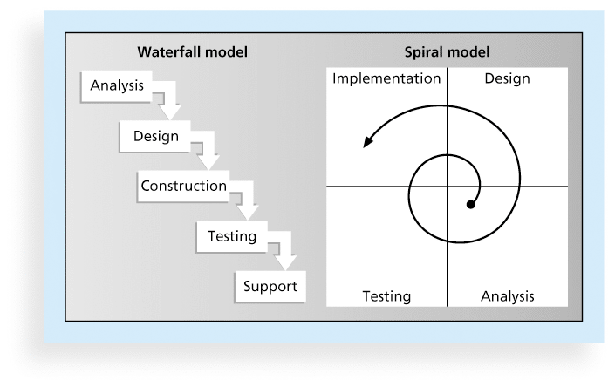
Waterfall and Spiral Life Cycle Models

Slide 37
Agile Software Development
Is an Adaptive Lifecycle approach
Is a time-boxed approach, usually
Agile software development has become popular to describe new approaches that focus on close collaboration between programming teams and business experts
Includes Scrum, Extreme programming and RUP

Slide 38
Agile Manifesto
We are uncovering better ways of developing software by doing it and helping others do it. Through this work we have come to value:
Individuals and interactions over processes and tools
Working software over comprehensive documentation
Customer collaboration over contract negotiation
Responding to change over following a plan
That is, while there is value in the items on the right, we value the items on the left more.

Slide 39
Scrum
According to the Scrum Alliance, Scrum is the leading agile development method for completing projects with a complex, innovative scope of work.
The term was coined in 1986 in a Harvard Business Review study that compared high-performing, cross-functional teams to the scrum formation used by rugby teams.

Slide 40
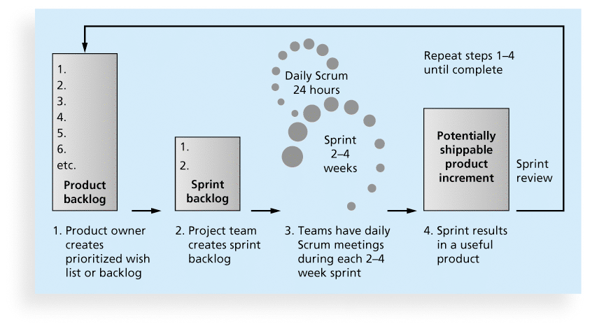
Scrum Framework

Slide 41
Activity Definition (Define Activities) is ___
a subproject
a process
a problem
a plan
WHICH???

Slide 42
Activity Definition (Define Activities) is part of what knowledge area?
Time management

Slide 43
Project Scope Management Processes
Plan Scope Management
Collect Requirements
Define Scope
Create WBS
Verify Scope
Control Scope

Slide 44
Project Time Management Processes
Plan Schedule Management
Define Activities
Sequence Activities
Estimate Activity Resources
Estimate Activity Durations
Develop Schedule
Control Schedule

Slide 45
Project Cost Management Processes
Plan Cost Management
Estimate Costs
Determine Budget
Control Costs

Slide 46
Project Quality Management Processes
Plan Quality Management
Perform Quality Assurance
Control Quality

Slide 47
Models are used in decision making…
Never
Sometimes
Frequently
Always
Always, B/C a mental
model is always used

Slide 48
The main purpose of a project plan is to ____
acquire resources
guide project execution
meet standards expectations
reduce risk
guide project execution

Slide 49
The most important output of project execution is
Not—change requests
Not—the WBS
Not—project plan
Not—requirements doc
Work Products and
The Final Project Deliverable

Slide 50
The Concept…
That work tends to fill up the time allotted for it is known as…..
Parkinson's Law

Slide 51
Most core knowledge areas have a
Planning process
And a
Controlling process

Slide 52
During the …
Planning phase, it is important that the project manager get
Consensus and Cohesion
Amongst the Stakeholders

Slide 53
Which of the following is NOT a way to motivate people?
Compelling vision of where the project is going
Treat people with respect, dignity
Appreciate, value people by making them feel important, being interested in them
Know what their “hot button” is
All of the above are ways to motivate people

Slide 54
What are the five steps of the Theory of Constraints (Goldratt)?
IDENTIFY the project constraint
Decide how to EXPLOITE that constraint
SUBORDINATE everything to that decision
ELEVATE the system’s constraint
Go back to step a

Slide 55
NOT…
SUBORDINATE that decision to everything else

Slide 56
According to Goldratt…
Team players put too much ____ into their estimated durations
Safety

Slide 57
As Goldratt sees it, ….
The ultimate constraint in projects is….
Critical Chain

Slide 58
Which of the following does Goldratt regard as a positive thing
Safety
Multitasking
Student syndrome
Win/lose contracting
None of the above

Slide 59
An activity has probabilistic completion times of 20, 50 and 80 for the optimistic, most likely and pessimistic durations.
What is the average time (duration) assuming a beta distribution?
30
40
50
60
70

Slide 60
You should know
How to construct a NETWORK chart from a table
How to construct a Gantt chart from a table
How to perform NETWORK crashing
How to do EVA

Slide 61
A work package…
Has $100,000 budgeted for it
Is 50% complete
What is its BCWP (EV)?
$30,000
$40,000
$50,000
$60,000

Slide 62
A task with a $10,000 budget has a start date in the future
Its BCWS (PV) is
$0
$5,000
$10,000
Can’t be determined

Slide 63
A task with a $10,000 budget has a stop date in the past.
Its BCWS (PV) is
$0
$5,000
$10,000
Can’t be determined

Slide 64
A task with a $10,000 budget and a 6 day duration has just finished day 3
Its BCWS is
$0
$5,000
$10,000
Can’t be determined

Slide 65
A task has a budget of $20,000 and a scheduled duration of 5 days
What is its daily burn rate?
If the project is 20% complete what is its BCWP?
If day three has just transpired, what is the BCWS?
What is the task’s SV (schedule variance)
Is the task ahead or behind schedule?

Slide 66
Questions about MS Project
Which key for subordination
Which key for linking
How to see total project duration and cost on the entry table
How to view project duration and cost on the project information dialog box
How to see all of the activity costs

Slide 67
For MS Project to cost your project, it needs to know
Resource hourly costs
Activity fixed costs
THIS IS ALL

Slide 68
In MS Project, durations/costs of phases (summary tasks) …..
Containing one or more subordinate tasks can be specified only by MS Project

Slide 69
Task info is entered in which view of MS Project, usually?
The Gantt view, using the entry table

Slide 70
When using the standard calendar, MS Project assumes
8-hour work days
No work on Sat or Sun
Two persons can do the work in half o f the time it takes one person
All of the above
Just a and b only

Slide 71
Questions over CRITICAL CHAIN
Major conclusions, recommendations
Goldratt’s view of EVA
What to Measure
What to Focus on

Slide 72
More Questions on CRITICAL CHAIN
To avoid non critical paths from becoming critical you should…
Critical chain is the sequence of tasks performed by key persons both on and off the critical path

Slide 73
Measurements should
Induce the parts to always do what is good for the system as a whole

Slide 74
Why does Goldratt not like BCWP, BCWS, ACWP?
Because they have no sensitivity to the critical path
Or any path for that matter…

Slide 75
If you are required to do a task on the critical path and ….
Your time to complete that task has arrived, then Goldratt recommends:
that you drop everything and just focus (150%) on that task until you get it done!!
No multitasking
No procrastination (student syndrome)

Slide 76
Notes on shortening project durations
This should be done in the Planning and Budgeting stage
Crashing
Reducing the duration of tasks on the critical path
Fast-tracking
Starting tasks sooner
Adding resources??
Checking for parallelism opportunities in the schedule
Pull as much work off of the critical path as you can

Slide 77
More Tips on shortening project durations
REUSE, REUSE, REUSE
Do it right the first time
Avoid changes to requirements

Slide 78
More techniques for shortening projects
Scrub the requirements
Remove from the requirements those items that add little or no value, but nevertheless are significant contributors to cost
Remember the Pareto principle—80% of the value comes from 20% of the functionality
Do everything right the first time (AGAIN)
REMOVE SAFETY--GOLDRATT

Slide 79
Network diagrams, drawn by commercial software
Do they use
Activity-on-Node, or
Activity-on-Arrow representations?

Slide 80
Ending inspiration: Work for it!!

Slide 81
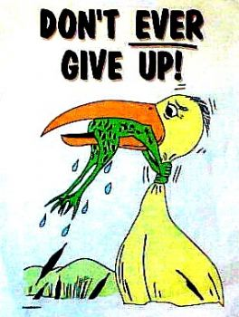
Don’t ever GIVE UP!!!

Slide 82
Final Slide: This means….
Never stop learning
Become a life-long learner
Never stop maturing
And taking others to higher levels of maturity
Never stop loving
Love your work, your project peers, etc.

Slide 83
That’s it!! That’s all folks!!
I enjoyed having you as a class—one of the best classes I’ve had.

