Slide 1
Chapter 11: Project Risk Management
Information Technology Project Management, Seventh Edition
Note: See the text itself for full citations.

Slide 2
Recitation
What is the greatest threat to the success of any project?
In face-to-face communications, how is most information conveyed?
By tone of voice, by the words spoken, by the body language, by the location?
Which of the following is not a process in project communication management
Plan communications management, manage communications, manage stakeholders, control communications

Slide 3
Recitation
If you add three more people to a project team of five, how many more communication channels will you add?
2, 12, 15, or 18??
A ______ report describes where a project stands at a specific point in time.
Status, performance, forecast, earned value
What term describes information that is sent to recipients at their request via websites, bulletin boards, e-learning, knowledge repositories like blogs, etc.
Push communications, pull communications, interactive communications, customer communications

Slide 4
Recitation
A _________ report is a reflective statement that documents important information learned from working on the project.

Slide 5
Learning Objectives
Understand risk and the importance of good project risk management
Discuss the elements of planning risk management and the contents of a risk management plan
List common sources of risks on information technology (IT) projects
Describe the process of identifying risks and create a risk register
Discuss qualitative risk analysis and explain how to calculate risk factors, create probability/impact matrixes, and apply the Top Ten Risk Item Tracking technique to rank risks

Slide 6
Learning Objectives (cont’d)
Explain quantitative risk analysis and how to apply decision trees, simulation, and sensitivity analysis to quantify risks
Provide examples of using different risk response planning strategies to address both negative and positive risks
Discuss how to control risks
Describe how software can assist in project risk management

Slide 7
The Importance of Project Risk Management
Project risk management is the art and science of identifying, analyzing, and responding to risk throughout the life of a project and in the best interests of meeting project objectives
Risk management is often overlooked in projects, but it can help improve project success by helping select good projects, determining project scope, and developing realistic estimates

Slide 8
Research Shows Need to Improve Project Risk Management
Study by Ibbs and Kwak shows risk has the lowest maturity rating of all knowledge areas
A similar survey was completed with software development companies in Mauritius, South Africa in 2003, and risk management also had the lowest maturity
KLCI study shows the benefits of following good software risk management practices

Slide 9
Table 11-1. Project Management Maturity by Industry Group and Knowledge Area*
KEY: 1 = LOWEST MATURITY RATING 5 = HIGHEST MATURITY RATING
Knowledge Area | Engineering/ Construction | Telecommunications | Information Systems | Hi-Tech Manufacturing
Scope | 3.52 | 3.45 | 3.25 | 3.37
Time | 3.55 | 3.41 | 3.03 | 3.50
Cost | 3.74 | 3.22 | 3.20 | 3.97
Quality | 2.91 | 3.22 | 2.88 | 3.26
Human Resources | 3.18 | 3.20 | 2.93 | 3.18
Communications | 3.53 | 3.53 | 3.21 | 3.48
Risk | 2.93 | 2.87 | 2.75 | 2.76
Procurement | 3.33 | 3.01 | 2.91 | 3.33
*Ibbs, C. William and Young Hoon Kwak. “Assessing Project Management Maturity,”
Project Management Journal (March 2000).

Slide 10
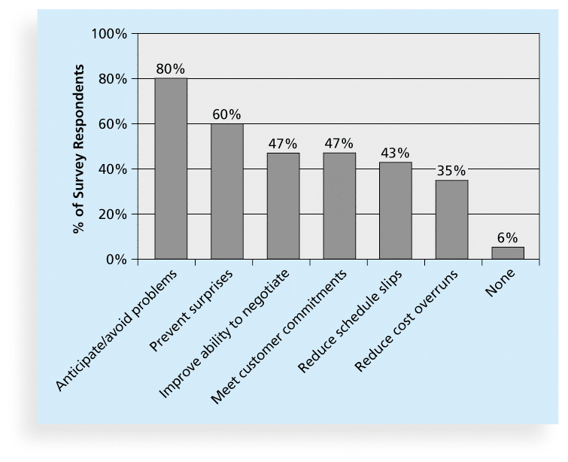
Figure 11-1. Benefits from Software Risk Management Practices*
*Source: Kulik and Weber, KLCI Research Group

Slide 11
Global Issues
Many people around the world suffered from financial losses as various financial markets dropped in the fall of 2008, even after the $700 billion bailout bill was passed by the U.S. Congress
According to a global survey of 316 financial services executives, over 70 percent of respondents believed that the losses stemming from the credit crisis were largely due to failures to address risk management issues
They identified several challenges in implementing risk management, including data and company culture issues

Slide 12
Negative Risk
A dictionary definition of risk is “the possibility of loss or injury”
Negative risk involves understanding potential problems that might occur in the project and how they might impede project success
Negative risk management is like a form of insurance; it is an investment

Slide 13
Risk Can Be Positive
Positive risks are risks that result in good things happening; sometimes called opportunities
A general definition of project risk is an uncertainty that can have a negative or positive effect on meeting project objectives
The goal of project risk management is to minimize potential negative risks while maximizing potential positive risks

Slide 14
Best Practice
Some organizations make the mistake of only addressing tactical and negative risks when performing project risk management
David Hillson, (www.risk-doctor.com) suggests overcoming this problem by widening the scope of risk management to encompass both strategic risks and upside opportunities, which he refers to as integrated risk management

Slide 15
Risk Utility
Risk utility or risk tolerance is the amount of satisfaction or pleasure received from a potential payoff
Utility rises at a decreasing rate for people who are risk-averse
Those who are risk-seeking have a higher tolerance for risk and their satisfaction increases when more payoff is at stake
The risk-neutral approach achieves a balance between risk and payoff

Slide 16
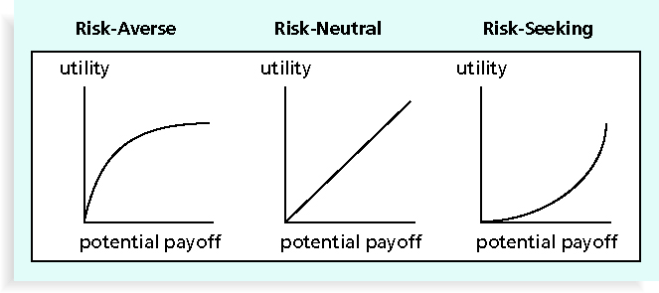
Figure 11-2. Risk Utility Function and Risk Preference

Slide 17
Project Risk Management Processes
Plan risk management : Deciding how to approach and plan the risk management activities for the project
Identify risks: Determining which risks are likely to affect a project and documenting the characteristics of each
Perform qualitative risk analysis: Prioritizing risks based on their probability and impact of occurrence

Slide 18
Project Risk Management Processes (cont’d)
Perform quantitative risk analysis: Numerically estimating the effects of risks on project objectives
Plan risk responses: Taking steps to enhance opportunities and reduce threats to meeting project objectives
Control risk: Monitoring identified and residual risks, identifying new risks, carrying out risk response plans, and evaluating the effectiveness of risk strategies throughout the life of the project

Slide 19
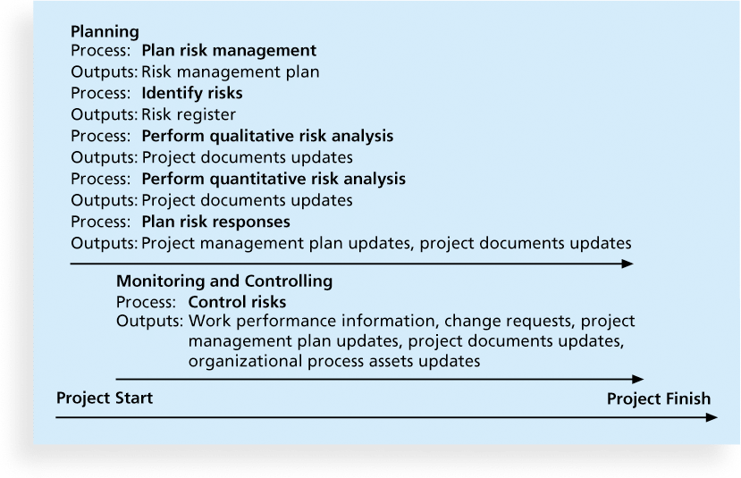
Figure 11-3. Project Risk Management Summary

Slide 20
Plan Risk Management
The main output of this process is a risk management plan—a plan that documents the procedures for managing risk throughout a project
The project team should review project documents and understand the organization’s and the sponsor’s approaches to risk
The level of detail will vary with the needs of the project

Slide 21
Table 11-2. Topics Addressed in a Risk Management Plan
Methodology
Roles and responsibilities
Budget and schedule
Risk categories
Risk probability and impact
Revised stakeholders’ tolerances
Tracking
Risk documentation

Slide 22
Contingency and Fallback Plans, Contingency Reserves
Contingency plans are predefined actions that the project team will take if an identified risk event occurs
Fallback plans are developed for risks that have a high impact on meeting project objectives, and are put into effect if attempts to reduce the risk are not effective
Contingency reserves or allowances are provisions held by the project sponsor or organization to reduce the risk of cost or schedule overruns to an acceptable level; management reserves are funds held for unknown risks

Slide 23
Common Sources of Risk in Information Technology Projects
Several studies show that IT projects share some common sources of risk
The Standish Group developed an IT success potential scoring sheet based on potential risks
Other broad categories of risk help identify potential risks

Slide 24
Table 11-3. IT Success Potential Scoring Sheet

Slide 25
Broad Categories of Risk
Market risk
Financial risk
Technology risk
People risk
Structure/process risk

Slide 26
What Went Wrong?
KPMG, a large consulting firm, published a study in 1995 that found that 55 percent of runaway projects—projects that have significant cost or schedule overruns—did no risk management at all, 38 percent did some (but half did not use their risk findings after the project was underway), and 7 percent did not know whether they did risk management or not
The timing of risk management is also an important consideration

Slide 27
Risk Breakdown Structure
A risk breakdown structure is a hierarchy of potential risk categories for a project
Similar to a work breakdown structure but used to identify and categorize risks

Slide 28
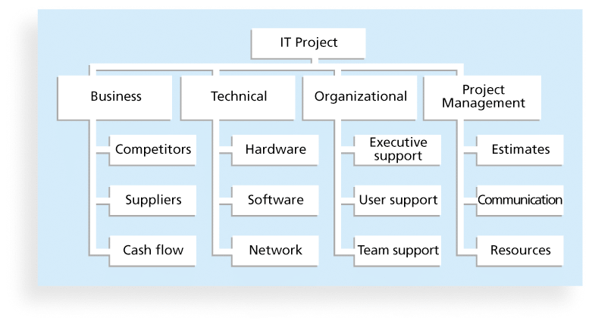
Figure 11-4. Sample Risk Breakdown Structure

Slide 29
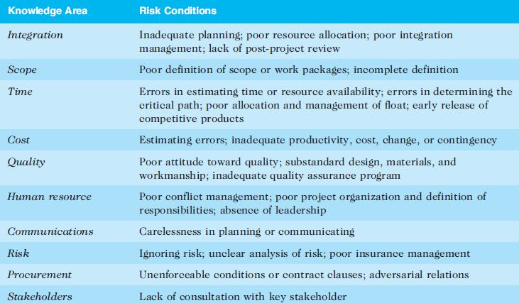
Table 11-4. Potential Negative Risk Conditions Associated With Each Knowledge Area

Slide 30
Identify Risks – the second …..
Identifying risks is the process of understanding what potential events might hurt or enhance a particular project
Another consideration is the likelihood of advanced discovery
Risk identification tools and techniques include:
Brainstorming
The Delphi Technique
Interviewing
SWOT analysis

Slide 31
Brainstorming
Brainstorming is a technique by which a group attempts to generate ideas or find a solution for a specific problem by amassing ideas spontaneously and without judgment
An experienced facilitator should run the brainstorming session
Be careful not to overuse or misuse brainstorming.
Psychology literature shows that individuals produce a greater number of ideas working alone than they do through brainstorming in small, face-to-face groups
Group effects often inhibit idea generation

Slide 32
Delphi Technique
The Delphi Technique is used to derive a consensus among a panel of experts who make predictions about future developments
Provides independent and anonymous input regarding future events
Uses repeated rounds of questioning and written responses and avoids the biasing effects possible in oral methods, such as brainstorming

Slide 33
Interviewing
Interviewing is a fact-finding technique for collecting information in face-to-face, phone, e-mail, or instant-messaging discussions
Interviewing people with similar project experience is an important tool for identifying potential risks

Slide 34
SWOT Analysis
SWOT analysis (strengths, weaknesses, opportunities, and threats) can also be used during risk identification
Helps identify the broad negative and positive risks that apply to a project

Slide 35
Risk Register
The main output of the risk identification process is a list of identified risks and other information needed to begin creating a risk register
A risk register is:
A document that contains the results of various risk management processes and that is often displayed in a table or spreadsheet format
A tool for documenting potential risk events and related information
Risk events refer to specific, uncertain events that may occur to the detriment or enhancement of the project

Slide 36
Risk Register Contents
An identification number for each risk event
A rank for each risk event
The name of each risk event
A description of each risk event
The category under which each risk event falls
The root cause of each risk

Slide 37
Risk Register Contents (cont’d)
Triggers for each risk; triggers are indicators or symptoms of actual risk events
Potential responses to each risk
The risk owner or person who will own or take responsibility for each risk
The probability and impact of each risk occurring.
The status of each risk

Slide 38
Table 11-5. Sample Risk Register
• No.: R44
• Rank: 1
• Risk: New customer
• Description: We have never done a project for this organization before and don’t know too much about them. One of our company’s strengths is building good customer relationships, which often leads to further projects with that customer. We might have trouble working with this customer because they are new to us.
• Category: People risk
• Etc.

Slide 39
Perform Qualitative Risk Analysis
The Third Process of six in the risk management knowledge area
Assess the likelihood and impact of identified risks to determine their magnitude and priority
Risk quantification tools and techniques include:
Probability/impact matrixes
The Top Ten Risk Item Tracking
Expert judgment

Slide 40
Probability/Impact Matrix
A probability/impact matrix or chart lists the relative probability of a risk occurring on one side of a matrix or axis on a chart and the relative impact of the risk occurring on the other
List the risks and then label each one as high, medium, or low in terms of its probability of occurrence and its impact if it did occur
Can also calculate risk factors:
Numbers that represent the overall risk of specific events based on their probability of occurring and the consequences to the project if they do occur

Slide 41
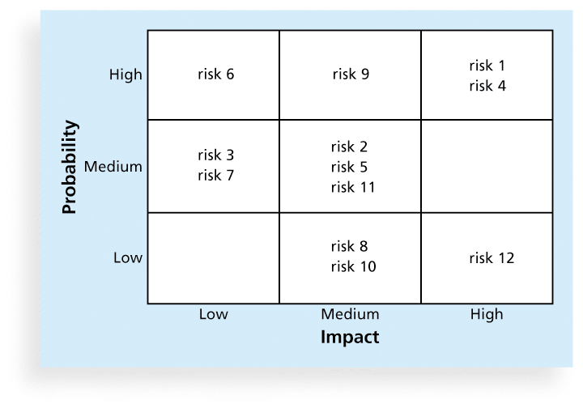
Figure 11-5. Sample Probability/Impact Matrix

Slide 42
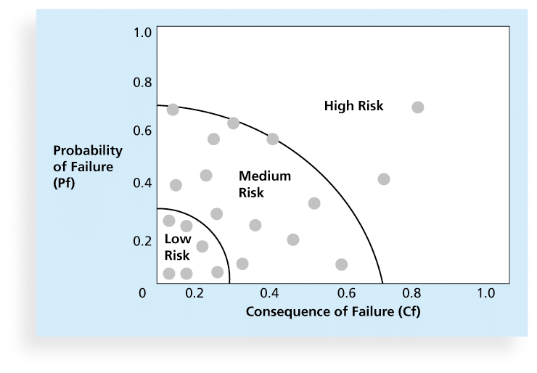
Figure 11-6. Chart Showing High-, Medium-, and Low-Risk Technologies

Slide 43
Top Ten Risk Item Tracking
Top Ten Risk Item Tracking is a qualitative risk analysis tool that helps to identify risks and maintain an awareness of risks throughout the life of a project
Establish a periodic review of the top ten project risk items
List the current ranking, previous ranking, number of times the risk appears on the list over a period of time, and a summary of progress made in resolving the risk item

Slide 44
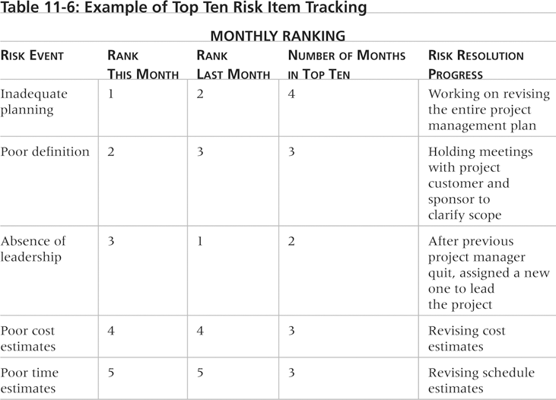
Table 11-6. Example of Top Ten Risk Item Tracking

Slide 45
Watch List
A watch list is a list of risks that are low priority, but are still identified as potential risks
Qualitative analysis can also identify risks that should be evaluated on a quantitative basis

Slide 46
Media Snapshot
The story of the Titanic is known throughout the world, and on April 15, 2012, people acknowledged the 100th anniversary of the Titanic’s sinking
A recent article in PMI’s Virtual Library explains how to avoid “the Titanic factor” in your projects by analyzing the interdependence of risks
For example, the probability of one risk event occurring might change if another one materializes, and the response to one risk event might affect another

Slide 47
Perform Quantitative Risk Analysis
The Fourth Process of six in the Risk Management Knowledge Area
Often follows qualitative risk analysis, but both can be done together
Large, complex projects involving leading edge technologies often require extensive quantitative risk analysis
Main techniques include:
Decision tree analysis
Simulation models
Sensitivity analysis

Slide 48
Decision Trees and Expected Monetary Value (EMV)
A decision tree is a diagramming analysis technique used to help select the best course of action in situations in which future outcomes are uncertain
Expected monetary value (EMV) is the product of a risk event probability and the risk event’s monetary value
You can draw a decision tree to help find the EMV

Slide 49
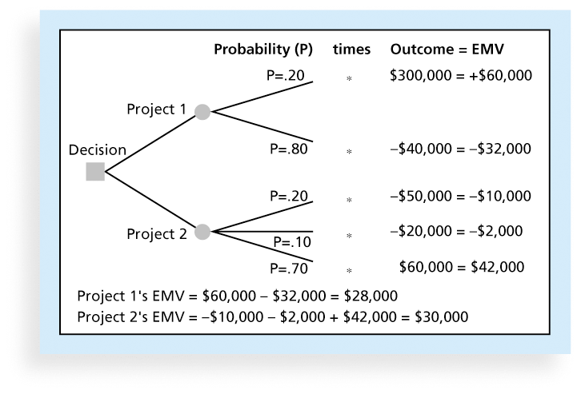
Figure 11-7. Expected Monetary Value (EMV) Example

Slide 50
Simulation Model
Simulation uses a representation or model of a system to analyze the expected behavior or performance of the system
Monte Carlo analysis simulates a model’s outcome many times to provide a statistical distribution of the calculated results
To use a Monte Carlo simulation, you must have three estimates (most likely, pessimistic, and optimistic) plus an estimate of the likelihood of the estimate being between the most likely and optimistic values

Slide 51
Steps of a Monte Carlo Analysis
Assess the range for the variables being considered
Determine the probability distribution of each variable
For each variable, select a random value based on the probability distribution
Run a deterministic analysis or one pass through the model
Repeat steps 3 and 4 many times to obtain the probability distribution of the model’s results

Slide 52
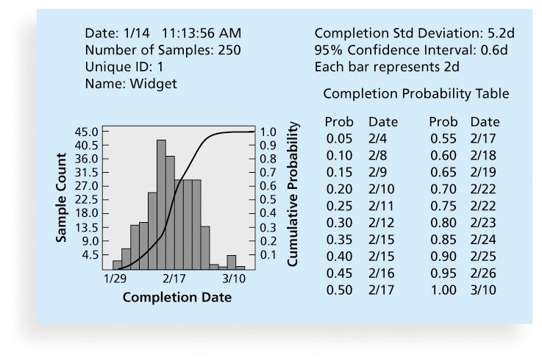
Figure 11-8. Sample Monte Carlo Simulation Results for Project Schedule

Slide 53
What Went Right?
A large aerospace company used Monte Carlo simulation to help quantify risks on several advanced-design engineering projects, such as the National Aerospace Plan (NASP)
The results of the simulation were used to determine how the company would invest its internal research and development funds
See text for examples of how General Motors, Eli Lily, and Proctor & Gamble use simulation software

Slide 54
Sensitivity Analysis
Sensitivity analysis is a technique used to show the effects of changing one or more variables on an outcome
For example, many people use it to determine what the monthly payments for a loan will be given different interest rates or periods of the loan, or for determining break-even points based on different assumptions
Spreadsheet software, such as Excel, is a common tool for performing sensitivity analysis

Slide 55
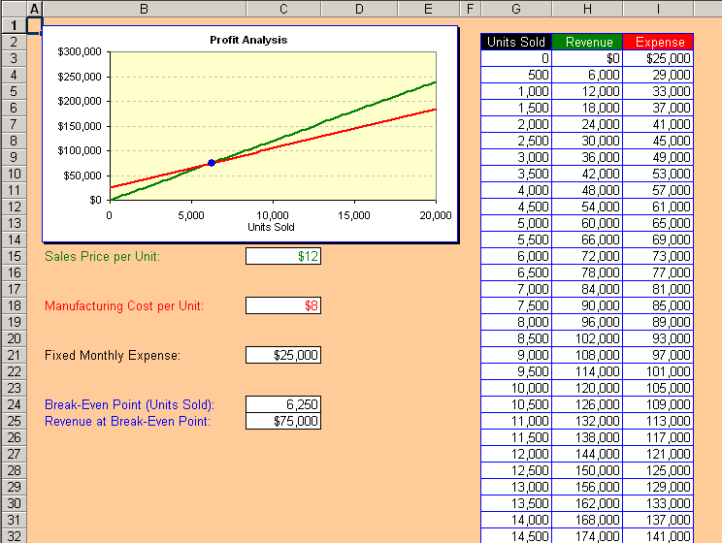
Figure 11-9. Sample Sensitivity Analysis for Determining Break-Even Point

Slide 56
Planning Risk Responses
After identifying and quantifying risks, you must decide how to respond to them
Four main response strategies for negative risks:
Risk avoidance
Just use the old system
Risk acceptance
Have a backup or contingency plan
Risk transference
Purchase insurance or a warraanty
Risk mitigation
Reduce the impact or the probability of occurrence

Slide 57
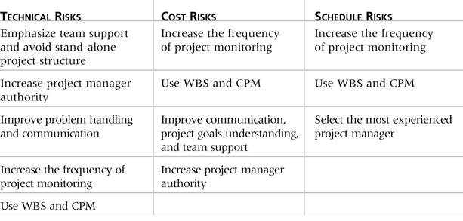
Table 11-7. General Risk Mitigation Strategies for Technical, Cost, and Schedule Risks

Slide 58
Response Strategies for Positive Risks
Risk exploitation
Risk sharing
Risk enhancement
Risk acceptance

Slide 59
Residual and Secondary Risks
It’s also important to identify residual and secondary risks
Residual risks are risks that remain after all of the response strategies have been implemented
Secondary risks are a direct result of implementing a risk response

Slide 60
Control Risks – the Sixth……
Involves executing the risk management process to respond to risk events and ensuring that risk awareness is an ongoing activity performed by the entire project team throughout the entire project
Workarounds are unplanned responses to risk events that must be done when there are no contingency plans
Main outputs of risk control are:
Work performance information
change requests
updates to the project management plan, other project documents, and organizational process assets

Slide 61
Using Software to Assist in Project Risk Management
Risk registers can be created in a simple Word or Excel file or as part of a database
More sophisticated risk management software, such as Monte Carlo simulation tools, help in analyzing project risks
You can purchase add-ons for Excel and Project 2010 to perform simulations

Slide 62
Results of Good Project Risk Management
Unlike crisis management, good project risk management often goes unnoticed
Well-run projects appear to be almost effortless, but a lot of work goes into running a project well
Project managers should strive to make their jobs look easy to reflect the results of well-run projects

Slide 63
Chapter Summary
Project risk management is the art and science of identifying, analyzing, and responding to risk throughout the life of a project and in the best interests of meeting project objectives
Main processes include:
Plan risk management
Identify risks
Perform qualitative risk analysis
Perform quantitative risk analysis
Plan risk responses
Control risks

Slide 64
Chapter 12: Project Procurement Management
Information Technology Project Management, Seventh Edition
Note: See the text itself for full citations.

Slide 65
Learning Objectives
Understand the importance of project procurement management and the increasing use of outsourcing for information technology (IT) projects
Describe the work involved in planning procurements for projects, including determining the proper type of contract to use and preparing a procurement management plan, statement of work, source selection criteria, and make-or-buy analysis
Discuss how to conduct procurements and strategies for obtaining seller responses, selecting sellers, and awarding contracts

Slide 66
Learning Objectives (cont’d)
Understand the process of controlling procurements by managing procurement relationships and monitoring contract performance
Describe the process of closing procurements
Discuss types of software that are available to assist in project procurement management

Slide 67
Importance of Project Procurement Management
Procurement means acquiring goods and/or services from an outside source
Other terms include purchasing and outsourcing
Experts predict that global spending on computer software and services will continue to grow
People continue to debate whether offshore outsourcing helps their own country or not

Slide 68
Debates on Outsourcing
Some companies, such as Wal-Mart, prefer to do no outsourcing at all, while others do a lot of outsourcing. GM recently announced plans to switch from outsourcing 90% of IT service to only 10%
Most organizations do some form of outsourcing to meet their IT needs and spend most money within their own country
The U.S. temporary workforce continues to grow as people work for temporary job agencies so they can more easily move from company to company

Slide 69
IT Outsourcing Market Continues to Grow
U.S. companies are transferring more work abroad, especially in the areas of IT infrastructure, application development and maintenance, and innovation processes
India, China, and the Philippines are the preferred locations for outsourcing, and Latin America is growing in popularity
A shortage of qualified personnel, not cost savings, is the top reason for global outsourcing of IT services

Slide 70
Why Outsource?
To access skills and technologies
To reduce both fixed and recurrent costs
To allow the client organization to focus on its core business
To provide flexibility
To increase accountability
Notes:
Do we have the resources in-house, do we have the capacity in-house, is there someone outd ltdhere who can do the project better, faster, cheaper than we can??

Slide 71
Buyer vs. Seller
Buyer is the firm doing the procuring
The company that has decided to outsource some of its work
Seller is..
Supplier
Contractor
The firm to whom work has been outsourced

Slide 72
Outsourcing vs. Offshoring
Offshoring may not be outsourcing—if the job stays within the company
Example: BP taking jobs from Tulsa to Argentina, but still jobs within BP
Outsourcing may not be offshoring
Example: Onshore Technology Services recruits workers from low income rural America and trains them to do high-value IT specialties
The US has some 90 million people who are out of work
This is depression era percentages
When a high-value technology job goes off-shore, our country loses

Slide 73
Contracts
A contract is a mutually binding agreement that obligates the seller to provide the specified products or services and obligates the buyer to pay for them
Contracts can clarify responsibilities and sharpen focus on key deliverables of a project
Because contracts are legally binding, there is more accountability for delivering the work as stated in the contract
A recent trend in outsourcing is the increasing size of contracts

Slide 74
What Went Wrong?
In 2011, New York City’s mayor, Michael Bloomberg, acknowledged that City Hall had mismanaged its major IT projects and vowed to improve their oversight
For example, prosecutors said the $700 million price tag for the CityTime payroll system was inflated by fraud, and the mayor demanded $600 million back from the main contractor
The automated personnel system, Nycaps, suffered significant delays and cost overruns due to leadership issues, increasing from an original estimate of $66 million to over $363 million

Slide 75
Project Procurement Management Processes
Project procurement management: Acquiring goods and services for a project from outside the performing organization
Processes include:
Plan procurement management: Determining what to procure and when and how to do it
Conduct procurements: Obtaining seller responses, selecting sellers, and awarding contracts
Control procurements: Managing relationships with sellers, monitoring contract performance, and making changes as needed
Close procurements: Completing and settling each contract or agreement, including resolving of any open items

Slide 76
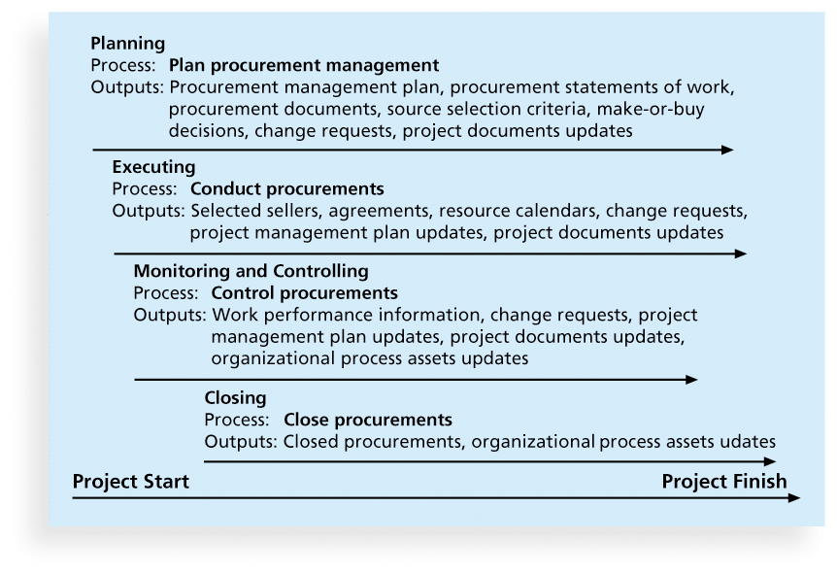
Figure 12-1. Project Procurement Management Summary

Slide 77
Plan Procurement Management
Identifying which project needs can best be met by using products or services outside the organization
If there is no need to buy any products or services from outside the organization, then there is no need to perform any of the other procurement management processes

Slide 78
What Went Right?
Several organizations, such as The Boots Company PLC in England, outsource their IT services to save money compared with the cost of running the systems themselves
Carefully planning procurement can also save millions of dollars, as the U.S. Air Force did by using a unit pricing strategy for a large office automation project

Slide 79
Types of Contracts
Different types of contracts can be used in different situations:
Fixed price or lump sum contracts: Involve a fixed total price for a well-defined product or service
Cost reimbursable contracts: Involve payment to the seller for direct and indirect costs
Time and material contracts: Hybrid of both fixed price and cost reimbursable contracts, often used by consultants
Unit price contracts: Require the buyer to pay the seller a predetermined amount per unit of service
A single contract can actually include all four of these categories, if it makes sense for that particular procurement

Slide 80
Point of Total Assumption
The Point of Total Assumption (PTA) is the cost at which the contractor assumes total responsibility for each additional dollar of contract cost
Contractors do not want to reach the point of total assumption, because it hurts them financially, so they have an incentive to prevent cost overruns
The PTA is calculated with the following formula:
PTA = (ceiling price – target price)/government share + target cost

Slide 81
Cost Reimbursable Contracts
Cost plus incentive fee (CPIF): The buyer pays the supplier for allowable performance costs plus a predetermined fee and an incentive bonus
Cost plus fixed fee (CPFF): The buyer pays the supplier for allowable performance costs plus a fixed fee payment usually based on a percentage of estimated costs
Cost plus percentage of costs (CPPC): The buyer pays the supplier for allowable performance costs plus a predetermined percentage based on total costs
Notes:
In cost reimbursable contracts, the seller gets paid for all direct and indirect costs incurred. The first type of contract is like going out for dinner. You pay the basic price plus a tip that considers the quality of
the food, the service and the overall experience itself.
The US Federal Gov will not do the latter type of contract because there is every incentive to run the project as long as possible.

Slide 82
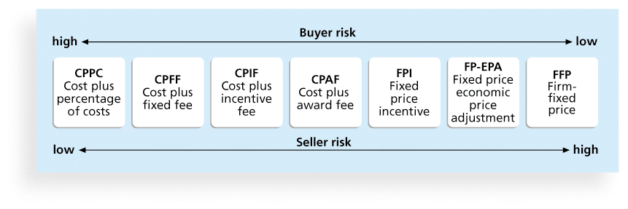
Figure 12-2. Contract Types Versus Risk

Slide 83
Media Snapshot
Contract incentives can be extremely effective. On August 1, 2007, tragedy struck Minneapolis, Minnesota, when a bridge on I-35W collapsed, killing 13 motorists, injuring 150 people, and leaving a mass of concrete and steel in the river and on its banks
Peter Sanderson, project manager for the joint venture of Flatiron-Manson led his team in completing the project. The contractors earned $25 million in incentive fees on top of their $234 million contract for completing the bridge three months ahead of schedule
MnDOT justified the incentive payment by saying that each day the bridge was closed it cost road users more than $400,000

Slide 84
Contract Clauses
Contracts should include specific clauses to take into account issues unique to the project
Can require various educational or work experience for different pay rights
A termination clause is a contract clause that allows the buyer or supplier (seller) to end the contract

Slide 85
Tools and Techniques for Planning Purchases and Acquisitions
Expert judgment
Market research
Make-or-buy analysis: General management technique used to determine whether an organization should make or perform a particular product or service inside the organization or buy from someone else
Notes:
Do we have the resources in-house, do we have the capacity in-house, is there someone outd ltdhere who can do the project better, faster, cheaper than we can??

Slide 86
Make-or-Buy Example
Assume you can lease an item you need for a project for $800/day. To purchase the item, the cost is $12,000 plus a daily operational cost of $400/day
How long will it take for the purchase cost to be the same as the lease cost?

Slide 87
Make-or Buy Solution
Set up an equation so both options, purchase and lease, are equal
In this example, use the following equation. Let d be the number of days to use the item:
$12,000 + $400d = $800d
Subtracting $400d from both sides, you get:
$12,000 = $400d
Dividing both sides by $400, you get:
d = 30
If you need the item for more than 30 days, it is more economical to purchase it

Slide 88
Procurement Management Plan
Describes how the procurement processes will be managed, from developing documentation for making outside purchases or acquisitions to contract closure
Contents varies based on project needs

Slide 89
Contract Statement of Work (SOW)
A statement of work is a description of the work required for the procurement
If a SOW is used as part of a contract to describe only the work required for that particular contract, it is called a contract statement of work
A SOW is a type of scope statement
A good SOW gives bidders a better understanding of the buyer’s expectations

Slide 90
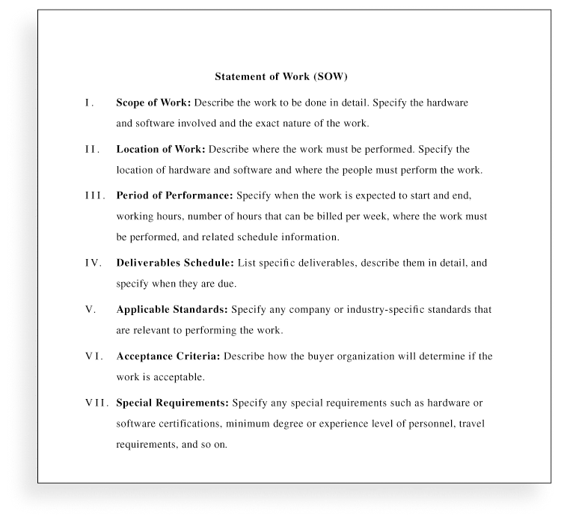
Figure 12-3. Statement of Work (SOW) Template

Slide 91
Procurement Documents
Request for Proposals: Used to solicit proposals from prospective sellers
A proposal is a document prepared by a seller when there are different approaches for meeting buyer needs
Requests for Quotes: Used to solicit quotes or bids from prospective suppliers
A bid, also called a tender or quote (short for quotation), is a document prepared by sellers providing pricing for standard items that have been clearly defined by the buyer

Slide 92
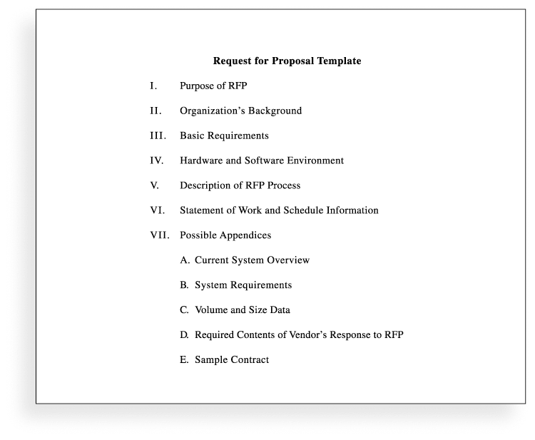
Figure 12-4. Request for Proposal (RFP) Template

Slide 93
Source Selection Criteria
It’s important to prepare some form of evaluation criteria, preferably before issuing a formal RFP or RFQ
Beware of proposals that look good on paper; be sure to evaluate factors, such as past performance and management approach
Can require a technical presentation as part of a proposal

Slide 94
Conducting Procurements
Deciding whom to ask to do the work
Sending appropriate documentation to potential
sellers
Obtaining proposals or bids
Selecting a seller
Awarding a contract

Slide 95
Approaches for Procurement
Organizations can advertise to procure goods and services in several ways:
Approaching the preferred vendor
Approaching several potential vendors
Advertising to anyone interested
A bidders’ conference can help clarify the buyer’s expectations

Slide 96
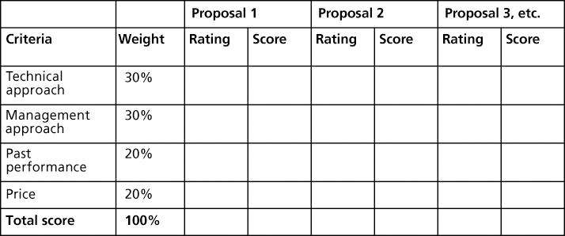
Figure 12-5. Sample Proposal Evaluation Sheet

Slide 97
Seller Selection
Organizations often do an initial evaluation of all proposals and bids and then develop a short list of potential sellers for further evaluation
Sellers on the short list often prepare a best and final offer (BAFO)
Final output is a contract signed by the buyer and the selected seller

Slide 98
Controlling Procurements
Ensures that the seller’s performance meets contractual requirements
Contracts are legal relationships, so it is important that legal and contracting professionals be involved in writing and administering contracts
It is critical that project managers and team members watch for constructive change orders, which are oral or written acts or omissions by someone with actual or apparent authority that can be construed to have the same effect as a written change order
Notes:
Ya gotta get the lawyers involved….

Slide 99
Global Issues
A recent trend is to hire people in rural areas of the same country to perform work, often at less cost. Rural sourcing uses two simple premises: Smaller towns need jobs, and workers there often charge 25 to 50 percent less than their urban counterparts.
Onshore Technology Services recruits workers from low-paying jobs and gives them intensive training in IT specialties. The company employs 65 people in IT centers in the rural Missouri towns of Macon, Lebanon, and Joplin
CrossUSA recruits older IT workers who are nearing retirement and want to enjoy a small-town quality of life. The company has 100 employees in Sebeka, Minnesota (population 700) and Eveleth, Minnesota (population 3,000)

Slide 100
Suggestions for Change Control in Contracts
Changes to any part of the project need to be reviewed, approved, and documented by the same people in the same way that the original part of the plan was approved
Evaluation of any change should include an impact analysis. How will the change affect the scope, time, cost, and quality of the goods or services being provided?
Changes must be documented in writing. Project team members should also document all important meetings and telephone phone calls

Slide 101
Suggestions for Change Control in Contracts (cont’d)
Project managers and teams should stay closely involved to make sure the new system will meet business needs and work in an operational environment
Have backup plans
Use tools and techniques, such as a contract change control system, buyer-conducted performance reviews, inspections and audits, and so on

Slide 102
Best Practice
Accenture developed a list of best practices from experienced outsourcers throughout the world:
Build in Broad Business Outcomes Early and Often
Hire a Partner, Not Just a Provider
It’s More Than a Contract, It’s a Business Relationship
Leverage Gain-Sharing
Use Active Governance
Assign a Dedicated Executive
Focus Relentlessly on Primary Objectives

Slide 103
Closing Procurements
Involves completing and settling contracts and resolving any open items
The project team should:
Determine if all work was completed correctly and satisfactorily
Update records to reflect final results
Archive information for future use
The contract itself should include requirements for formal acceptance and closure

Slide 104
Tools to Assist in Contract Closure
Procurement audits identify lessons learned in the procurement process
Negotiated settlements help close contracts more smoothly
A records management system provides the ability to easily organize, find, and archive procurement-related documents

Slide 105
Using Software to Assist in Project Procurement Management
Word processing software helps write proposals and contracts, spreadsheets help evaluate suppliers, databases help track suppliers, and presentation software helps present procurement-related information
E-procurement software does many procurement functions electronically
Organizations also use other Internet tools to find information on suppliers or auction goods and services

Slide 106
Chapter Summary
Project procurement management involves acquiring goods and services for a project from outside the performing organization
Processes include:
Plan procurement management
Conduct procurements
Control procurements
Close procurements

