Slide 1
Today
Discuss homework
REVIEW

Slide 2
Announcements
Exam is Thursday, February 16, 2017
Review for Exam TODAY

Slide 3
Exam will cover:
Pages 1-181 (Chs 1-4) of SCHWALBE
Chs 1-3, 5 and 6 of Burns Chapters
Homework

Slide 4
Exam Format
Up to 85 multiple choice
Up to four discussion problems
All exams are closed book, closed notes, closed neighbor.

Slide 5
Bring….
Scantron sheet (orange)
Pencil
Eraser
Calculator

Slide 6
Comments about your homework
Systems consist of: subsystems, boundaries, inputs, outputs, hierarchies, behaviors
Models are representations of real systems, processes
Simulation models are computer models
Verbal models are just written descriptions of situations, scenarios
When it comes to decision making, models are used: ALWAYS

Slide 7
What your weekly time log should have looked like

Slide 8
B3-10 List the steps you will take now to ensure that you are “ready” for the most intense six months of your life as you begin your working career as an IT professional.
Answers will vary, but should include doing once a week planning, putting the important activities on the calendar first, keeping those plans and TO_DO lists in a journal, tracking how much estimated time and how much actual time it took to do tasks, continuing to clarify your vision and goals, focusing on vision and goals daily, being well rested and in excellent health, being ready to work long hours, anticipating the nature of the work and acquiring the specific skills to do the anticipated tasks, if necessary.

Slide 9
Still more things you can do…
Get to know four new people, write your job description, have “how am I doing” meeting with your boss, get something done,

Slide 10
Further comments
B5-6 How would you handle the problem of differing customer and stakeholder expectations?
One job of the project manager is to manage all of these differing stakeholder expectations. In so far as possible the project manager should seek to get consensus and alignment amongst all the stakeholders. Recall Chapter 3 and the discussion there about conflict resolution. When all efforts have failed to resolve the issue, the differences should be resolved in favor of the customer. Use a matrix to conduct stakeholder analysis and develop a plan for managing each stakeholder separately. Keep in mind that there can be a lot of agreement when it comes to ends values, but significant disagreement when it comes to means values. For example, the VP of Manufacturing might agree with the VP of Marketing that a 20% annual increase in sales is needed. However, there could be significant disagreement as to the means for accomplishing that. The VP of Marketing might insist that his budget be increased by 20% so he can field 20% more sales people, while the VP of Manufacturing might require that his production capacity be increased by 20% in order to accommodate the increase in revenues.

Slide 11
B5-21
B5-21 |  | Software | Hardware | Upgrading Potential |  | Time Considerations |  |  | Vendor
 |  | 0.3 | 0.2 | 0.2 |  | 0.1 |  |  | 0.2
 | Sys Software | App Software |  |  |  | EquipDel |  | App on-line by date |  | benefit |  | benefit/
 | 0.5 | 0.5 |  |  |  | 0.5 |  | 0.5 |  | grade | cost | cost
 | 0.15 | 0.15 | 0.2 | 0.2 |  | 0.05 |  | 0.05 | 0.2
proposal 1 | 78 | 85 | 88 | 90 |  | 75 |  | 88 | 67 | 81.6 | $ 250,000.00 | 0.0003264000
proposal 2 | 78 | 90 | 90 | 90 |  | 90 |  | 90 | 80 | 86.2 | $ 350,000.00 | 0.0002462857
Based on a consideration of grade (benefit) alone, the second proposal would get selected.
However, when benefit/cost is considered, the first proposal wins by a landside.
The second proposal is just too expensive.

Slide 12
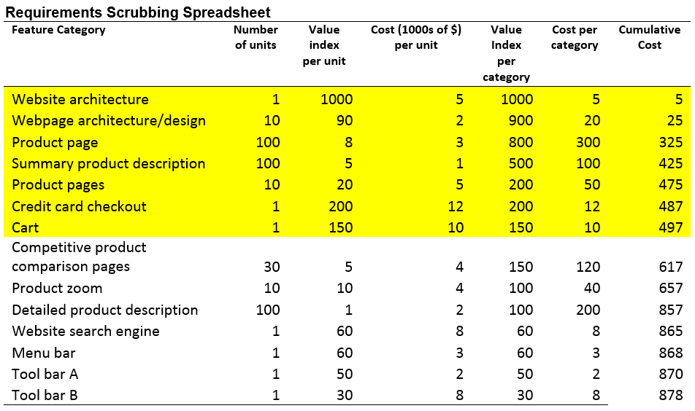
Requirements Scrubbing Sheet

Slide 13
B: 6-10

Slide 14
B: 6-12
Hire the consultant. Her information is worth $410,000 = EVSI.
Perfect information is worth $1,000,000 = EVPI.
The consultant’s wants only $50,000 for additional information.
Do the project if the consultant predicts SUCCESS.
Don’t to the project if the consultant predicts FAILURE.
The net to the company is $360,000 after subtracting the consultant’s fee.

Slide 15
Recitation
What is meant by feasibility?
What are three kinds of feasibility?

Slide 16
Covey’s Urgency/Importance Matrix

Slide 17
PMBOK
FIVE PROCESS GROUPS
TEN KNOWLEDGE AREAS
47 PROCESSES

Slide 18
FIVE PROCESS GROUPS
INITIATING
PLANNING
EXECUTING
MONITORING AND CONTROLLING
CLOSING

Slide 19
TEN KNOWLEDGE AREAS
FOUR CORE
SCOPE, TIME, COST, QUALITY
FIVE FACILITATING
- COMMUNICATIONS, RISK, HUMAN RESOURCES, PROCUREMENT, STAKEHOLDERS
ONE to INTEGRATE THE OTHERS

Slide 20
Projects
endeavor to accomplish a specific objective through a unique set of interrelated tasks and the effective utilization of resources
The objective of a project is usually defined in terms of scope, schedule and cost
The scope of the project is all of the work that must be done in order to satisfy the customer that the deliverables meet the requirements

Slide 21
Projects, cont’d
The schedule for a project is the timetable that specifies when each activity should start and finish—represented by a Gantt chart
It is important to develop a plan before the start of the project; this plan should include all the work tasks, associated costs, and estimates of the time necessary to complete them.

Slide 22
Projects, cont’d
Ultimately, the responsibility of the Project Manager is to make sure the customer is satisfied.
There are five stages to any project. They are:
Initiating
Planning
Executing
Monitoring and Controlling
Closing
In which stage does the SPECIFICATION of a proposed solution take place?
Which stage is responsible for developing a baseline plan?

Slide 23
Projects, cont’d
What do we call the hierarchical tree of work elements?
What do we call a diagram showing precedence relationships among tasks?

Slide 24
What are the 7 elements of a project?
a well-defined objective
interdependent tasks
use of resources
a specific time-frame
a unique or one-time endeavor
a customer
degree of uncertainty/risk

Slide 25
What 4 factors constrain the accomplishment of a project objective?
scope
cost
schedule
customer satisfaction
Which three of these make up the triple constraint?
What is the point of the triple constraint?

Slide 26
Define expectations for a work package
able to be done by one person
reasonably independent and autonomous
taking 1-4 wks
consisting of one or more tasks
appears at the bottom of the WBS

Slide 27
Projects
What is the relationship between projects and processes?
What do the following stand for?
SOW, RFP, JRP, JPDS

Slide 28
Teams
What are the five phases of teaming, according to Tuckman?
What is meant by team synergy?

Slide 29
Excellence
What is meant by excellence?
Name three things star performers do
What is meant by continual clarification of what is important to you?
Describe some techniques for time management

Slide 30
The Seven Habits
Who??
Name five of them

Slide 31
The Seven Habits
Be proactive
Begin with the end in mind
Put first things first
Think WIN/WIN
Seek first to understand, then to be understood
Synergize
Sharpen the saw

Slide 32
Linkages in the Project Management Life Cycle
STAGE 1:
Initiating
STAGE 2:
Planning
STAGE 3:
Executing
STAGE 5:
Closing
STAGE 4:
Monitoring-and-Controlling
2/13/2017
Texas Tech University -- J. R. Burns
32

Slide 33
Project Lifecycle
What purposes does the project lifecycle serve?
Why is there a feedback loop between stages one and two?
Why is there a feedback loop between stages two and three?
Do you think, that by the time the project gets to stage 3, the requirements ought to be frozen?

Slide 34
Questions
What are the implications of the learning curve in software development?
What is a WBS?
What are the major sections of a requirements document
Should sign-off signatures be obtained on the Req. doc?

Slide 35
You should Know
What Gantt charts are
What network diagrams are
What a milestone is
What a SOW is
What an RFP is
What a project charter is
How to become a STAR at work

Slide 36
You should know…
Best practice
Critical path
Enterprise project management software
Ethics
Gantt chart
Leader
Manager
Program
Program manager
project
Po
Project management portfolio
Project sponsor
Stakeholders
Tradeoff triangle=triple constraint

Slide 37
More Questions
1. The five stages of any project
2. Interactions between the stages—be able to draw figs 3.1 and 4.1 in Burns copy packet
3. The ten PMBOK knowledge areas
4. The five phases of team development
5. The primary functions of project manager, project leader, project professional

Slide 38
More Questions
6. The major deliverables of the initiating phase
7. The major organizational structures (Three)
8. Which of these assigns the most authority/control to the project manager
9. Which of these assigns the least to the PM

Slide 39
More Questions
10. Why systems thinking is important to any project professional (copy packet—Chapter 2)
Coping with the complexity created by Information Technology
11. The criteria by which success of a project is measured
12. Reasons why projects fail –Ch. 3 of copy packet
13. Covey says we should be guided by the compass rather than the ____

Slide 40
More Questions
14. What is the implication of the urgency importance matrix?
Find more time to do the important stuff FIRST
15. IT Project types
16. Major stakeholder types

Slide 41
More Questions
17. Who among the stakeholders is the most likely source of funds?
The CFO—Chief Financial Officer
18. What is meant by a quality gate?
A point at which certain quality standards have to be met
19. Who among the stakeholders should act as quality gate keeper?
The Chief Quality Officer
20. Name some processes used in project integration management?
21. Name some processes used in project scope management

Slide 42
More Questions
What is a JRD Session?
Name some processes that must be undertaken within the planning phase (there are 24 of them)
Name a methodology appropriate for a JRD Session, especially when the solution is unknown?

Slide 43
You should know…
Project Management Institute (PMI)
PMP—Project Management Professional
CAPM—Certified Associate in Project Management

Slide 44
You should know…
Examples of SDLCs
Predictive
Agile
To which of these does SCRUM belong?
To which does the waterfall methodology belong? Spiral? CASE tools?

Slide 45
You should know….
Adaptive software development
Agile
Champion
Deliverable
Functional organizational structure
Projectized organizational structure
Matrix organizational structure

Slide 46
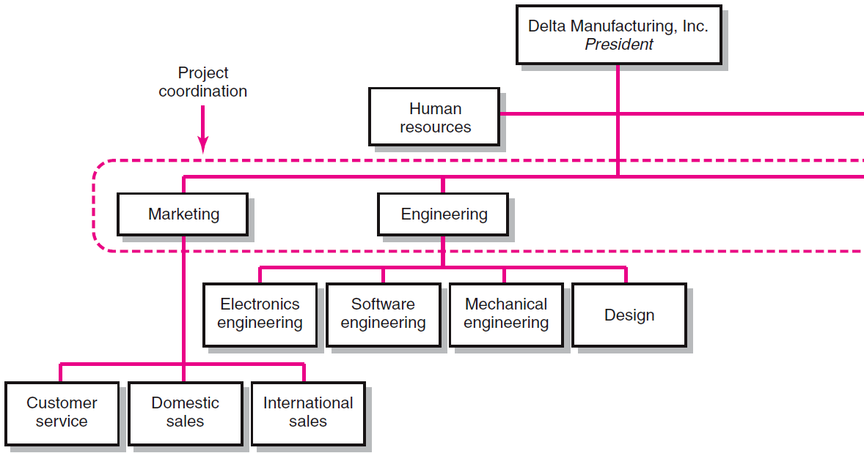
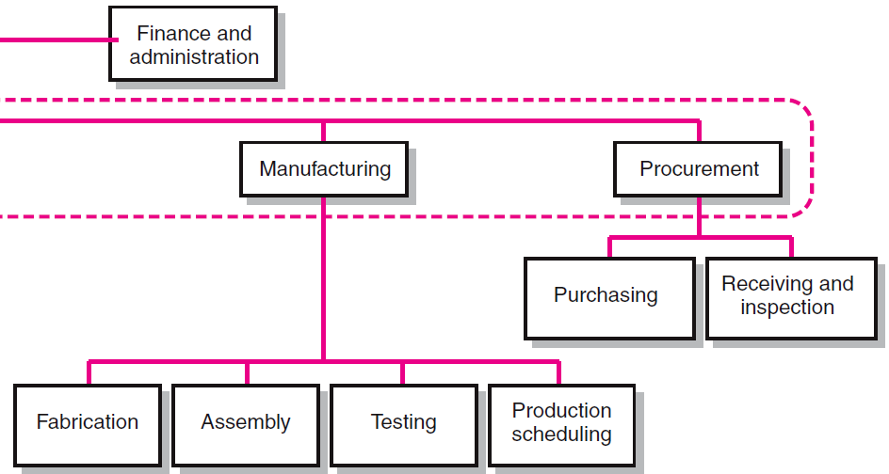
Functional Organizations
Notes:
For such projects there may not be a formally assigned project manager.

Slide 47
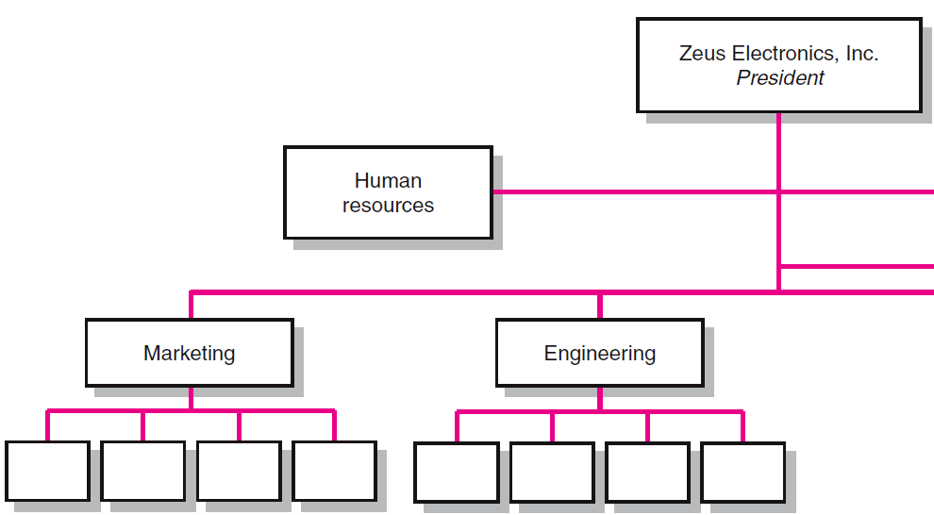
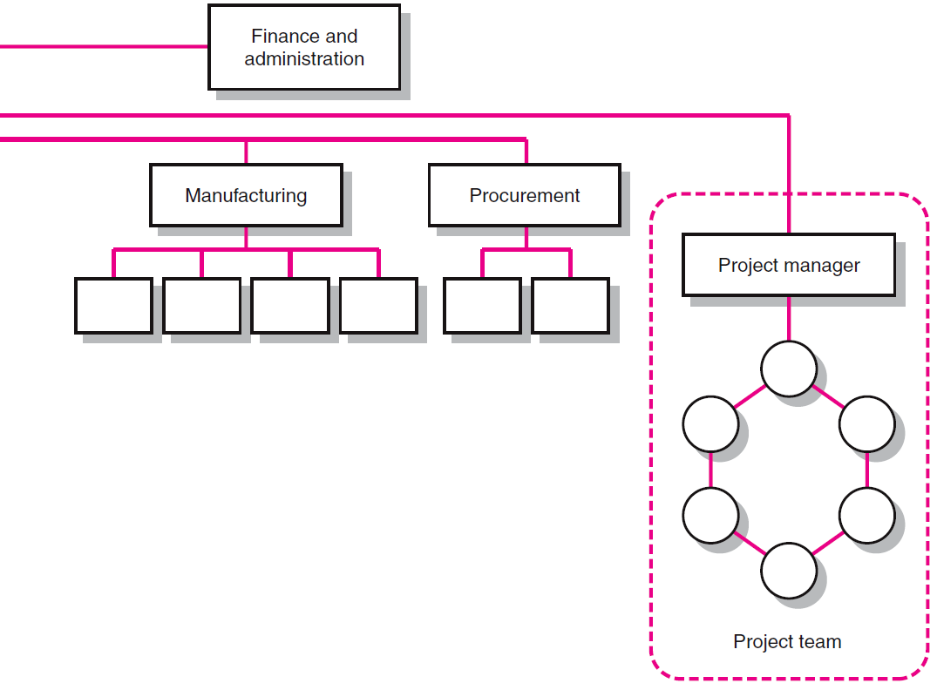
Dedicated Project Team

Slide 48
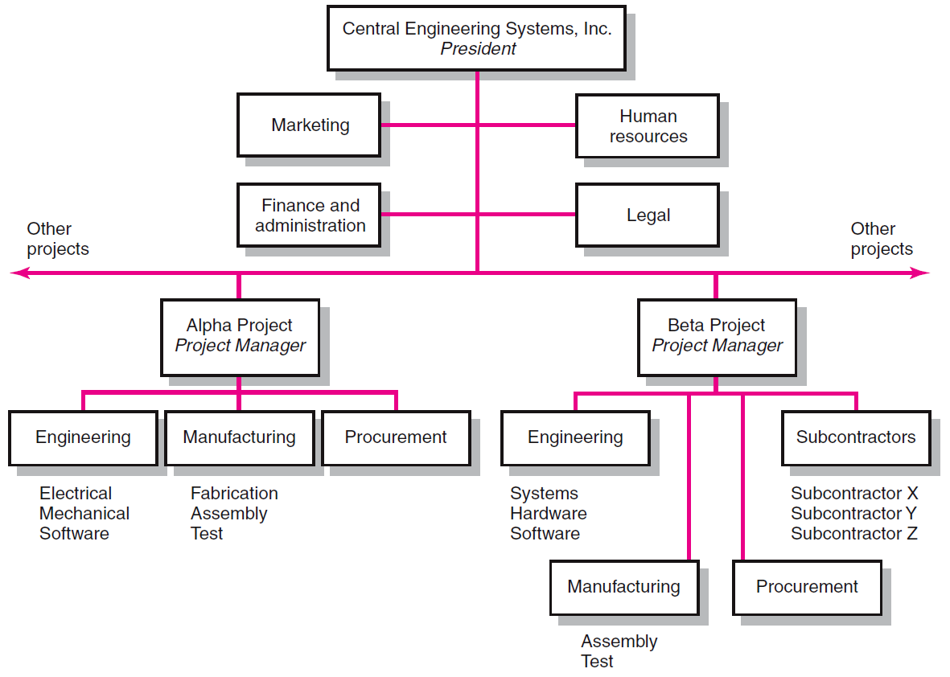
Projectized Organizational Structure

Slide 49
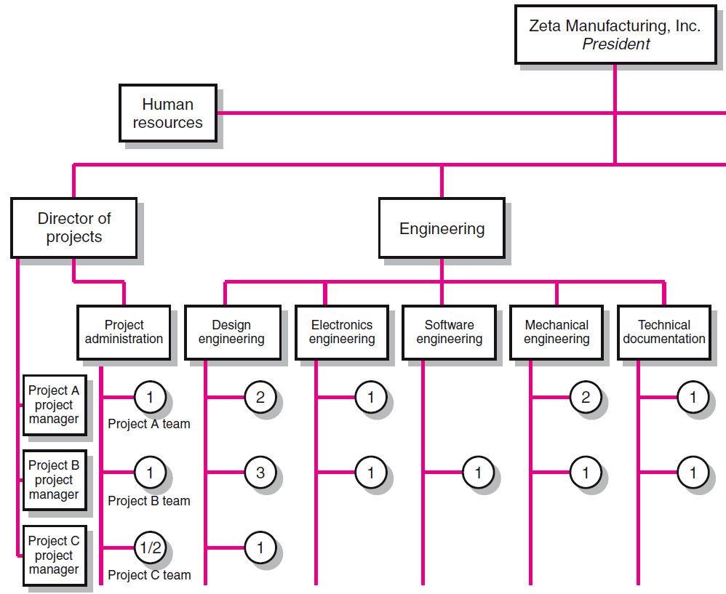
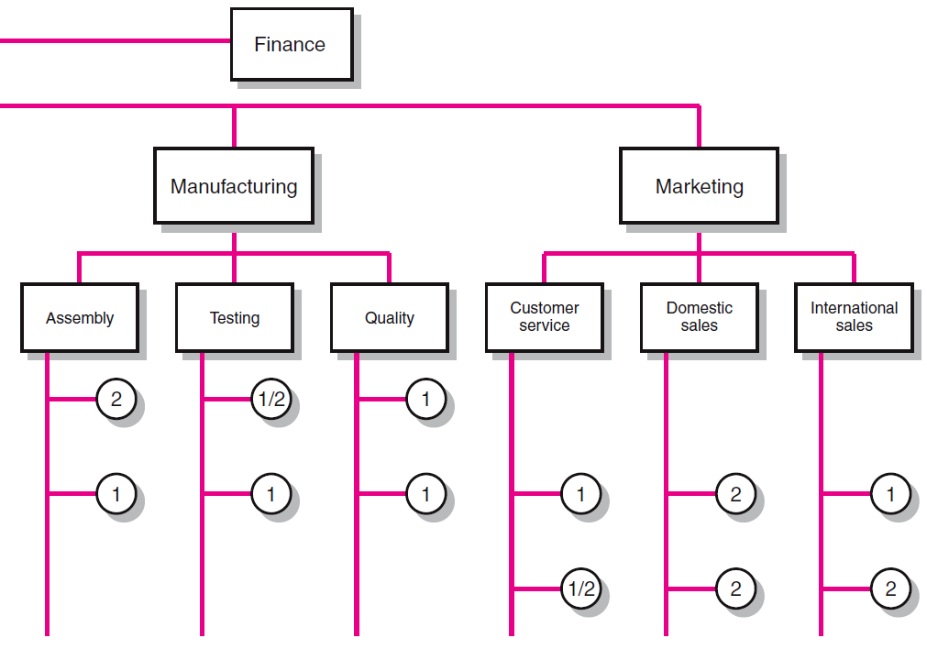
Matrix Organization Structure

Slide 50
Know:
How to Create a Project Management Culture—see slides…
That the WBS is used for scope management
not time management
The tendency of a project to get larger and larger is known as scope creep

Slide 51
YOU SHOULD KNOW...
KANBAN
OFFSHORING
OUTSOURCING
PHASE EXIT (KILL POINT)
VIRTUAL TEAM
(DISPERSED TEAM, DISTRIBUTED TEAM)
PRINCE2 (Projects IN Controlled Environments)
RUP
Project management process groups

Slide 52
You should know…
Baseline
Capitalization rate
Cash flow
Change control board
Configuration management
Discount factor
Integrated change control
Interface management
IRR
NPV
ROI
Weighted Scoring Model

Slide 53
Weighted Scoring Model

Slide 54
That is all!!
No More!!

