Slide 1
Lean-Agile Software Development

Slide 2
Sources
Schwaber, Ken, (2004) Agile Project Management with Scrum.
Wysocki, Robert, (2009) Effective Project Management: Traditional, Agile, Extreme—Fifthe Edition.
Larson, Eric and Clifford Gray (2011) Project Management: The Managerial Process—Fifth Edition.
Shalloway, Alan, Guy Beaver, James Trott (2010) Lean-Agile Software Development: Achieving Enterprise Agility

Slide 3
Wysocki Quote
“Based on data collected from over 10,000 project managers from around the world, over 70% of projects are best managed by processes that adapt to continual learning and discovery of the project solution

Slide 4
History of Agile PM
Agile PM has been around for 25 years

Slide 5
The Iterative PMLC model
Plan Iteration
Launch Iteration
Control Iteration
Scope
Next Iteration?
Close Iteration
Close Project

Slide 6
Introduction
What we value
Principles of the Agile Manifesto
Core Beliefs of Waterfall
Core Beliefs of Agile
Core Beliefs of Lean

Slide 7
What we value
Individuals and interactions over processes and tools
Working software over comprehensive documentation
Customer collaboration over contract negotiation
Responding to change over following a plan

Slide 8
Principles of the Agile Manifesto
Our highest priority is to satisfy the customer through early and continuous delivery of valuable software
Welcome changing requirements, even late in development
Deliver working software frequently
Business people and developers must work together daily throughout the project

Slide 9
More Principles of Agile Development
Build projects around motivated individuals
The most effective method of conveying information to and within a team is faqce-to-face communication
Working software is the primary measure of progress
Agile processes promote sustainable development

Slide 10
More Principles of Agile Development
Continuous attention to technical excellence and good design enhance agility
Simplicity—maximizing the amount of work ot required
The best architectures, requirements and designs emerge from telf-organizing teaqms
At regular intervals, the team reflects on how to become more effective

Slide 11
Core Beliefs of Waterfall
You can know everything required to build a software produced properly at the start of the project
Customers can accurately tell you what they want at the start of the project
Feedback from the customer is not necessary until the end
Managers, developers and customers can determine the status of a project by looking at completed milestones

Slide 12
Core Beliefs of Waterfall, Cont’d
You can have separate groups do analysis, design, code and test
Handoffs between people in different roles can be done efficiently by writing down what has to be done in each step
Testing is only required at the very end of the project
Management can demand that a certain task be done at a certain time and can expect the same to happen

Slide 13
Core Beliefs of Agile
You cannot know everything required to build a software product at the start of the project
Customers cannot accurately tell you what they want
You want feedback from the customer as often as possible and you want to give developers feedback on how they are doing early and often

Slide 14
Core Beliefs of Agile. Cont’d
Working code is the most accurate way of seeing the progress of the development effort
Groups working together minimizes delays as well as the loss of information between people
Moving tests to the front of the development cycle improves the conversation between developers, customers and testers, resulting in improved quality

Slide 15
Core Beliefs of Lean
Most errors are due to the processes used rather than to the individuals using those processes
People doing the work are the best ones to understand how to improve the system
Ad hoc is not an acceptable process

Slide 16
Traditional PM versus Agile Methods
Traditional PM Approach
Concentrates on thorough, upfront planning of the entire project.
Requires a high degree of predictability to be effective.
Agile Project Management (Agile PM)
Relies on incremental, iterative development cycles to complete less-predictable projects.
Is ideal for exploratory projects in which requirements need to be discovered and new technology tested.
Focuses on active collaboration between the project team and customer representatives.
17–16

Slide 17
Some Agile definitions
Stories, story points—these are features, portions of functionality
Elevation—an iteration that does not result in added functionality, does not usually get released to the customer
Scrum meeting—held daily, usually at the beginning of the day—for 15 min
Sprint—an iteration--usually 1 to 4 weeks in duration, resulting in the delivery of something of value to the customer—a small, short ‘project’

Slide 18
Some Agile definitions
Stories, story points—these are features, portions of functionality
Elevation—an iteration that does not result in added functionality, does not usually get released to the customer
Scrum meeting—held daily, usually at the beginning of the day—for 15 min
Sprint—an iteration--usually 1 to 4 weeks in duration, resulting in the delivery of something of value to the customer—a small, short ‘project’

Slide 19
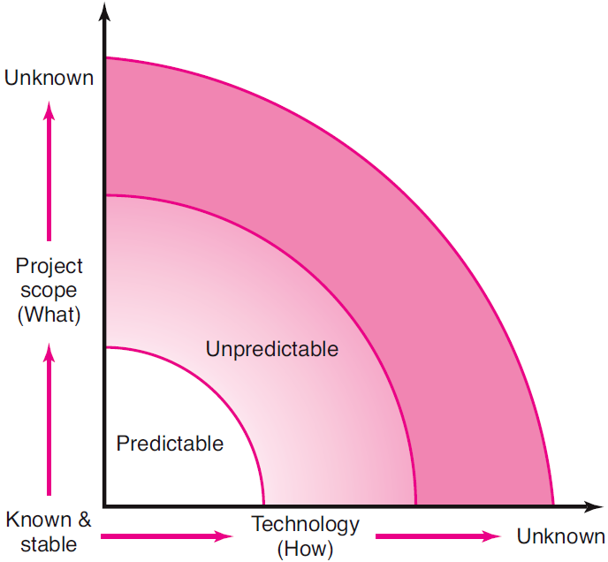
Project Uncertainty
FIGURE 17.1
17–19

Slide 20
Traditional Project Management versus Agile Project Management
Traditional | Agile
Design up front | Continuous design
Fixed scope | Flexible scope, specifically
Deliverables | Features/requirements
Freeze design as early as possible | Freeze design as late as possible
Low uncertainty | High uncertainty
Avoid change | Embrace change
Low customer interaction | High customer interaction
Conventional project teams | Self-organized project teams
TABLE 17.1
17–20

Slide 21
Process Map
Waterfall
Few risks, late integration and testing
High Ceremony
Low Ceremony
Heavy Doc, heavy process discipline, CCB
Little Doc, light process discipline
Iterative
Risk Driven, Continuous integration and testing

Slide 22
Agile Software Development
Software is developed in increments using an iterative approach
Backbone first
User interfaces next
Important functionality next
Less important functionality last
Learning takes place all along the way
Important components may be improved before less important components are even started
Provides the user with an early experience with the software.
Endeavors to deliver business value early.

Slide 23
More Agile Software Development
An iteration lasts one to four weeks
Each iteration passes through a full software development cycle including planning, requirements analysis, design, coding, testing, and documentation.
The goal is to have an available release (without bugs) at the end of each iteration.
At the end of each iteration, the team re-evaluates project priorities.
Agile methods emphasize face-to-face communication over written documentation.

Slide 24
Principles Behind the Agile Manifesto
Customer satisfaction by rapid, continuous delivery of useful software.
Working software is delivered frequently (weeks rather than months).
Working software is the principal measure of progress.
Even late changes in requirements are welcomed.
Close, daily cooperation between business people and developers is strongly encouraged.
Face-to-face conversation is the best form of communication.

Slide 25
More Principles behind Agile Development
Projects are built around motivated individuals, who should be trusted.
Continuous attention to technical excellence and good design is required.
Simplicity is a hallmark.
Self organizing teams are always used.
Regular adaptation to changing circumstances is accommodated.

Slide 26
Iterative, Agile Processes
Rational Unified Process (RUP)
Dynamic Systems Development Method (DSDM)
Extreme Programming (XP)
Crystal
Scrum—most popular

Slide 27
The Home Ground
For agile software development, the home ground is a culture that thrives on chaos, low criticality, a small number of senior developers are used, and requirements change very often, applications are small.
For plan-driven methods (such as the Waterfall Model), the home ground is high criticality, junior developers, requirements don't change too often, a large number of developers, and a culture that demands order.

Slide 28
Project Management & SCRUM
SCRUM is a type of agile software development, along with extreme programming (1996) , Crystal Clear, Adaptive Software Development, Feature Driven Development, and Dynamic Systems Development Method (DSDM) (1995).

Slide 29
More SCRUM
Scrum is an agile development methodology, implying low ceremony (little documentation, face-to-face meetings).
Scrum is a process skeleton that includes a set of practices and predefined roles.
There are two types of roles used in connection with Scrum, those who are committed are called ‘pigs’ and those
who are involved who are called ‘chickens.’ Stakeholders are considered chickens whereas the
project team and Scrum master (project manager) are called ‘pigs.’

Slide 30
Still More SCRUM
Scrum consists of a series of sprints. Each sprint is a period of 15 to 30 days, during which the team creates a usable module of software.
Scrum is considered ‘easy to learn’ and doesn’t require a lot of training to start using it.
Sprint periods of 30 days are similar to the monthly time-boxes used in RAD.

Slide 31
SCRUM Meetings
Each day during the sprint, a project status meeting occurs. This is called a SCRUM Meeting.
The procedure for a SCRUM Meeting is the following :
1) the meeting starts precisely on time with team-decided punishments for tardiness
2) all are welcome, but only “pigs” may speak
3) the meeting is time-boxed at fifteen minutes regardless of the team’s size
4) all attendees should stand
5) the meeting should happen at the same location and same time every day

Slide 32
SCRUM….In Summary
In summary, scrum is an agile process to manage and control development work.
Scrum is a team-based approach to iteratively, incrementally develop systems and products when requirements are rapidly changing.
Scrum is a process that controls the chaos of conflicting interests and needs.
Scrum is a way to improve communications and maximize co-operation.
Scrum is a way to detect and cause the removal of anything that gets in the way of developing and delivering products.
Scrum is a way to maximize productivity.
Scrum is scalable from single projects to entire organizations. Scrum has controlled and organized development and implementation for multiple interrelated products and projects with over a thousand developers and implementers.

Slide 33
Project Uncertainty
FIGURE 17.1
17–33

Slide 34
Agile Project Management
Agile PM
Is related to the rolling wave planning and scheduling project methodology.
Uses iterations (“time boxes”) to develop a workable product that satisfies the customer and other key stakeholders.
Stakeholders and customers review progress and re-evaluate priorities to ensure alignment with customer needs and company goals.
Adjustments are made and a different iterative cycle begins that subsumes the work of the previous iterations and adds new capabilities to the evolving product.
17–34

Slide 35
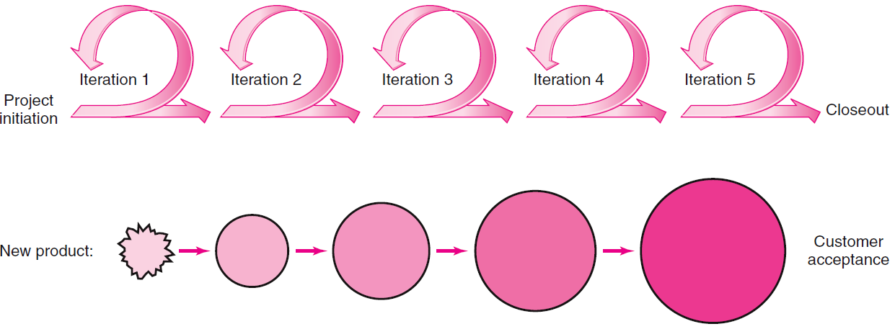
Iterative, Incremental Product Development
FIGURE 17.2
17–35

Slide 36
Agile Project Management (cont’d)
Advantages of Agile PM:
Useful in developing critical breakthrough technology or defining essential features
Continuous integration, verification, and validation of the evolving product.
Frequent demonstration of progress to increase the likelihood that the end product will satisfy customer needs.
Early detection of defects and problems.
Superior to traditional plan-driven development when it comes to creating new products, evidence shows
17–36

Slide 37
Popular Agile PM Methods
Scrum
Crystal Clear
Extreme Programming
RUP (Rational Unified Process)
Agile PM Methods
Dynamic Systems Development Method (DSDM)
Agile Modeling
Rapid Product Development (PRD)
Lean Development
17–37

Slide 38
Agile PM Principles
Focus on customer value
Iterative and incremental delivery
Experimentation and adaptation
Self-organization
Continuous improvement
17–38

Slide 39
Agile PM in Action: Scrum
Scrum Methodology
Is a holistic approach for use by a cross-functional team collaborating to develop a new product.
Each iteration is called a SPRINT
Defines product features as deliverables and prioritizes them by their perceived highest value to the customer.
Re-evaluates priorities after each iteration (sprint) to produce fully functional features.
Has four phases: analysis, design, build, test
17–39

Slide 40
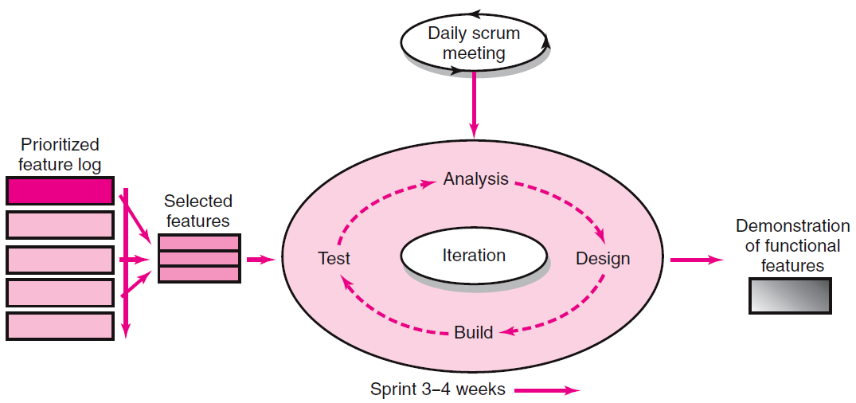
Scrum Development Process
FIGURE 17.3
17–40

Slide 41
Key Roles and Responsibilities in the Scrum Process
Product Owner
Acts on behalf of customers to represent their interests.
Development Team
Is a team of five-to-nine people with cross-functional skill sets--is responsible for delivering the product.
Scrum Master (aka Project Manager)
Facilitates scrum process and resolves impediments at the team and organization level by acting as a buffer between the team and outside interference.
17–41

Slide 42
Scrum Meetings
FIGURE 17.4
17–42

Slide 43
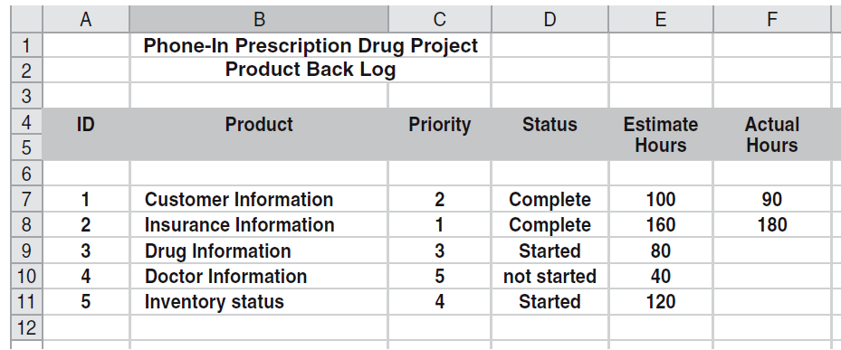
Partial Product Backlog
FIGURE 17.5
17–43

Slide 44
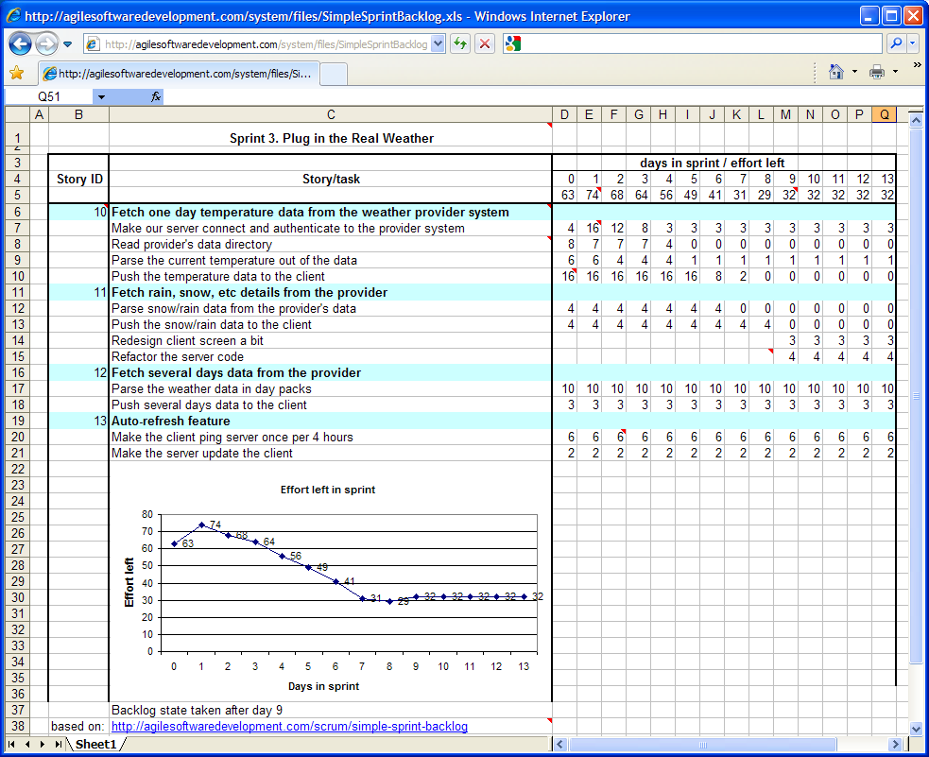
Partial Sprint Backlog
FIGURE 17.6
17–44

Slide 45
Applying Agile to Large Projects
Scaling
Is using several teams to work on different features of a large scale project at the same time.
Staging
Requires significant up-front planning to manage the interdependences of different features to be developed.
Involves developing protocols and defining roles to coordinate efforts and assure compatibility and harmony.
17–45

Slide 46
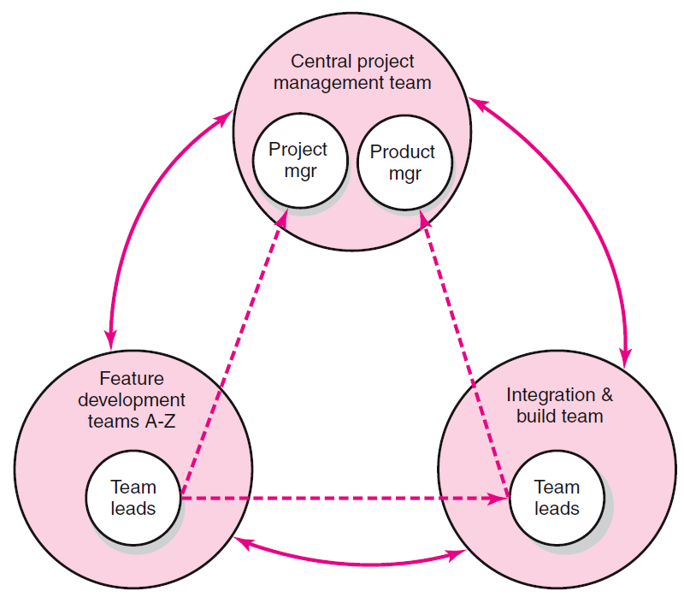
Hub Project Management Structure
FIGURE 17.7
17–46

Slide 47
Limitations and Concerns of Agile PM
It does not satisfy top management’s need for budget, scope, and schedule control.
Its principles of self-organization and close collaboration can be incompatible with corporate cultures.
Its methods appear to work best on small projects that require only five-nine dedicated team members to complete the work.
It requires active customer involvement and cooperation.
17–47

